Slide 1
Feminergy Capsules
BF Suma Ghana TOT
11-Feb-2017

Slide 2
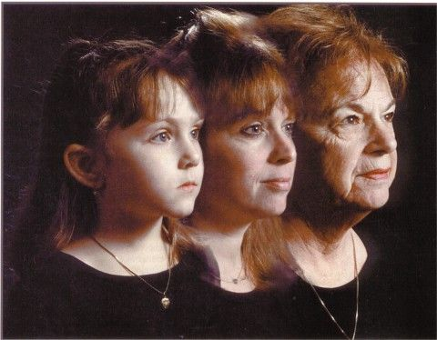
Why human ages?

Slide 3
The matters associated with aging
Organ
dysfunction
Death
Menopausal
women
Aging
diseases
Aging
Skin
wrinkles
Unhealthy
Skin

Slide 4

Factors affecting youth
Hereditary
Diet
Real young?
Age
Look younger?
Lifestyle
Environment

Slide 5
Free Radicals
Youth’s Enemy

Slide 6

Contents
1
Free Radicals
What are free radicals?
Where do they come from?
Why harmful?
2
Anti-Oxidants
3
BF Suma Feminergy Capsules

Slide 7
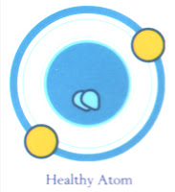
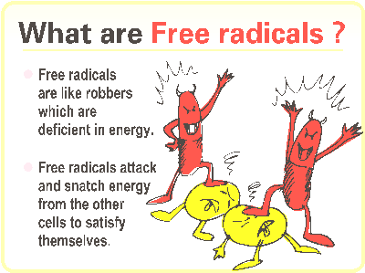


1
Free Radicals — what are free radicals?

Slide 8
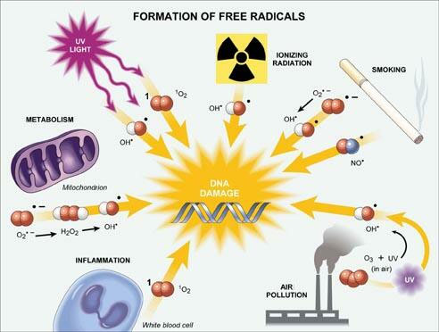
1
Free Radicals — where do they come from?

Slide 9
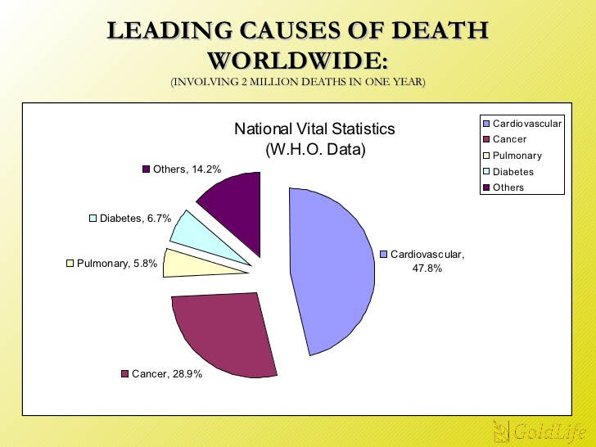
1
Free Radicals — why harmful?

Slide 10
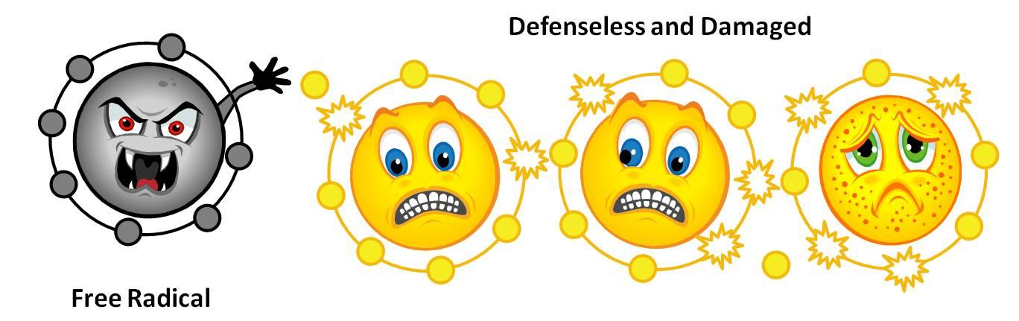
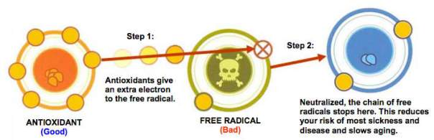
Free Radicals vs Antioxidants

Slide 11
Contents
1
Free Radicals
2
Anti-Oxidants
What are anti-oxidants?
Why are they important?
Common sources of anti-oxidants
Grape seed extract and its benefits
Benefits from grape seed extract
Skin beauty
Health benefits
Other health benefits
3
BF Suma Feminergy Capsules

Slide 12

2
Anti-Oxidants –
what are anti-oxidants?
Anti-oxidants are the substances that can inhibit free radicals oxidation.
The mechanism of anti-oxidants may be a direct effect on free radicals, or a indirect consumption of substances that can generate free radicals.
The stronger of anti-oxidant capacity of body, the more health, and the longer of life.

Slide 13
2
Anti-Oxidants — why important?
Immune
Benefits
Anti-
Aging
Prevent
Health
Problems
Anti-
Inflammatory
Stress-
Free

Slide 14
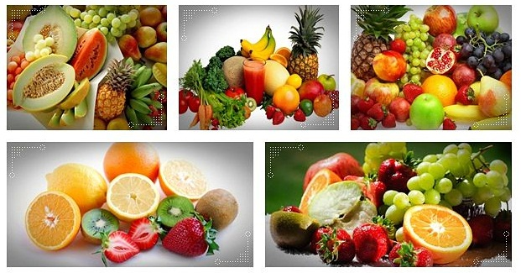
Common sources of anti-oxidants

Slide 15
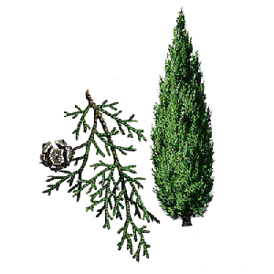
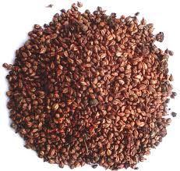
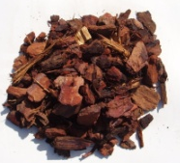
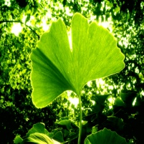

2
Anti-Oxidants — OPC
OPC (oligomeric procyanidins) is a natural strong anti-oxidant that exists in many plants, such as cypress, grape seed extract, ginkgo leaves, rose, pine bark and so on. Among them, the concentration of OPC in grape seed extract up to 95%.
Cypress
Pine Bark
Grape seed extract
High concentrate of OPC
OPC
Rose
Ginkgo leaves

Slide 16
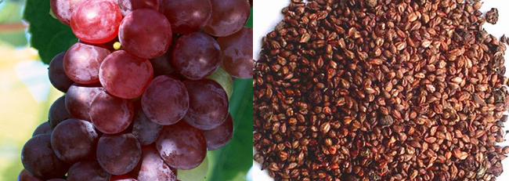
Anti-Oxidants — grape seed extract and its benefits
2
Natural source
Grape seed extract, containing high concentrate of oligomeric procyanidins, or called OPC, is a new form and high efficient natural antioxidant that human body cannot synthesize.
Strongest anti-oxidant
It is the substance with strongest free radical scavenging capacity currently found in nature, which 50 times than Vitamin E, and 20 times than Vitamin C.
Anti-oxidation
It can effectively remove excess free radicals in body, super-strong to anti-aging as well as boost immunity.

Slide 17
2
Anti-Oxidants— grape seed extract
Prevention of hypertension
Protection of Cardiovascular system
Anti-radiation effect
2
3
Skin beauty
Anti-allergic
Anti-inflammatory
1
4
4 big effects

Slide 18

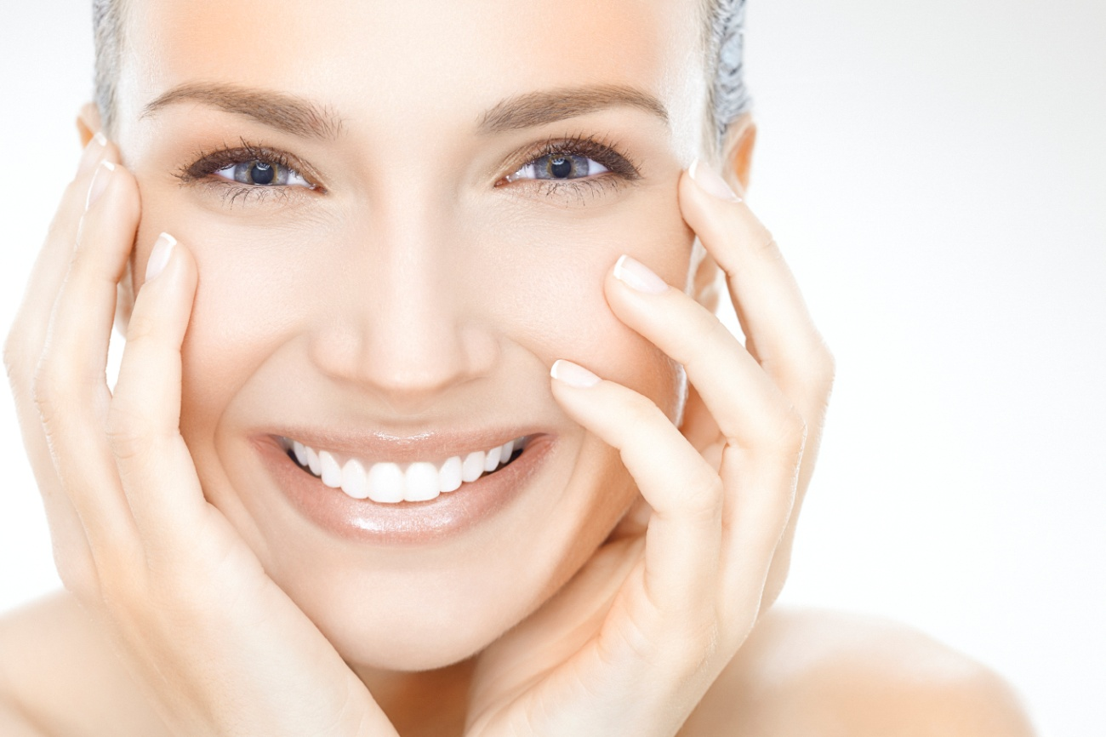
2
Anti-Oxidants— grape seed extract effects
Anti-oxidation on Skin Beauty
Skin aging is one of the big signals of aging
Improve skin elasticity:
OPC can stabilize the activity of collagen.
Anti-wrinkle
Whitening and anti-freckle
Help cell metabolism normally and reduce melanin accumulation
Keep skin moisture
OPC can protect cell and avoid cell water loss.

Slide 19
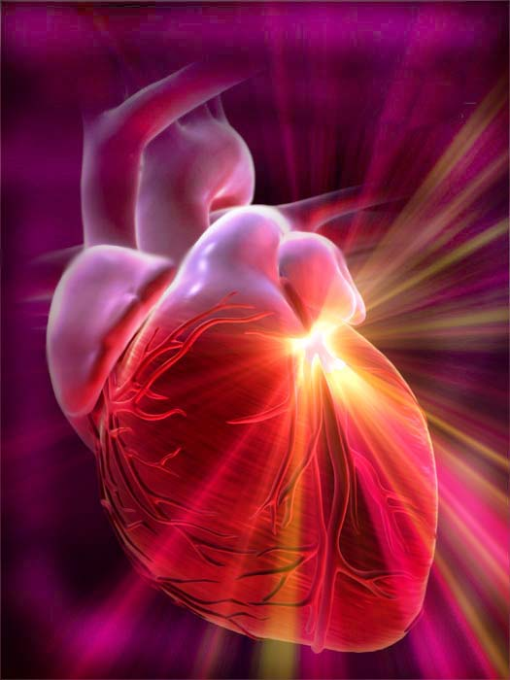

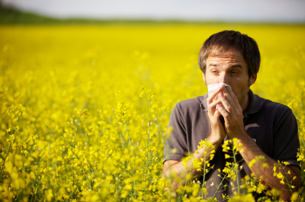
2
Anti-Oxidants— grape seed extract effects
Anti-oxidation on Health Benefits
Improve the elasticity of blood vessels and lower blood pressure
Prevention of thrombosis.
Reduce the harm of ultraviolet rays, mobile phones, television and other radiation on human body.
Very effective for hey fever, no general allergy medication side effects, such as lethargy, obesity after taking.

Slide 20

2
Anti-Oxidants— grape seed extract effects
Improving the quality of life of patients prostate
Prevent cataracts
Eye
Prostate
Prevention for dental caries and gingivitis
Other Health Benefits
Early prevention of Alzheimer's disease
Teeth
Brain
Lung
Cancer
Help to treat of asthma
Anti-mutagenic
anti-tumor effect

Slide 21
Contents
1
Free Radicals
2
Anti-Oxidants
3
BF Suma Feminergy Capsules
Ingredients
Functions
Why choose us?
Applications

Slide 22
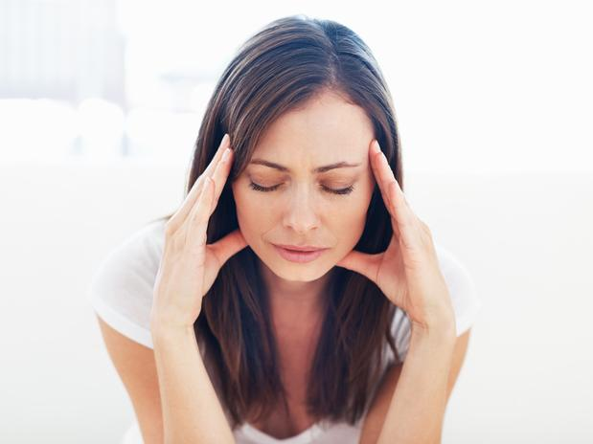
Are you still worried?
Unhealthy Skin
Wrinkles
Diseases with Aging

Slide 23
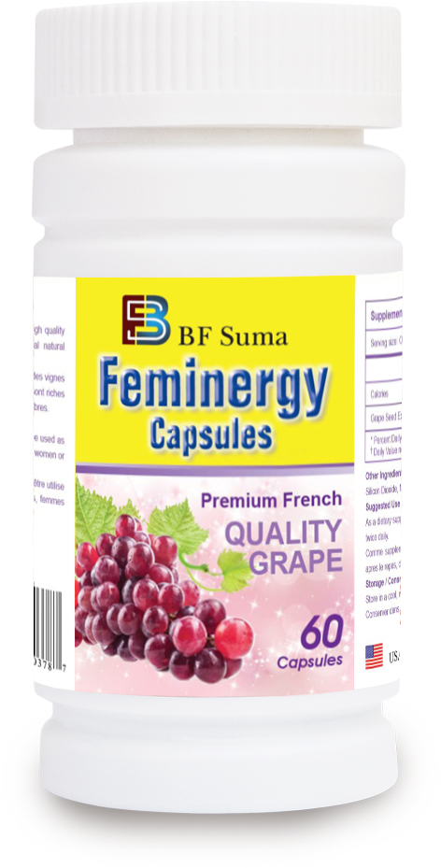
FEMINERGY CAPSULES
One of the strongest anti-oxidants at present!
20~50 times of anti-oxidation capacity than Vitamin C and Vitamin E!
Secret to stay young and healthy!

Slide 24
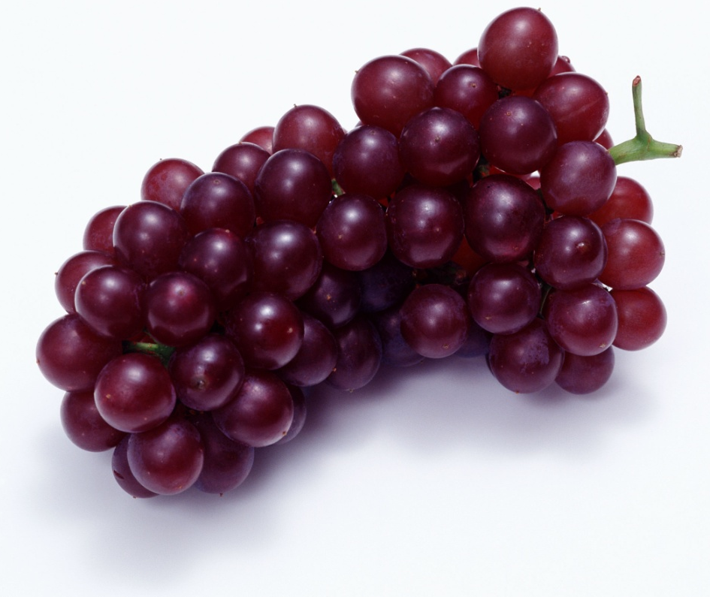
3
Feminergy Capsules – ingredient
Feminergy Capsules contains active ingredient of grape seed extract, which is sourced from high quality vineyards of France.
OPC >=95%

Slide 25
3
Feminergy Capsules – functions
Delay skin aging
Preventing melanin accumulation
Help to skin whitening
Reduce wrinkles
Prevent diseases associated with aging
Cancers, Diabetes, Cataracts, cardiovascular disease,
Alzheimer’s, etc.
Delaying organs aging
Maintain their normal functions

Slide 26
3
Feminergy Capsules – Why choose us?
High quality
Featured raw materials
GMP manufacturing
Rapidly absorbed
Being effect 20 min after taken
Safety
No any side effects
Highly Absorption rate
Absorption rate as highly as 90%
Higher than any other brands in the market
Strong Effects
Ingredients contain 95% OPC that effectively anti-aging and anti-oxidation.
Good solubility
Rapidly dissolved in body
Why choose BF Suma Feminergy Capsules?

Slide 27
3
Feminergy Capsules – applications
Usage | Take as a daily supplement; Two times a day, one capsule per time; Take Half an hour after meal.
Suitable for | Recommend to young, middle age and old women; Also suitable for men to benefit health; People who easy feel fatigue, easy to catch a cold and get allergies; People who are irritability, dizziness; People who wish to delay aging and maintain youth; People with wrinkles, skin laxity and with melasma; People who with cardiovascular and cerebrovascular diseases; People who have had radiation therapy, chemotherapy; Long-term user of computers, cell phones and TV

Slide 28

Grape seed extract, choose BF Suma Feminergy Capsules!
OPC, choose grape seed extract!
Anti-oxidant, choose OPC!

Slide 29

Feminergy Capsules
Secret for women to stay youth!
Beauty through supplement!

Slide 30
THANKS FOR WATCHING
Africa Marketing Department 2016

