Slide 1
Elements
— super meal replacement
One meal replacement a day，
Lose weight without effort.

Slide 2
Healthy？
Satiety？
About meal replacement products,
are they safe？
Every details you need to know.
Can they provide enough nutrition?

Slide 3
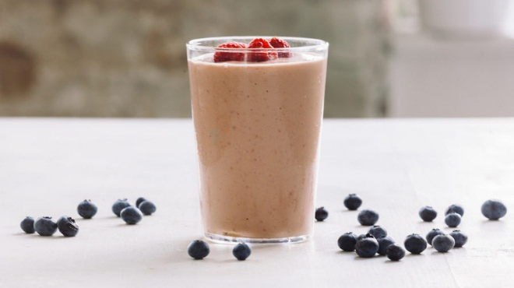
What is it made of?
Checking its label is the best choice

Slide 4
Ingredient Inspection Report of Elements shows absolute confidence in our product
Inspection and verification from authoritative inspection institute
Notes:
SGS 是 Societe Generale de Surveillance S.A. 的简称，是目前全球最有公正力的，获得（26个）最多国家认可的第三方检测机构。

Slide 5
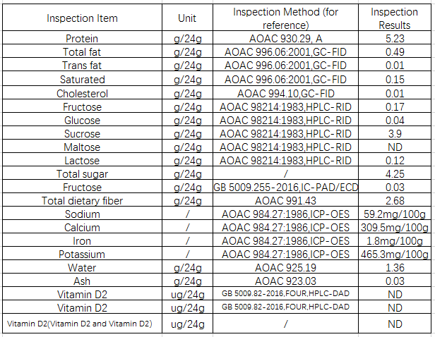
Equivalent to one egg
Almost no fat
No added saccharin
Diabetic don’t have to worry about excessive sugar.
Be rich in
dietary fiber
Rich minerals and Vitamins
Notes:
这是我们敢于拿出来炫耀的一件事情
胆固醇日推荐摄入量
和糖尿病人
每一包的含量表

Slide 6
Safety Certification Health Guarantee
Efficient, Reliable Safe
GMP Standard
Better Production Equipment
Consistent Production Process
Perfect Quality Control
Strict Inspection System
Notes:
GMP(GOOD MANUFACTURING PRACTICE)是一套适用于制药、食品等行业的强制性标准，要求企业从原料、人员、设施设备、生产过程、包装运输、质量控制等方面按国家有关法规达到卫生质量要求，
我们的产品是安全健康的

Slide 7
What did the experts say?
Let's focus on those authoritative reports.
Notes:
自说自话到科学界权威认证

Slide 8
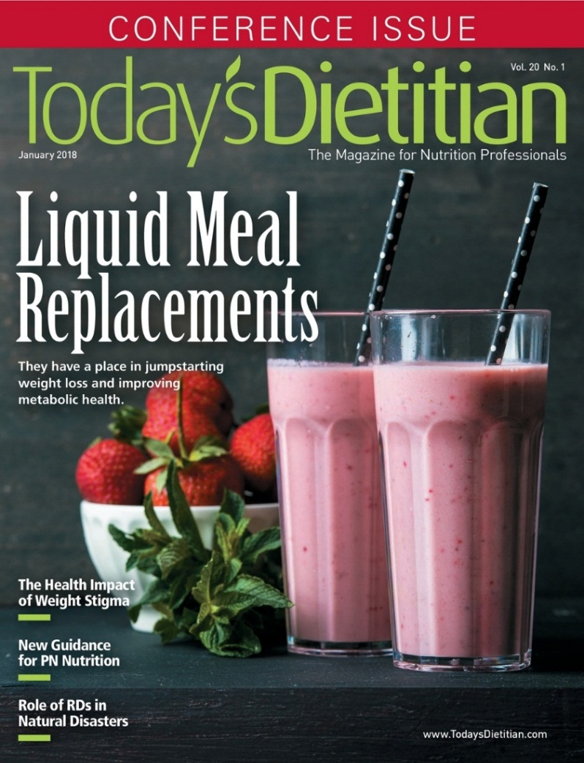
What do nutrition experts think?
Ashley koff R.D
Rachel Lustgarten
Well-known registered Dietician Professor
Weill Cornell Medical College in New York
We always eat a lot of inferior food in our daily life , but Meal replacement can help us intake the nutrition what our body need.
Meal replacement enables you to control calorie intake.
Notes:
Meal replacements can help with portion
纽约维尔康医学院的营养师Rachel
ACI美国权威资格认证协会
牛津大学发表的一项新研究发现，作为12个月饮食疗法的一部分，膳食替代计划在12月内显示出远远优于传统的卡路里控制饮食的减肥效果
但如果市面奶昔类，都含有较高的糖分

Slide 9
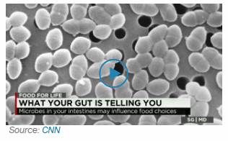
Authoritative Magazine Reports
1
2

Slide 10
Experimental Verification of Famous University
$❶$278 Participants in the experiment
❷ They use one kind of product every day to replace the usual meal.
Susan Jebb, the Diet and Population Health Professor of Nuffield Primary Health Care and Health Science Department in University of Oxford, said: “In the past, we were worried that the rapid weight loss in a short period could lead to a rapid weight recovery. However, this study shows that people has lost three times weight a many as the regular weight loss programs after nine months of the intensive phase.
❸ After 12 months, these participants
lost an average weight of 10.7 kg.
❹ They also show a risk reduction of
heart disease, stroke and diabetes.
❺ 45% of low-energy project
participants lost 10% or more
of their weight.

Slide 11
Scientific meal replacement is an effective way to control weight
Control calorie intake, only eat nutrient rich foods.
Notes:
科学不仅是说使用方式科学，还是说代餐本身的成分科学

Slide 12
It will not replace all meals, but can replace any meal.
Scientific using method
Scientific formula
A carton of milk 167 calories
A package of Elements has only 90 calories
An apple 100 calories
Notes:
轻点是一款更加出色的代餐。蛋白质缺失会有什么问题？
脂肪燃烧减慢，营养性水肿
一般人一餐热量摄取约600~900千卡，而食用代餐粉减肥，可以将热量控制在50千卡左右，热量摄取小于需要量，体重自然会减轻。
90大卡如何够满足身体营养，讲基础代谢

Slide 13
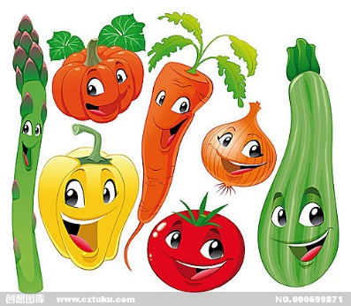
Element Nutrition Analysis
1
milk protein
5
kinds of fruit nutrients
7
kinds of vegetable
cellulose
A big nutritious meal with 90 calories
20%
Extra minerals

Slide 14
The collision between Nature and Science
Raw Material Introduction Of Elements
Red chenopodium quinoa willd powder
“Nutritional gold”
Psyllium Husk
Be rich in fiber and up to 80%
Zero cholesterol, vegetable protein
Complete protein
and total nutrition
Nutrition and Satiety
Whey protein concentrate
Pure animal protein
Triple satiety
High purity,
high absorption
Notes:
藜麦是一种完全蛋白全营养食品，这意味着你可以减少其它食物总进食量。完全蛋白质是指那些含有的必需氨基酸种类齐全，含量充足，相互比例适当， 能够维持生命和促进生长发育的一类蛋白质。 植物蛋白，一种即满足人体基本营养需求
车前草的种子外壳经加工磨碎后，可吸收膨胀约50倍，种壳中内含可溶性与不可溶性纤维，比例约3：1

Slide 15
It inhibits the absorption of sugar in the intestines and accelerates the burning rate of fat.
Green Coffee
Extract
Promote fat burning and speed up metabolism
Natural water-soluble dietary fiber to promote gastrointestinal peristalsis and improve its function.
Inulin

Slide 16
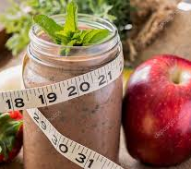
How can it help us control weight more efficiently?
Notes:
前面介绍了是安全的，健康的，营养的，低卡的，饱腹的，不伤身体

Slide 17
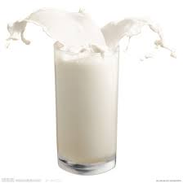
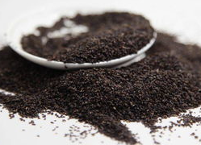
Elements Unique Advantages
Red chenopodium quinoa willd powder
good for heart care and blood circulation
Green Coffe
Conducive to metabolism and liver protection
Inulin
good for spleen and immunity improvement
Psyllium Husk
Concentrated whey protein powder
good for kidney and reducing water retention
good for lung
Notes:
感冒身体处于不好的状态，不吃饭也不会饿，身体消耗热量低

Slide 18
Update cycle for organs
14-Day Meal Replacement
=
Cleaning for Internal organs
=
More efficient fat burning
Balance the body
Improve metabolism
Help the body in self-cleaning
Notes:
两周一次肠道更新

Slide 19
Elements Selling Points
Balance meal with one package
Less Calories, More Nutritional Supplements
Be rich in human required nutrients
Possess Triple Satiety, Accelerate Fat Burning
Special ingredients to promote metabolism and accelerate fat burning
American “Light Meal”, Quality Life
Silicon Valley new “fashion”, meal replacement, get greasy out
Regular Body Balance
Make fat loss easier
Notes:
帮助你更快速的生活
更换一餐饭，开始新的一天

Slide 20
Suggested Use
Once time in a day, it is recommended for dinner replacement.
Two minutes
One package of Elements
Hot water
Pour 150Ml hot water into the cup firstly.
Then add Elements to the cup
Keep Stiring while adding Elements, enabling mix the powder and water thoroughly
Don’t stop Stiring for about 1~2 minutes until it can be drank without sediment.
Notes:
使用建议，产品组合，百搭产品

Slide 21
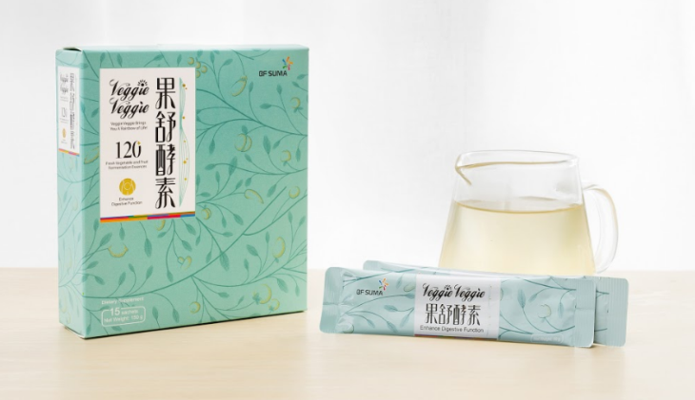
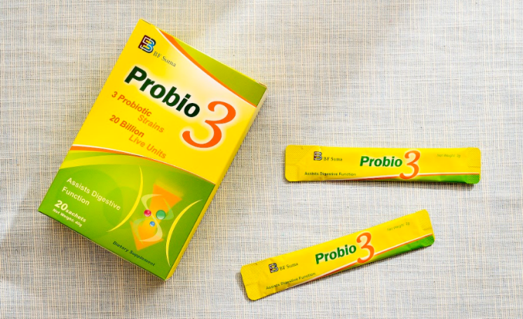
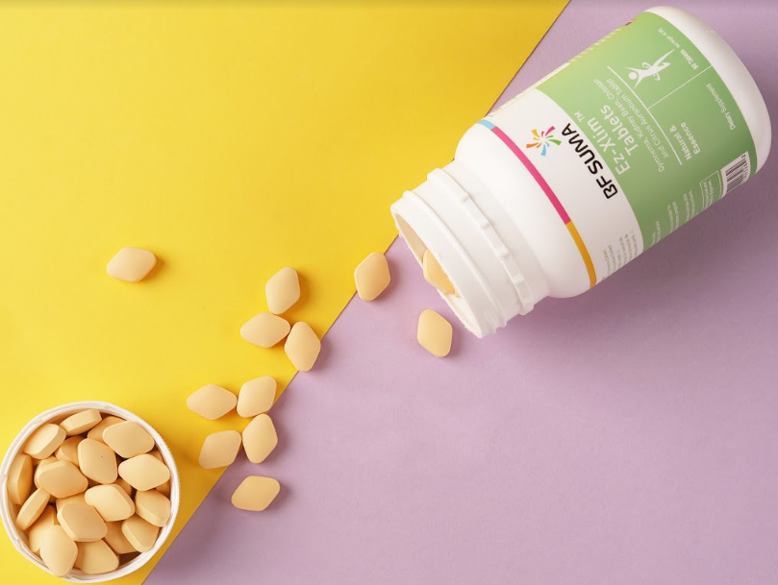
Product Portfolio of Elements
All-match Products

Slide 22
Relieve patients with severe constipation !
Loosening Bowel to Relieve Constipation（Elements+ConstiRelax）：
relieve constipation and loosen bowel.
Replacing a greasy diet to reduce the bowel burden, Elements possess more fiber that can promote gastrointestinal peristalsis.
With the help of Elements, ConstiRelax can improve intestinal environment more quickly to relieve constipation.

Slide 23
Weight lost easily !
Lose weight（Elements+Veggie veggie）：
Detoxification in the morning, fat lost in the evening.
Use Veggie in the morning. Veggie will clean up the toxins accumulated in the whole evening to ensure a slim and good state throughout the day.
Use Elements to control calorie intake in the evening, create a calorie gap, restore the various organs in the evening, and maintain the balance state to effectively lose fat.

Slide 24
Save foodie！
Eat more, loose fat（Ez-Xlim+Elements）：
Eat more freely, control calories, replace meals.
When you are attracted by delicious food and can't control yourself, Ez-Xlim can help you reduce the calories absorption.
Dual control of calorie intake
At the same time, you can use Elements to replace a meal, and balance the total calories of the whole day after free eating and drinking.

Slide 25
Healthy bowel, healthy usually!
Improve immunity（ Probio3+Elements）：
Regulate the microflora and restore metabolic balance
Elements contain dietary fiber which is a good “feed” for the intestinal microflora, but when they are used at the same time, the survival rate of the microflora in Probio3 will be higher, enabling the beneficial microflora to grow faster.

Slide 26
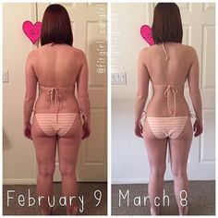
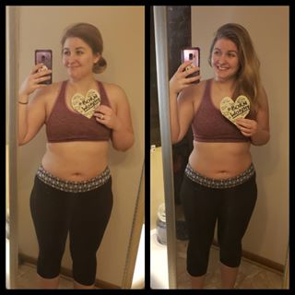
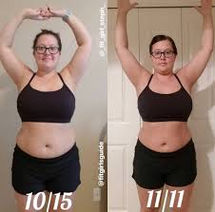
One month
Two month
Three month
Super equation for kill fat SUMA FIT. Let's see changes!
Veggie veggie + Ez-Xlim + Elements = Normal breakfast with detoxification +Free lunch with fat control+Nutritious dinner with low calories

Slide 27
TIME TO
BURN
SOME FAT.

Slide 28
Thank you
Together we can make a…
…Brighter life and better future

