Slide 1
ArthroXtra Tablets

Slide 2
Bone & Cartilage Supplements
ArthroXtraTM Tablets
Dual Nourishment For More Motion

Slide 3
Have you ever concerned Bone & Cartilage Health?

Slide 4
You enjoy travelling because the healthy bone & cartilage support you to walk further…

Slide 5
You like sporting due to the healthy bone & cartilage help to performance better…

Slide 6
You play piano well since you get the flexible fingers…

Slide 7
But…
Have you ever seen people like these?

Slide 8
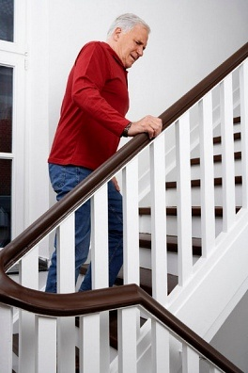
CONDITION 1
They spend a lot of time to climb stairs because every step is pain for them.
→
NEXT

Slide 9
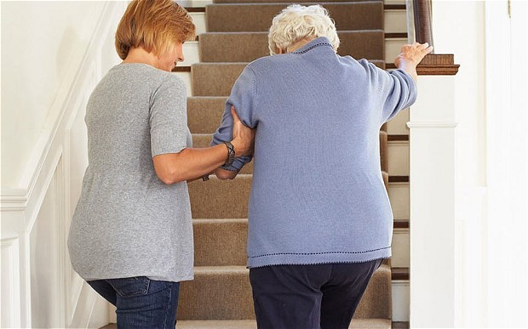
CONDITION 2
Even worse, they need people help them to walk.
→
NEXT

Slide 10
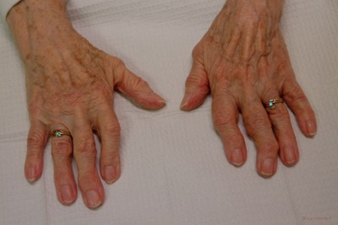
CONDITION 3
Their fingers turn swollen and the joints deform which not flexible any more.
They could not use cold water to wash hands and cloths since cold water may aggravate this condition.
→
NEXT

Slide 11
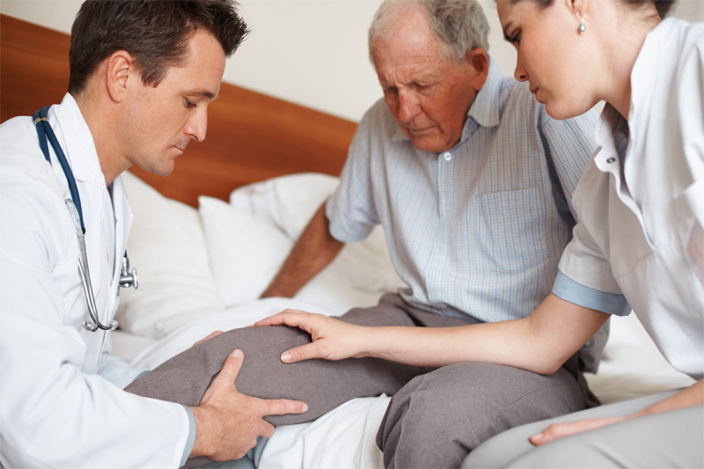
CONDITION 4
Their knees get flame and pain heavily, especially when the seasons alter and weather changing.

Slide 12
What happened with them?

Slide 13
FIRST…
Let us learn some basic physical knowledge.

Slide 14
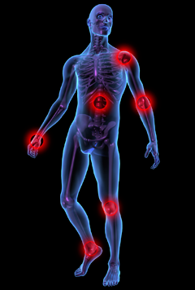
BODY JOINT LOCATION
1
Shoulder Joint
Vertebral Articulation
Elbow Joint
Wrist Joint
Hip Joint
Finger Articulation
Knee Joint
Ankle Joint

Slide 15
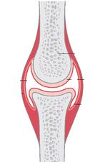
2
JOINT STRUCTURE & COMPONENTS
Bone
Fluid Inside Joint
Articulate Cartilage
Knee Joint Structure

Slide 16
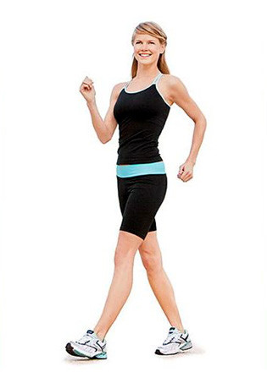
3
JOINT FUNCTIONS
Connect bones
Allow bone movements (except for skull bones)
Prevent bone surface from movement rubbing
Provide bone supporting

Slide 17
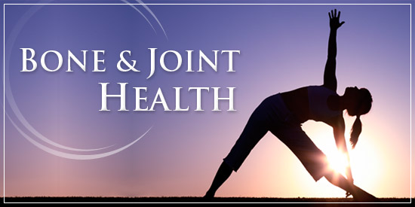
“
People always concern the health more seriously, but bone & cartilage health is easily to ignored.
”

Slide 18
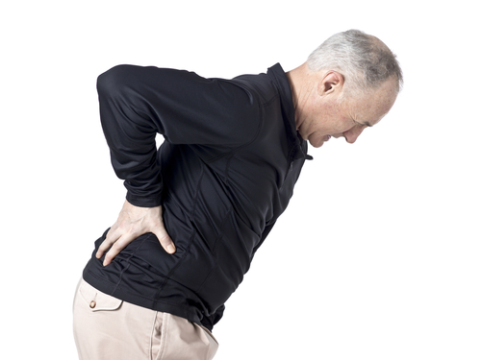
4
OSTEOARTHRITIS (OA)
A Main Disease that threaten bone & Cartilage Health.

Slide 19
Osteoarthritis (OA)
5
The physical substance in cartilage, proteoglycans reduce to produce
When bone surfaces become less well protected by cartilage, bone may be exposed and rubbed
66
OA
Reasons of OA
Symptoms of OA
Damage to Bone
Result
Osteoarthritis (OA) is degeneration of cartilage inside the joint.
Include joint pain, tenderness, stiffness, locking, and sometimes an effusion
Pain for movement, atrophy for regional muscles and may lax ligaments

Slide 20
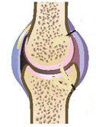
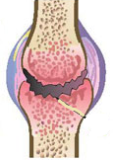
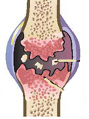
6
EVOLUTION OF OA
Cartilage turn thin
Cartilage continue turn thin
Cartilage Fragments
Bone Spurs
Overgrowth of bone and appear cartilage fragment
Normal Joint
Thinning of Cartilage

Slide 21
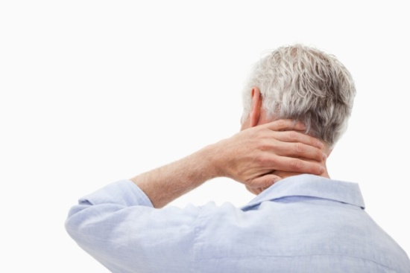
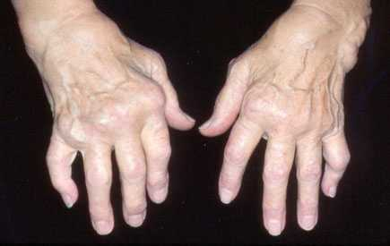
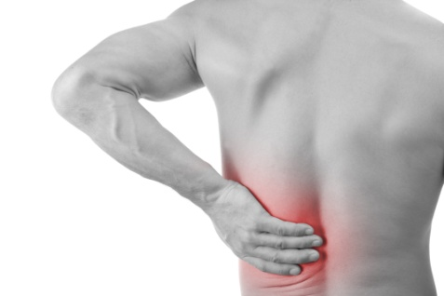
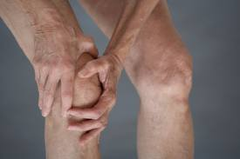
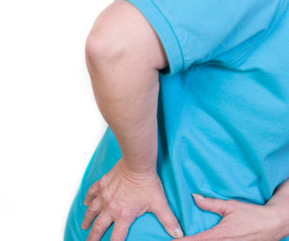
7
PREDILECTION SITES
Neck
Articulation of hands
Spine
Knee Joint
Hip

Slide 22
Not realize the serious?
Let us look at some data & facts.

Slide 23
DATA & FACTS
9.6 %
18 %
80 %
25 %
400,000,000
9.6% of men and 18.0% of women aged 60+ have OA.
4 billion people have OA
80% of OA patients have limitations in movement. 25% cannot perform their major daily activities of life

Slide 24
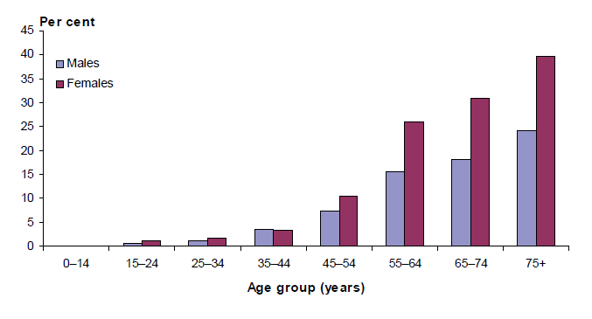
PREVALENCE OF OA
The morbidity of osteoarthritis at age 44+ increases rapidly.
——Source: AIHW analysis of ABS 2007-08 National Health Survey.

Slide 25
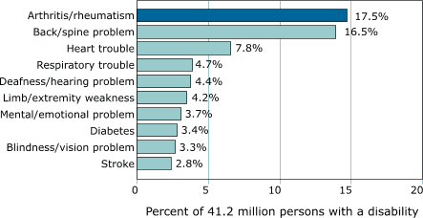
Leading Cause of DISABILITY

Slide 26
How to treat OA?

Slide 27
1
TRADITIONAL TREATMENTS
Lose Weight & Aerobic Exercise
Surgery
Jogging
Cycling
Swimming
Debridement
Joint Replacement
…
Medicines
Oral Analgesic to Resist Pain
…

Slide 28
2
LOSE WEIGHT
Less the Burden of Joint
Drawbacks: Could not achieve the quick result for relieving OA pain.

Slide 29
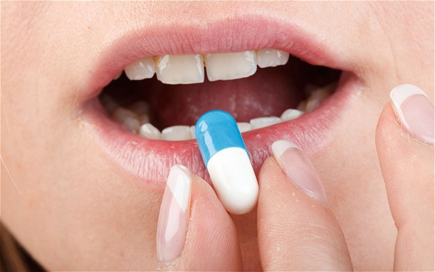
3
ORAL PAINKILLER DRUGS
Relief the Joint Pain
Drawbacks: Inducing side effects that may harmful to gastrointestinal health, such as ulcer.

Slide 30
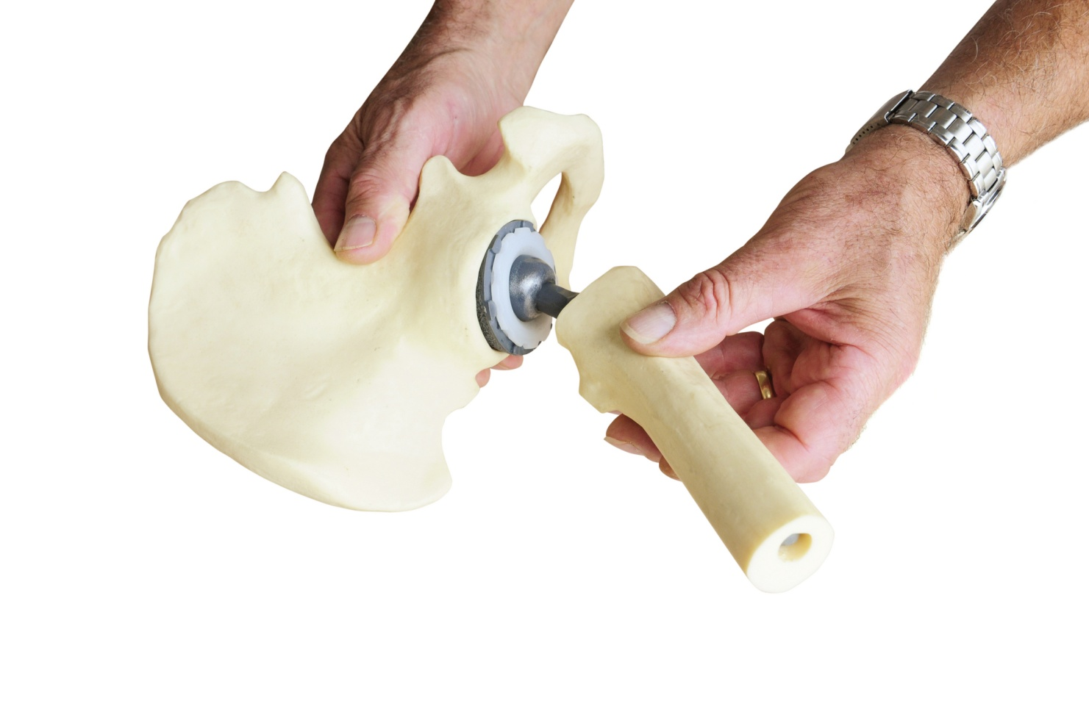
SURGERIES
4
Replace an Artificial Joint
Drawbacks: High cost to treatment.

Slide 31
Osteoarthritis is difficult to cure.
We must prevent as early as possible.
Don’t Worry!
We Have A Best Solution.

Slide 32
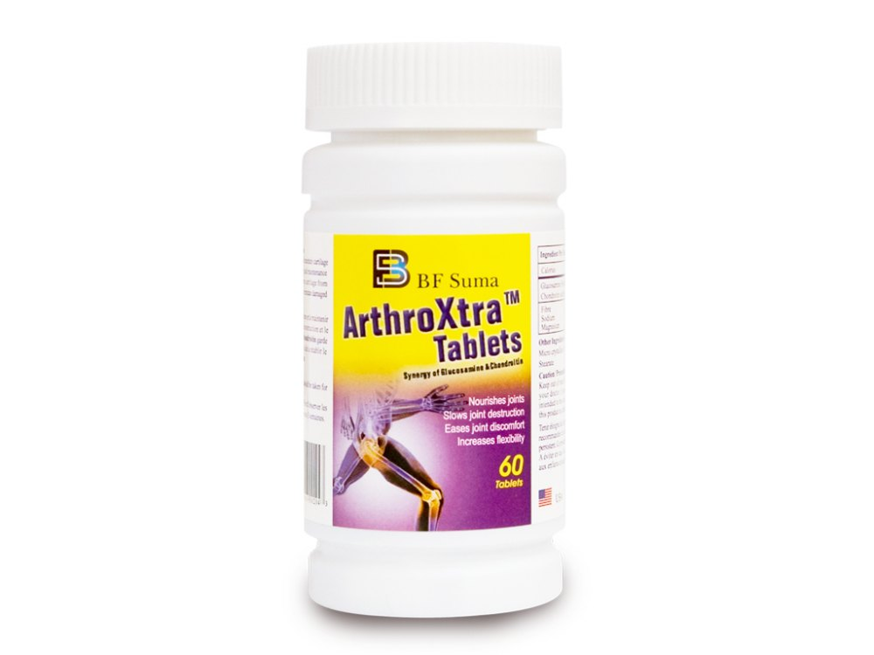
ArthroXtraTM Tablets is a good helper to prevent Osteoarthritis!
Two Natural Components
Dual nourishment for Bone & Cartilage

Slide 33
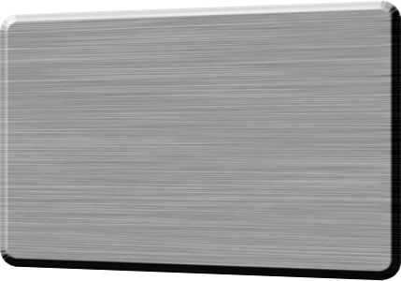
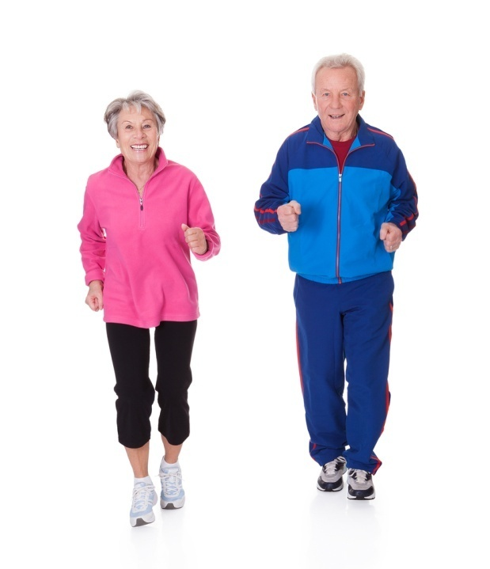
TWO INGREDIENTS
Gluocosamine
Effective
Chondroitin
Old people should pay more attention on bone & cartilage health

Slide 34
Ingredient
Exist in Body
Is an amino acid mainly exist in joints and connective tissues
Physical Functions
Important component of fluid inside joint
Important raw material for synthesis physical substances in body
Reduce with Age
Decrease producing glucosamine with age
Glucosamine
Daily Food Intake
Can intake only a few in daily food

Slide 35
Supply the physical substance to synthesis proteoglycans, which is the component of cartilage
Natural Care for Cartilage
Glucosamine
Long lasting to Relief Pain
Inhibit: Enzyme that may damage
cartilage cells
Stimulate: Produce normal amount of
proteoglycans to protect
cartilage cell membrane.

Slide 36
1
Help to increasing glucosamine concentration.
Maintain water inside joint.
3
Chondroitin
Improve the nourish absorption of joint.
Maintain the joint moisture.
4
2

Slide 37
ADVANTAGES
Two ingredients care for your bone & cartilage.
more nourishment.
More effective to reduce pain.
Help you to move with flexible joint.

Slide 38
APPLICATIONS
Relief various discomforts of joints.
Care for strain-induced joint damage.
Help to retard aging joints.

Slide 39
CHOOSE BF SUMA
The Most Professional Solution for Bone & Cartilage Care
Care for Osteoarthritis
Dual Nourishment for Osteoarthritis
Care for Osteoarthritis & Osteoporosis
Efficient supplement for Calcium & Zinc

Slide 40
Life is long,
you can walk further.

Slide 41
THANKS FOR WATCHING
Africa Marketing Department 2017

