Slide 1
Pure water makes life well
Purewell water purifier
Kama
2017.09.15

Slide 2
In the U.S
The poor drinks milk
The rich drinks quality water.

Slide 3
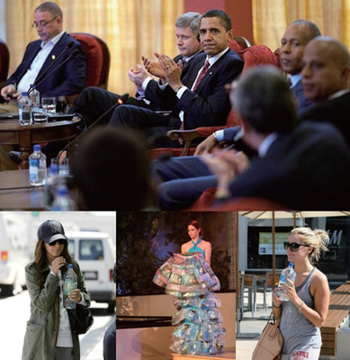
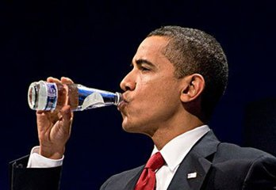
Rich in water ,water brings rich
Quality water popular in the rich circle quickly:
The upper classes live a luxurious and superior life
Looking for the most essential things of life --Healthy Lifestyle
Water is the core of a healthy lifestyle. Its taste, quality and nutritional value affect our quality of life directly.
Fiji mineral water, Priced at $ 2.5, has swept the market. Obama likes to drink it and has become their loyal customer. Paris Hilton loves it. R & B singer Mary Bridget refused to sing without drinking it.
Quality water : clean and pure, pleasant taste, rich in minerals
Notes:
在美国，无论是奥巴马、好莱坞大明星、还是贵妇太太们，对洁净水已经进入了狂热到白热化的状态，一瓶简简单单的瓶装水，成了全球人的时尚新宠。。（接下来引出潮流背后本质）
他们身边豪车，私人飞机，别墅小洋楼，名牌包包，奢华服饰围绕，经常参加各种趴，出入各种顶级私人俱乐部，过着高端而优越的生活。但是，最近…贵族们开始转移战场，他们开始追求生活本质的东西。
他们开始追求健康的生活理念，继通过健身维持健康和塑造完美体形，再到营养餐控制营养与热量摄入之后，他们开始更深入的挖掘到与他们健康生活理念息息相关的东西，饮用水
水一直围绕在他们生活左右，对他们的健康生活理念起着至关重要的作用。他们对使用水有着严格的要求，重视饮用水的口感、品质及营养价值，追求洁净，清新，富含矿物质的使用水。

Slide 4
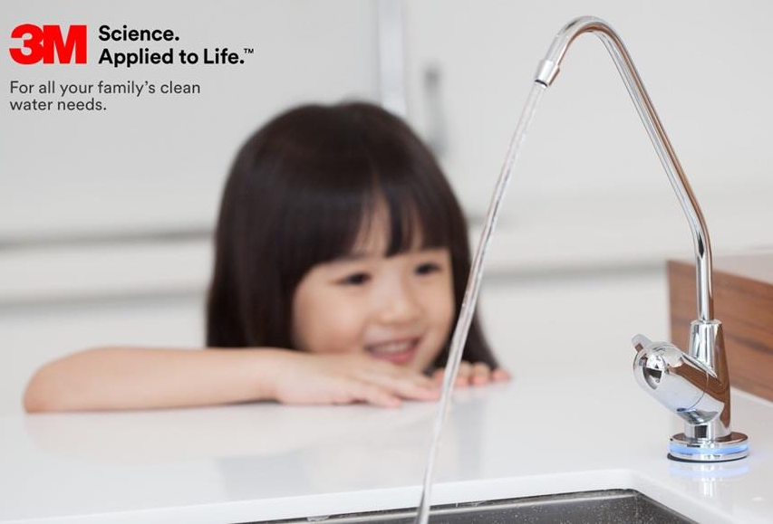
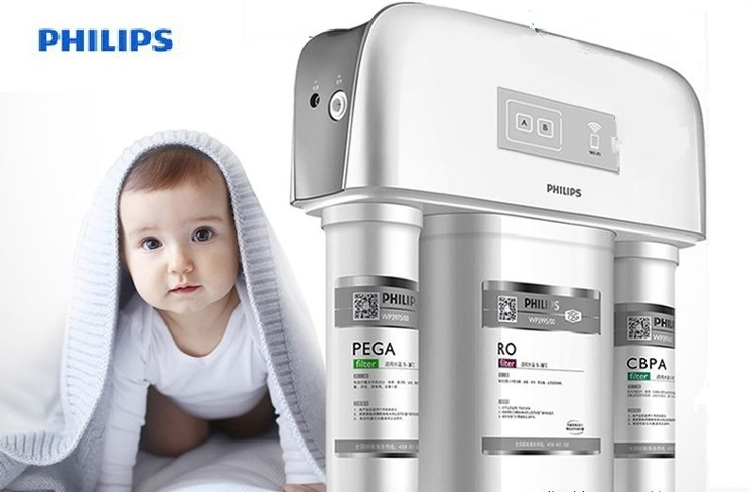
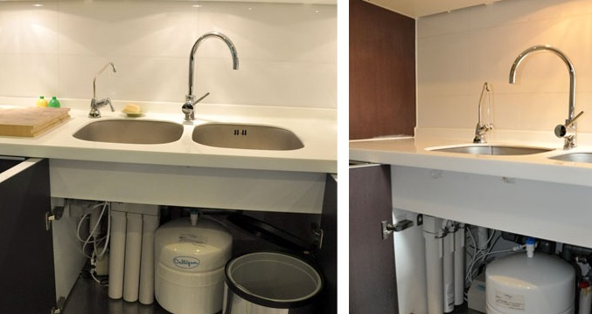
Water Purifier
The key to American healthy lifestyle
Healthier & Purer
Water purifier improve the water quality of household water effectively.
Philips, 3M, and other famous companies have launched water purifiers to meet the needs of upper-middle-class.
Water purifier is becoming the household necessities of upper-middle-class gradually .
Notes:
1.上层人士在外通过喝矿泉水来保证水源优质，那么回到家呢，他们又会有什么法宝呢
2.据调查发现，富豪家庭中，净水器是必不可少的居家用品，他们通过安装净水器来改善家庭水质，以尽量达到他们对优质水的极致追求。
3.净水器过滤后，除了可以保证水的纯净安全之外，还能去除水中的异味，还原水原本清新自然的味道，有效的提高我们的生活品质。
4.渐渐，净水器也渐渐开始成为每个高档家庭必备生活用品

Slide 5
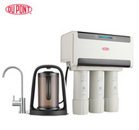
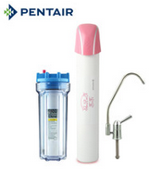
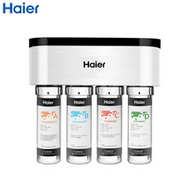
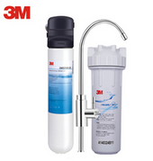
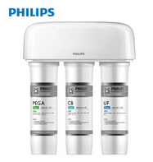
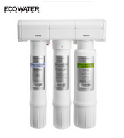
The water purifier is originated in USA in 1980s
accumulating
Water Purifying
The core ideas of healthy life
Notes:
美国净水器发展与经济发展。类比非洲
Accumulate ： 财富积累 知识积累 历练积累 细菌也随着我们日常饮用水的不注意也在积累
过滤使用水后的健康生活，净水不仅是净水本身，更是生活理念提升与优质品质的必备附属物。

Slide 6
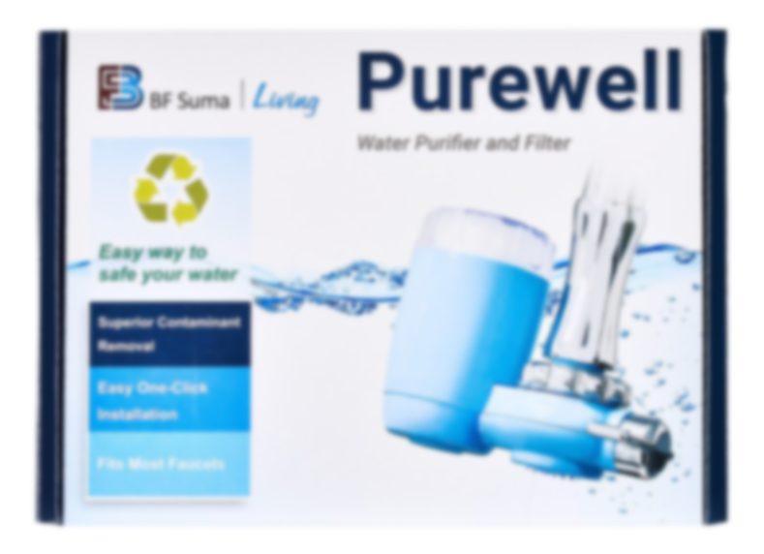
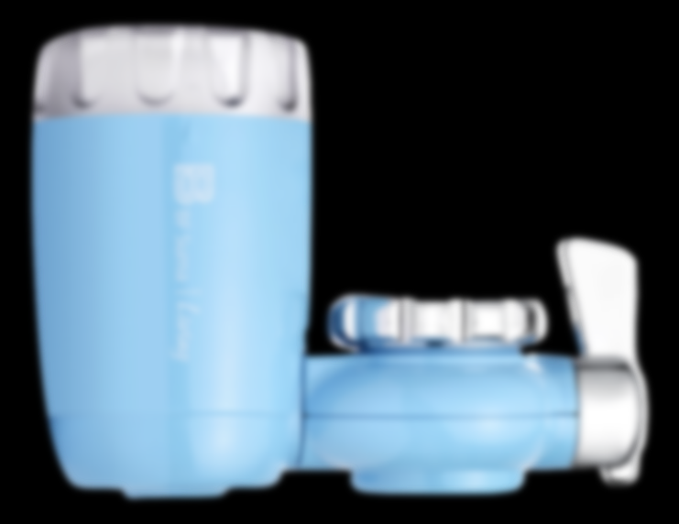
BF SUMA purewell water purifier
Pure water makes life well...
引出产品+slogan
7
hyper filtration with diatomite，giving you a healthy lifestyle

Slide 7
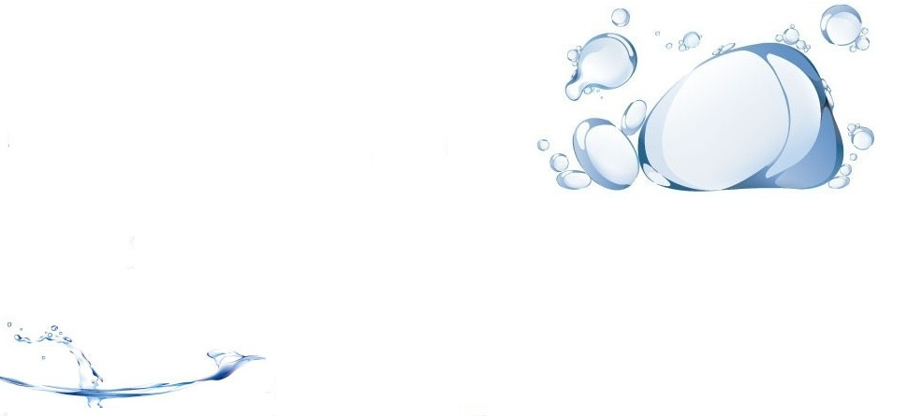
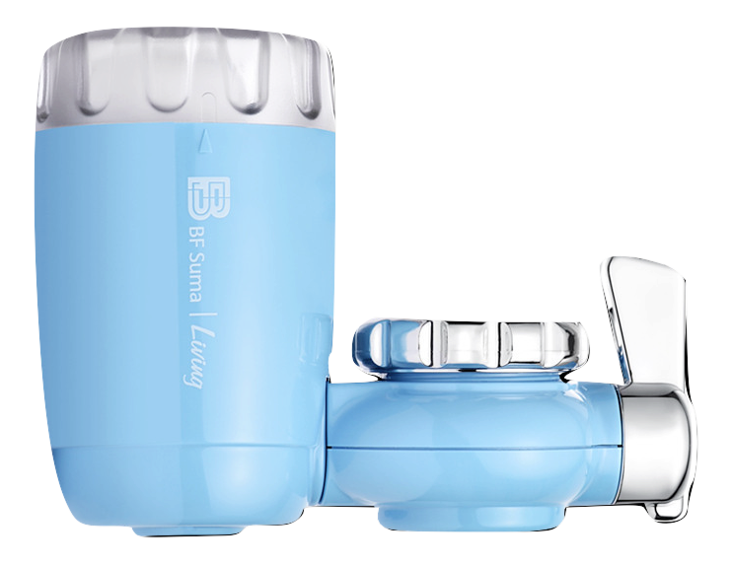
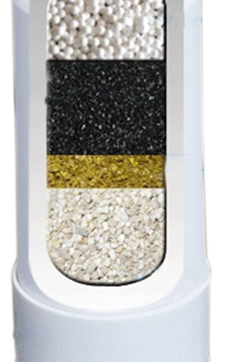
Better Filter leads to better life
7 layer ceramic filter
Built-in ceramic filter
Filter rust, sediment, red worms, colloids and so on
CaSO3
Filter out residual chlorine, chloroform
Activated carbon (coconut shells)
Filter odor, adsorbing heavy metals
KDF
Filter heavy metals
Maifan Stone
Produce negative ions, and active water molecules.
PP cotton
304 stainless steel filter

Slide 8
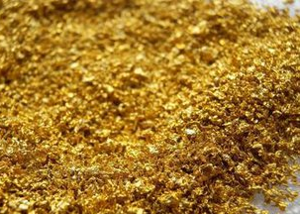
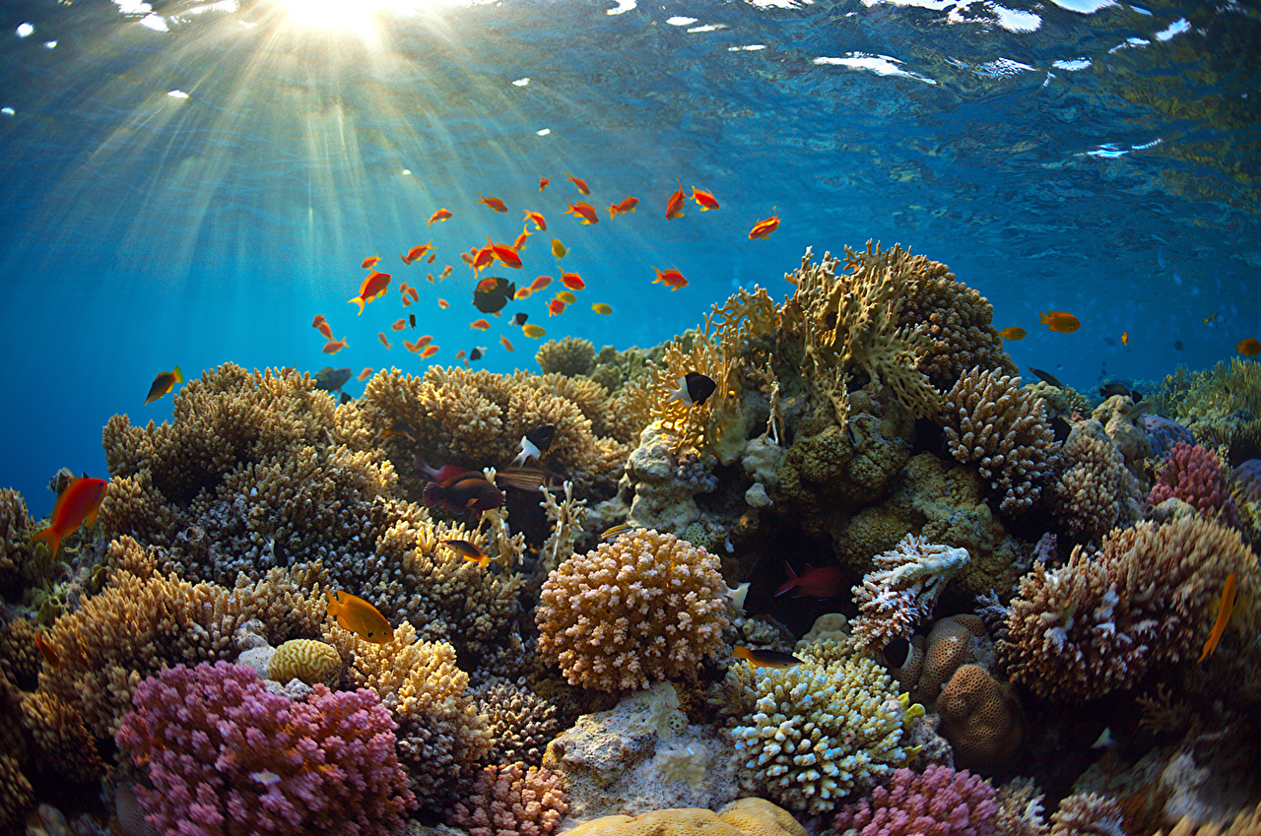
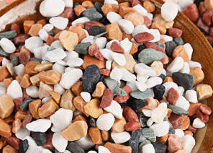
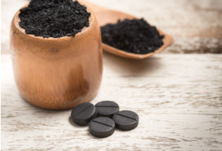
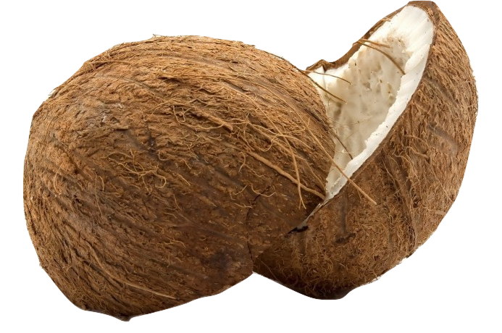
Superior material , super filtration
KDF
Guard of water
Inhibit the growth and reproduction of microorganisms in water, filter heavy metals
Diatom mud (deep sea) Natural and pure, no addition, can be cleaned, effective filter particles.
Activated carbon
(coconut shells) Remove Cl2, odor, large adsorption area, high efficiency
Maifan stone
There is adsorption, filtration, odor removal effect, and release a variety of beneficial minerals

Slide 9
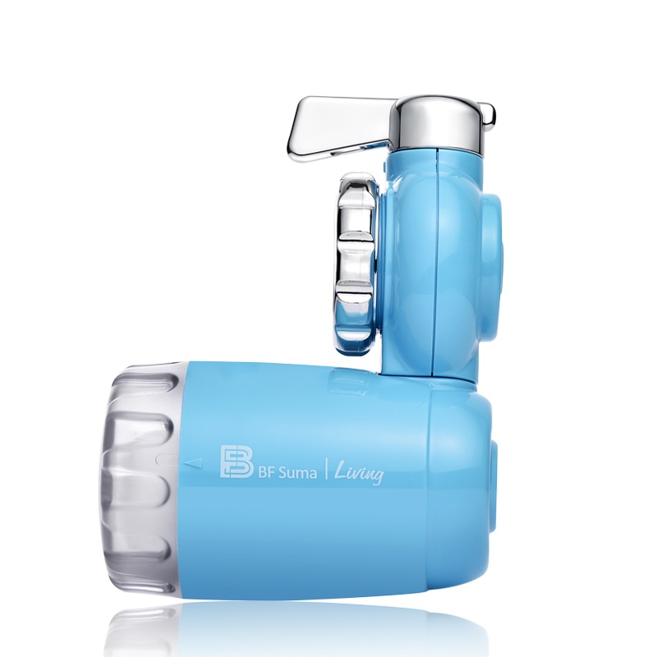
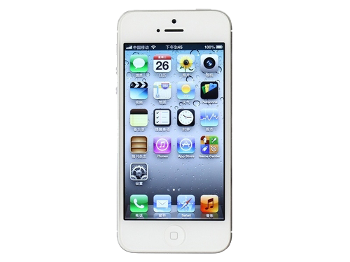
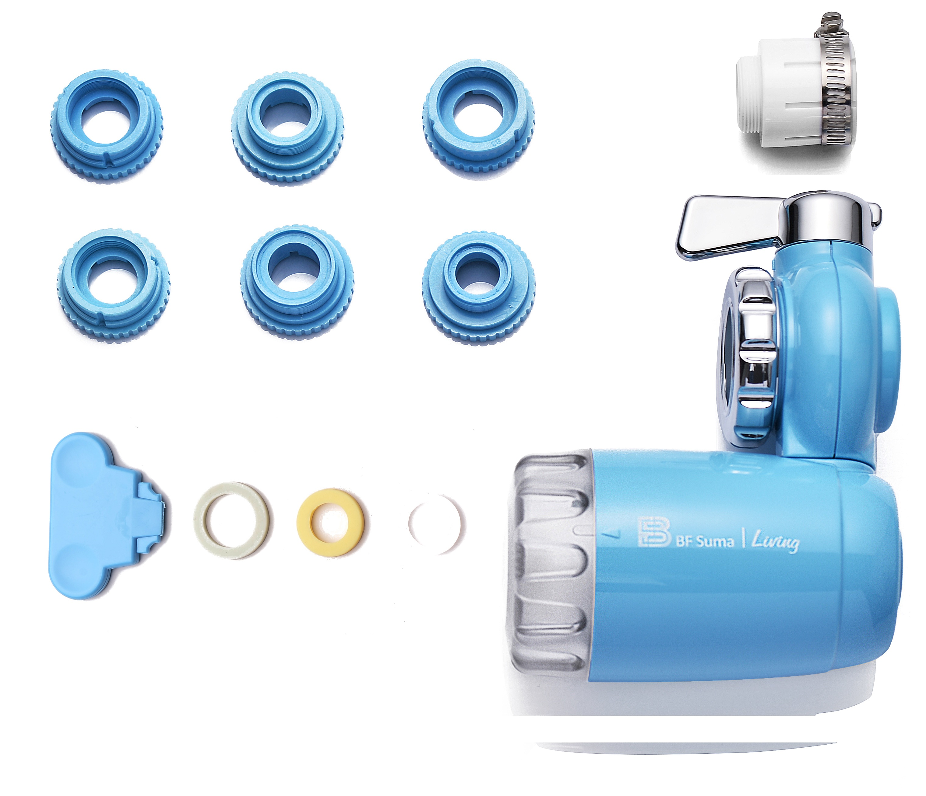
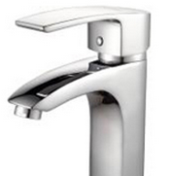
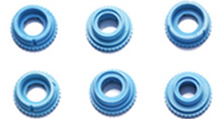
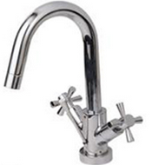
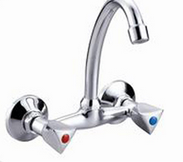
Modern & convenient
4
1
2cm
No power needed
Easy to carry
No matter how bad your heart has been broken, the world doesn’t stop for your grief. The sun comes right back up the next day.李益达，一个不甘平庸的逗比！
www.tretars.com
3
Three-step installation
Applicable to common faucets
2
No matter how bad your heart has been broken, the world doesn’t stop for your grief. The sun comes right back up the next day.李益达，一个不甘平庸的逗比！
www.tretars.com

Slide 10
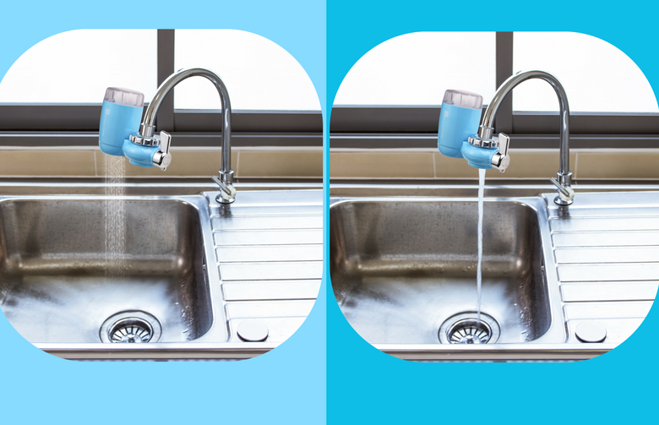
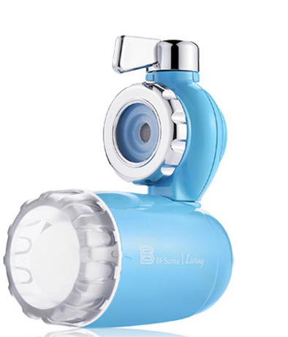
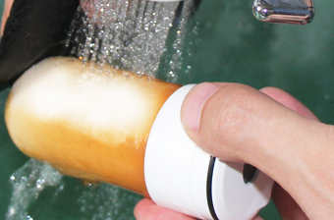
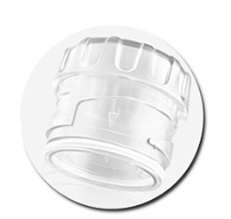
Human-centered design
Dual water path
Transparent cap
Reusable filter
Clean water
Raw water
Boil water
Wash dishes
Cooking
Wash clothes
Washing face
Clean the house
Changes in usage
After cleaning the filter

Slide 11
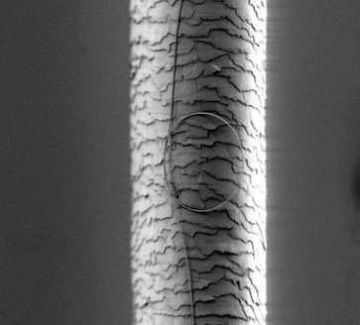
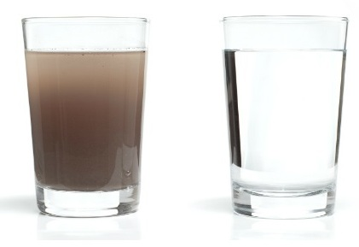
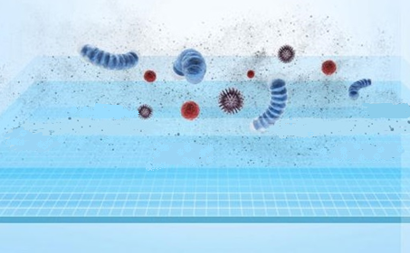
Gosh! Your body as a filter now?
50um
intercept the material more than 0.1um
Hair
eggs
intercept
fiber
rust
silt
Gel
Cl
NaNO2
silt
Worm eggs
rust
muddy matter
impurity
0.1um
intercept
Notes:
1.人体水分占70%。
2. 我们身体的水分来源于每天摄入的水，我们每个细胞流淌着都是我们喝进去的水，虽然我们的身体原本就有净化能力，但是若我们长期摄入不干净的水，用身体来当过滤器，对我们身体将造成无法逆转的伤害。
3.参考左右两个小人仔…..0.1um拦截，净化你的每一个细胞。

Slide 12
Right water , life better
BF Suma water purifier
Great filtration with smaller size
Easy to install
No need to pick up, easy to install and easy to use.
Contains 7 layers of high-quality materials, filtered Selectively, and can release beneficial minerals.
Easy installation, Simple to use
7 layer Filter element
New taste
Super filtration function
Clean/raw water Free to switch
intelligent water purification mode
0.1um intercept
Can blocking the particles smaller than the hair 500 times , filter efficiently
Clean/raw water free to switch ,can convert different usage patterns for different water needs

Slide 13
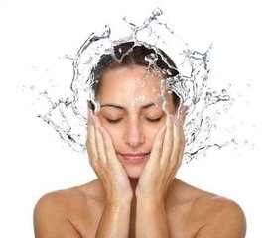
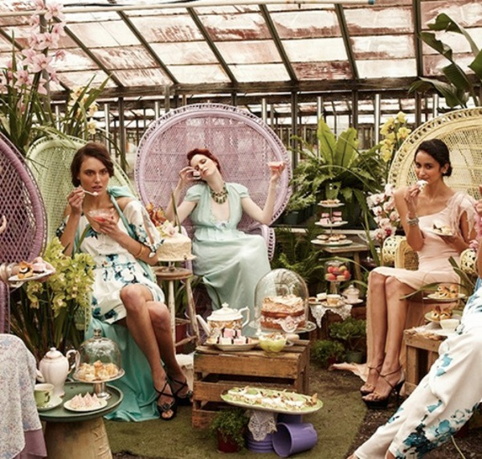
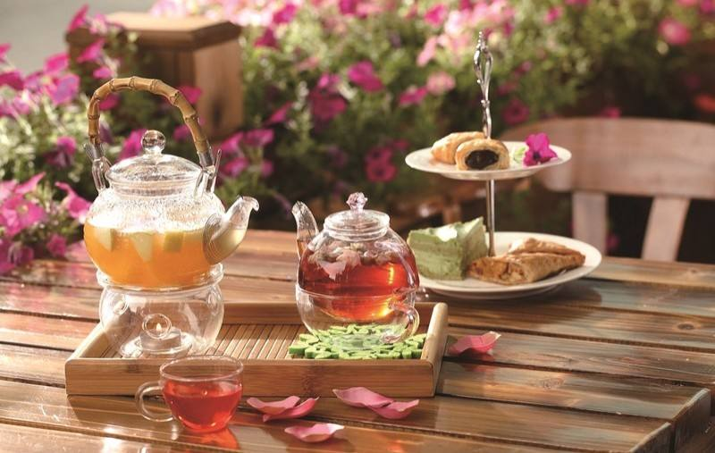
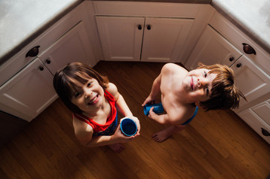
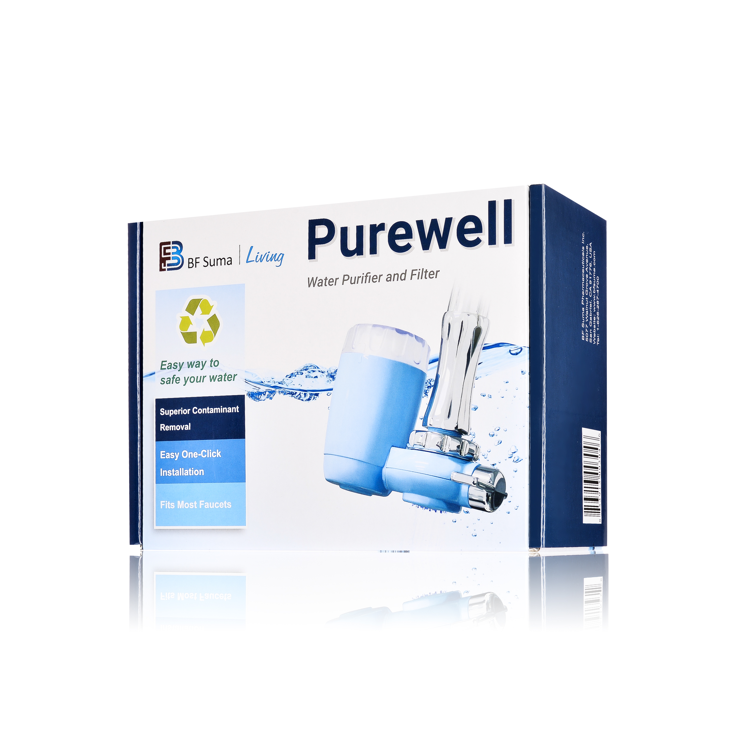
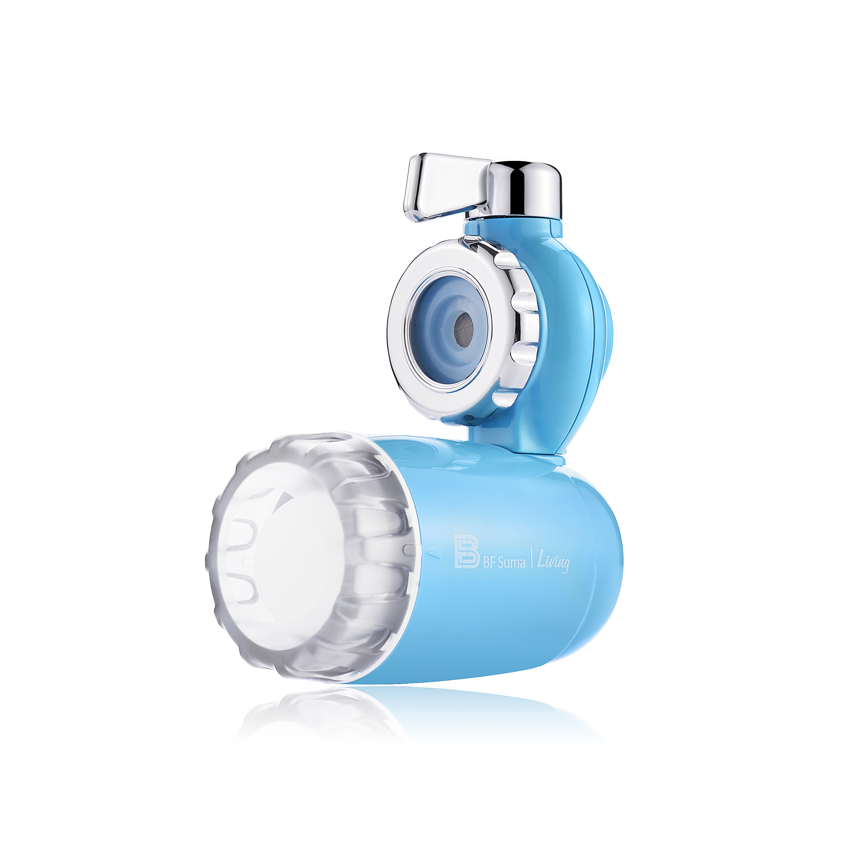
Quality water makes quality life
--- Enjoy life, start from water

Slide 14
THANKS FOR WATCHING
Central Marketing Department 2017

