Slide 1
Zaminocal Capsules
BF Suma Ghana TOT
11-Feb-2017

Slide 2
ZaminoCalTM Capsules
CALCIUM & ZINC, NEW FORM FOR BONE PARTNER.

Slide 3
DIFFERENCE AMONG CHILDREN
Some children always get sick.
Some children grow with a strong body.

Slide 4
DIFFERENCE AMONG ADULTS
Some adults are competent and vigorous when working.
Some adults are easy feeling tired.

Slide 5
DIFFERENCE AMONG THE AGED
Some elders are able to do exercises even at old age.
Some elders need a cane for walking.

Slide 6
QUESTION 1
We live in the same world,
How could it be so different in health?

Slide 7
First, let’s do a
Case Study…

Slide 8
Joel is a healthy and cheerful baby when he was born.

Slide 9
With a few weeks, his parents started noticing worrisome symptoms during night time in that he shook a lot, sometimes to the point of trembling.

Slide 10
They initially perceived the trembling as Joel’s bodily susceptibly to cold weather.
So they wrapped him nice and tight.

Slide 11
However, things get worse the next day when his hands and legs shook uncontrollably, force him to cry incessantly.

Slide 12
Much to the dismay of his parents, the doctor announced that Joel suffered from a sub health issue – Calcium Deficiency.

Slide 13
Case Summary
Calcium and Zinc are essential factors to build our healthy body, not only for babies, but also for adults, aged people and pregnant women.

Slide 14
PART 1
Calcium

Slide 15
QUESTION 2
What is Calcium?
(Choose 1 or more answers)
It is a mineral.
It is a kind of food.
It is essential for strong bones.
It’s essential for adults only.
(See answer in the next page)

Slide 16
Ca
Calcium
Calcium is an important mineral which is obtained through the diet only.
More than 90% Calcium we take are absorbed by bones and teeth to give them strength and rigidity.
(Answer for question2: A &C)

Slide 17
QUESTION 3
What are the main functions of calcium?
(Choose 1 or more answers)
Maintains strong and healthy bones
Muscle contraction
Helps prevent osteoporosis
Essential during pregnancy
(See answer in the next page)

Slide 18
Maintains teeth & bones strong
Main Function
Blood Clotting
Calcium
Functions
Nerve Function
Others
Muscle Contraction
Cells Interaction
(Answer for question 3: ALL)

Slide 19
QUESTION 4
How much calcium is recommended to an adult (10-30 y.o.) for daily consumption?
(Choose 1 answer)
500 mg.
1000 mg.
10000 mg.
2500 mg.
(See answer in the next page)

Slide 20
Guideline for Calcium Intake Daily
Life Stage Group | Estimated Average Requirement (mg / day) | Recommended Dietary Allowance(mg / day) | Upper Level Intake (mg / day)
Infants (0-6 months) |  |  | 1000
Infants (6-12 months) |  |  | 1500
1-3 years old | 500 | 700 | 2500
4-8 years old | 800 | 1000 | 2500
9-13 years old | 1100 | 1300 | 3000
14-18 years old | 1100 | 1300 | 3000
10-30 years old | 800 | 1000 | 2500
31-50 years old | 800 | 1000 | 2500
51-70 years old (male) | 800 | 1000 | 2500
51-70 years old (female) | 1000 | 1200 | 2500
70 above | 1000 | 1200 | 1200
14-18 Lactating / Pregnant | 1100 | 1300 | 1300
19-50 Lactating / Pregnant | 800 | 1000 | 2500

Slide 21
Each life stage groups would have its symptoms of calcium deficiency.
COME AND SELF-DIAGNOSE!

Slide 22
Baby – Influenced by embryo and breastfeeding.
Baby calcium deficiency may has the symptoms below.
Difficult to fall asleep.
Easy to cry and be awakened when sleeping.
Delayed intellectual development and learned walking on the 13th month after birth which is later than the normal.
Teeth didn’t grow until the 10th month after birth which is later than normal.
Thinning of hair.
Easy to catch colds.

Slide 23
Teenagers
Bone growth consumes most of the calcium.
Some teenagers’ picky eating would influence the calcium absorption.
Picky
Eating
Unattentive
Pain when bone grow
Easy to catch colds
Calcium
Deficiency
Symptoms

Slide 24
QUESTION 5
What factors induce adults for calcium deficiency?
(Choose 1 answer)
Irregular lifestyle.
Unhealthy diet.
Body does not absorb calcium well
All of the above.
(See answer in the next page)

Slide 25
Adults
Working pressure and intense pace of life may let adults neglect health.
This life stage has not obvious symptom of calcium deficiency.
1. Easily get tired.
Symptoms
2. Easy to catch colds.
3. Backache.
(Answer for question 5: D)

Slide 26
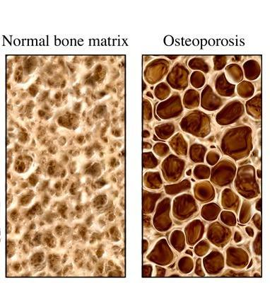
Aged People
Aged people absorb calcium less and excretion more.
Leading to osteoporosis.
POROUS BONES
A bone disease that mineral calcium flow from bone to blood.
Lead to bone mass loss and structure deterioration of bone tissue.
Result is bone fragility and an increased susceptibility to fractures of the hip, spine, and wrist.

Slide 27
PART 2
Zinc

Slide 28
Zn
Zinc
Zn is famous for promoting brain health and preventing Alzheimer’s disease.
It is an essential trace element for human body.

Slide 29
Zinc Function
May help clean cholesterol in the body.
6.
1.
Component of more than 100 kinds of enzymes in the body. These enzymes control the metabolism of protein, fat, sugar and Nucleic acid.
5.
2.
Strengthen the immune system.
Zinc
Influences the sense of taste and appetite.
4.
3.
Promotes sexual organ development.
Supports male and female reproductive health and fertility.
Cares for the skin.

Slide 30
3 Factors for Zinc Deficiency !
Inborn Deficiency
Intake Deficiency
Less body absorbance

Slide 31
Zinc Deficiency Symptoms
Life Stage | Symptoms
Baby Teenagers | Picky eating Oral ulcers; facial acnes Body growth and intelligence development delaying Immunity decrease and easy to catch a cold
Pregnant Women | Aggravated of pregnancy reaction Retardation of fetal growth Increasing rate of abnormal fetal
Adults Male | Abnormal semen, such as little amount, great viscosity May induce prostatitis

Slide 32
QUESTION 6
Which group of people is mostly considered to have zinc deficiency?

Slide 33
Answer to question 6
People who are picky-eating.
Vegetarian: vegetables containing low level of zinc.
Teenagers: their body develop rapidly.
Men with low sexual performance.
Cancer patients: they need to improve immune function.
People who get serious acne.
Women experiencing irregular menstruation.
Pregnant and breasfeeding women.

Slide 34
Calcium & Zinc deficiency induces disease and affects human health.
How take Calcium & Zinc properly?
BF Suma Gives You the Best Solution!

Slide 35
Best Solution=
+
Balanced Diet
Nutritional Supplements

Slide 36
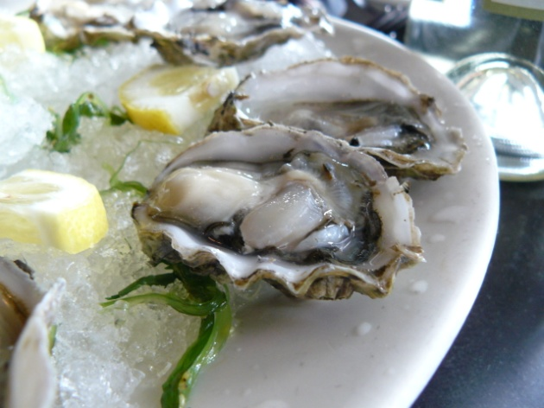
Balanced Diet for Calcium Deficiency
Drink Milk Daily
Eat Seaweeds
Eat Oysters

Slide 37
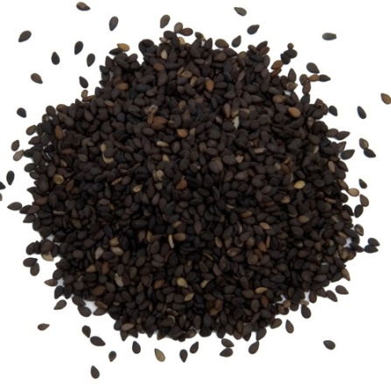
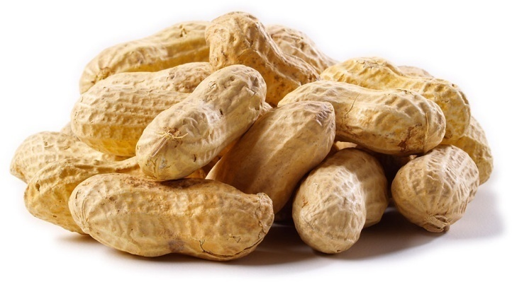
Balanced Diet for Zinc Deficiency
Sesame
Peanuts

Slide 38
Shortage of Balanced Diet
Supply More
But Slow Effect

Slide 39
ZaminoCalTM Capsules
CALCIUM & ZINC
NEW FORM OF BONE PARTNER

Slide 40
Breakthroughs
Golden formulation that supply calcium & zinc at the same time.
High technology to increase mineral absorption.
More safety.
Breakthrough

Slide 41
1.Golden Formulation
1
=
Zinc
Supply Calcium & Zinc at the same time
Calcium

Slide 42
Zinc
Calcium
Strengthens Bone and Teeth
Improve the Appetite
Help to prevent Osteoporosis
Beneficial to the Immune System
Promote the Body and Brain Development

Slide 43
2. High Technology
– Amino Acid Chelating
Concept
Advantages
Using amino acid and minerals to combine two elements.
This complex greatly increase the absorption of minerals absorbed by human body.
Dissolves rapidly in body condition.
Absorb completely than common forms of mineral.

Slide 44
 | Solubility in body | Absorption rate | Total Absorption Rate
Common Calcium Supplement | < 5% | < 30% | < 1.5%
ZaminoCal TM | > 99% | > 90% | > 90%
Total absorption rate is higher than any other common calcium supplements for about
60 times!

Slide 45
3. Good Safety
Other Common Calcium and Zinc products side effects
Our ZaminoCalTM
Has No Side Effects!
Some products contain ingredients which stimulate stomach and induce nausea.
Some contains a great amount of sugar, sodium and not suitable for people with diabetes and hypertension.
Some need Vitamin D to improve absorption. Excess Vitamin D may toxicity for human body.

Slide 46
Target Users & Suggested Use
Target Users
Suggested Use
Children
Teenagers
Pregnant and lactating Women
Middle-aged
Elderly People
1 capsule daily with meal
Especially for people with allergy to daily food and drinks containing calcium.

Slide 47
Take Calcium and Zinc in one powerful Capsule (BF SUMA Zaminocal Capsules)
Share happy time with your family.

Slide 48
THANKS FOR WATCHING
Africa Marketing Department 2016

