Slide 1
Xpower Man
BF Suma Ghana TOT
11-Feb-2017

Slide 2
X POWER MAN
CAPSULES
Sexual Products
Product Training Materials

Slide 3
COPYRIGHT STATEMENT
This training material is owned by BF Suma Pharmaceuticals Inc.
BF Suma Pharmaceuticals Inc. reserves all rights of final interpretation and revision.
Any reproduction or usage for commercial purpose in whole or in part without permission is prohibited.
© 2006-2014 BF Suma Pharmaceuticals Inc. All rights reserved.

Slide 4
CONTENTS
PART 1
PART 2
PART 3
PART 4
Concern About Sexual Performance
Penis Erection
Erectile dysfunction
BF Suma
X power man Capsule

Slide 5
Gentlemen:
How to make your wife happy?

Slide 6
Preparing a memorable anniversary date?

Slide 7
Buy the gift she dreamed for a long time?

Slide 8
But, you know that
These little tricks are not enough to satisfy her

Slide 9
Improve sexual performance
Happy with your wife together!

Slide 10
Gentlemen:
How to show your confidence in front of your wife?

Slide 11
With a handsome face?

Slide 12
Wearing luxuries?

Slide 13
But, you know that
These are not the real key.

Slide 14
Improve sexual performance
The key to be a real man!

Slide 15
CONTENTS
PART 1
PART 2
PART 3
PART 4
Concern About Sexual Performance
Penis Erection
Erectile dysfunction
BF Suma
X power man Capsule

Slide 16
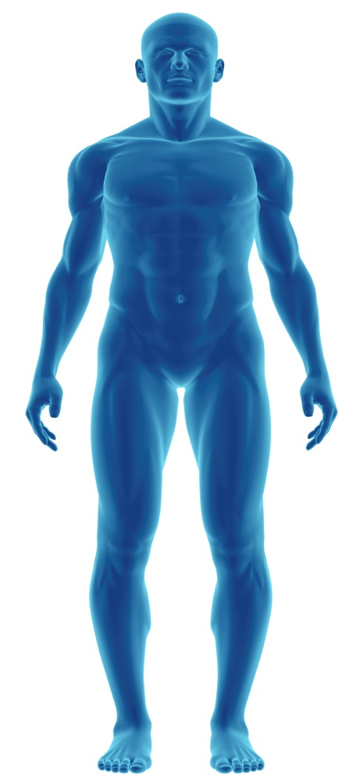
Penis Erection Process
Nerve signals in brain
When men become sexually aroused, a number of hormones, muscles, nerves, and blood vessels all work in conjunction with one another to signal an erection.
Send to penis
Muscles in penis relax;
Blood flow to penis tissue

Slide 17
Penis Erection Process
Penis Erection Maintain
Following Sexual Arousal
Once an erection is achieved, the blood vessels to the penis close off, so that the erection can be maintained
Following sexual arousal, the veins in the penis again open up allowing the blood to leave.

Slide 18
CONTENTS
PART 1
PART 2
PART 3
PART 4
Concern About Sexual Performance
Penis Erection
Erectile dysfunction
BF Suma
X power man Capsule

Slide 19
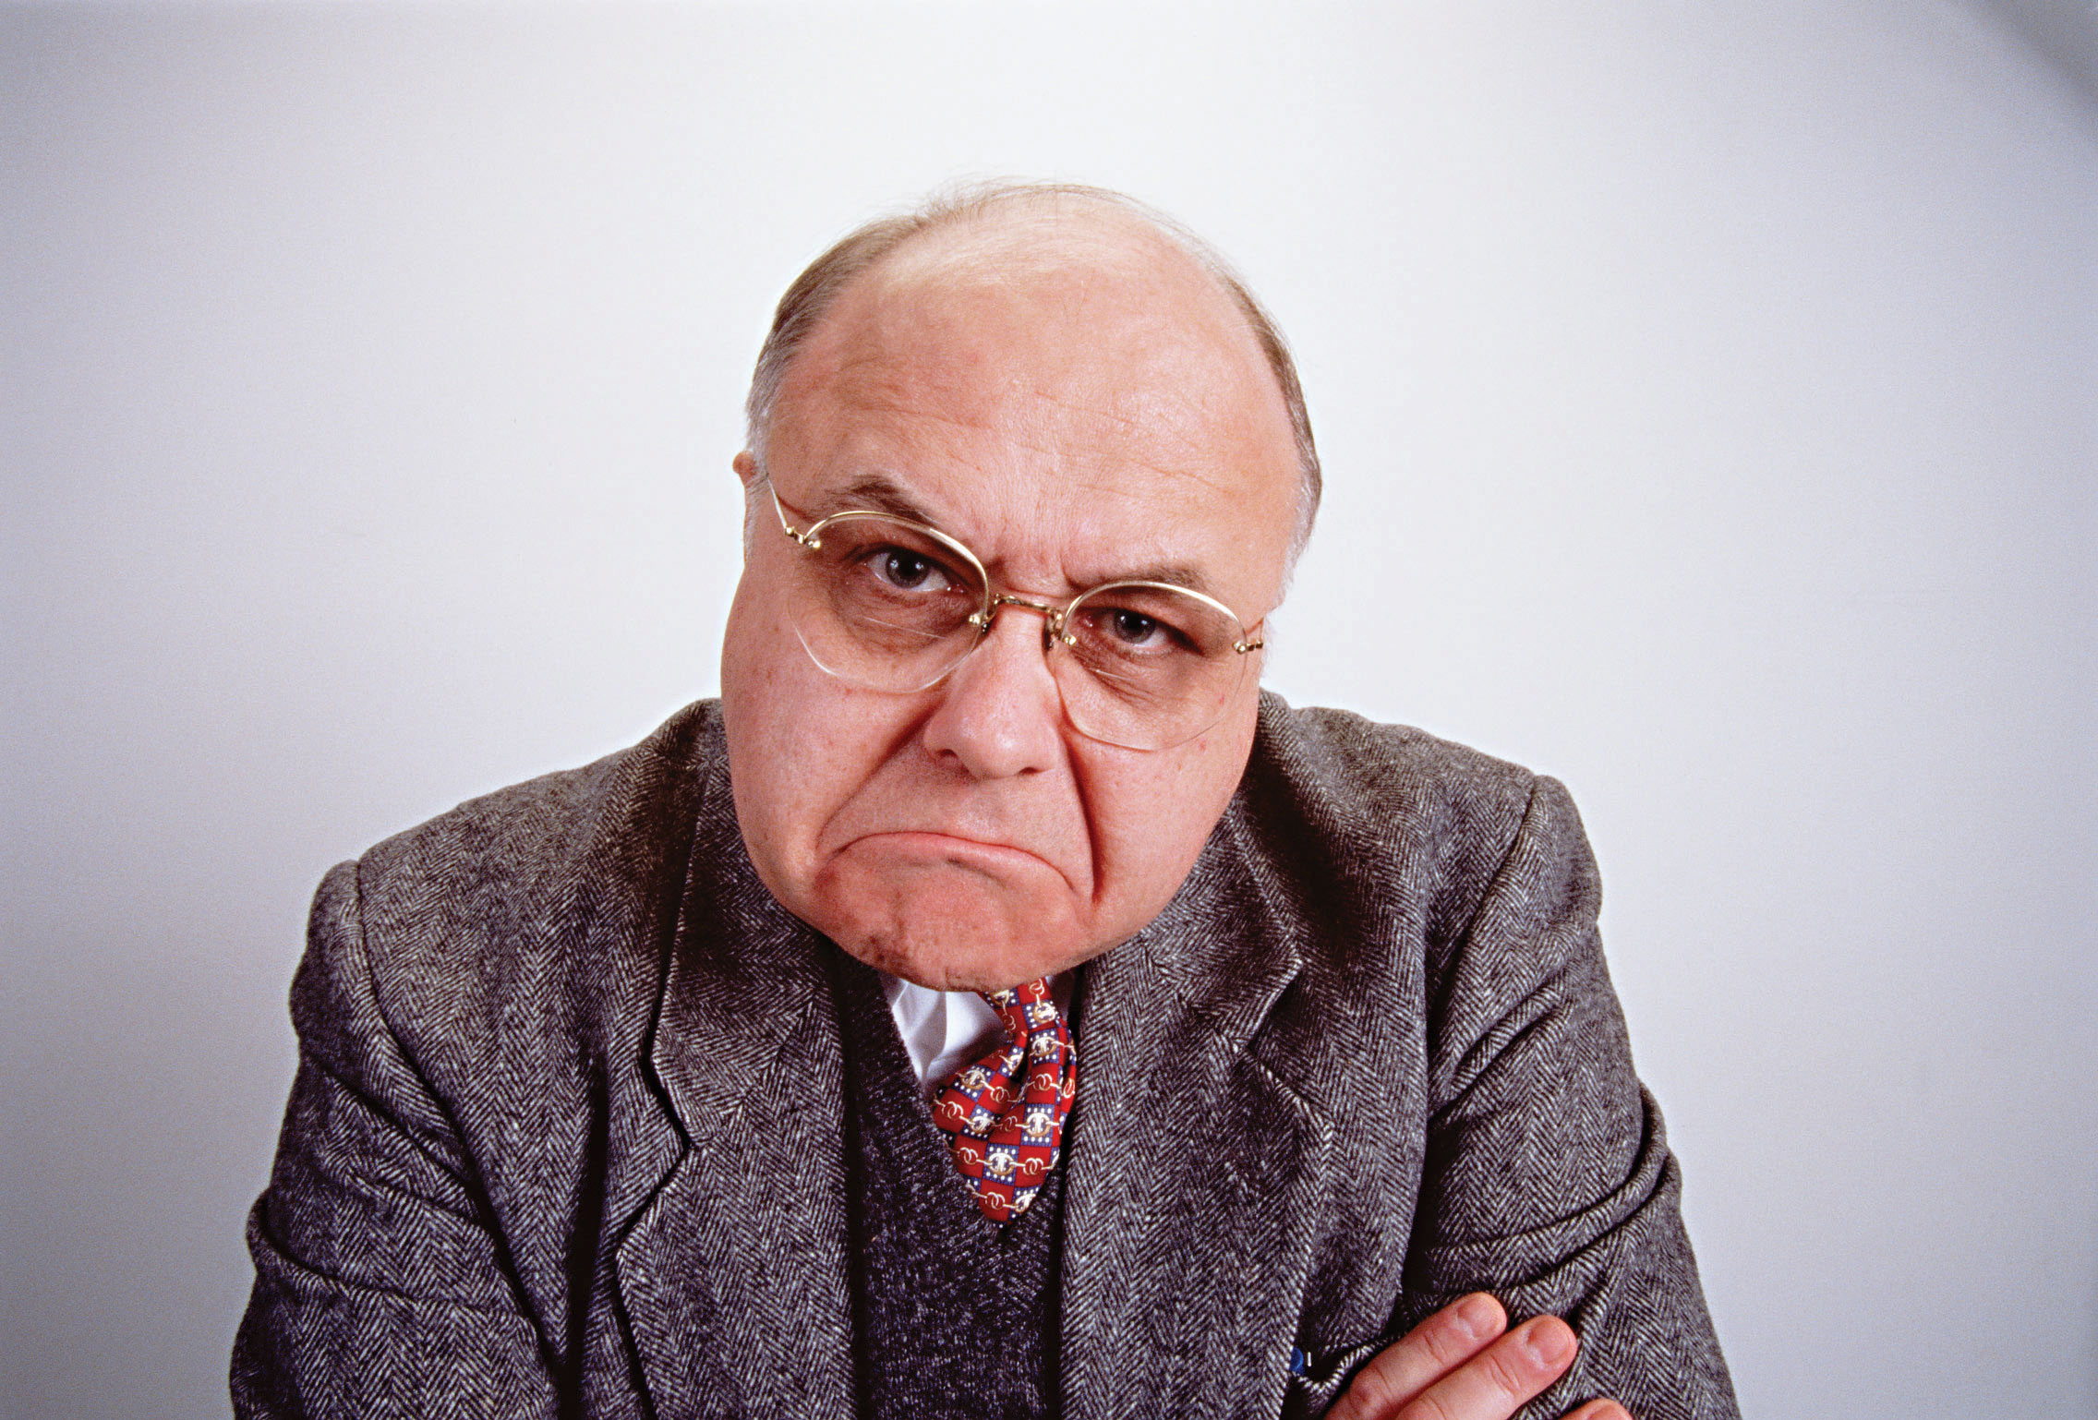
Erectile Problem
At some time, men may have difficulty achieving or maintaining an erection.
For most men, this problem occurs occasionally and is not a serious issue.
Poor performance on bed

Slide 20
However
If a man is unable to achieve an erection 25 % of the time or more, he may have a health problem that requires medical attention.
Erectile Dysfunction (ED)
Erectile problems occur when a man cannot achieve an erection that is firm enough to have sexual intercourse.

Slide 21
Data From
National Institute of Health
Experiencing Erectile Dysfunction
5% of 40-year-old men
25% of 65-year-old men

Slide 22
Why ED?
The blood circulation into the penis not adequate.
There is no stimulus from the brain.
1
2
3
4
The nerves to the penis not functioning well.
The veins unable to "trap and keep" the blood inside the penis.

Slide 23
Common Causes of Erection Problems
Physiological
Reasons
Psychological
Reasons
Causes of ED

Slide 24
Physiological
Reasons
Diseases
Heart disease
High blood pressure
High cholesterol
Diabetes
Obesity
Atherosclerosis (hardening of the arteries)
Parkinson’s disease
Peyronie’s disease(development of scar tissue in the penis, causing painful erections)
Use of certain medications, including diuretics, muscle relaxers, or antidepr Injury to the spinal cord or genital region
essants
Liver or kidney disease
Bad Hobbies
Alcoholism abuse
Tobacco use

Slide 25
Psychological
Reasons
Depression
Work stress
Anxiety
Relationship problems

Slide 26
ED Is Harmful!
Relationship problems
Stress and Anxiety
Affect male fertility

Slide 27
ED Affects Couples’ Relationship
Erectile dysfunction
Self-esteem
Loss of sexual desire
Reduce the times of sexual intercourse
Bad couples’ relationship
Wife Infidelity
Finally lead to divorce

Slide 28
Divorce Report
Investigation: People’s Reasons for Divorcing
Launched by: The Pennsylvania State University
Duration: Between 1980 and 1997
No. of Respondents: 208
Results: See the table on the next slide

Slide 29
Percentage of Responses and Respondents
Causes of Divorce

Slide 30
Report Analysis
The result shows that infidelity is the main reason of divorce. The cases of infidelity women is 1.5 times more than that of men’s.
Men’s poor sexual performance lead to women not getting enough during sexual intercourse. This greatly affects the intimate relationship and needed to pay high attention.

Slide 31
ED Intensifies Stress & Anxiety
A
Erectile Dysfunction
Psychological reasons such as stress and anxiety may lead to ED.
A
B
Stress & Anxiety
Vicious cycle
In turn, ED may aggregate stress & anxiety, such as lack of energy, difficulty concentrating. the patient will get backache, chills and other symptoms.
B

Slide 32
ED Affects Male Fertility
ED can be divided into mild, moderate and severe.
Mild ED men can barely complete sexual intercourse but with low quality of sperms. Not guarantee fertilize a healthy baby.
Severe ED men cannot complete sexual life so that sperm cannot combine with the egg. Unable to complete the conception that affect the fertility.

Slide 33
How to improve sexual performance?
BF Suma
Gives you advices

Slide 34
Maintain a healthy body status, improve blood circulation to penis
Getting plenty of rest
Eating a healthy diet
Exercising regularly

Slide 35
Maintain a relaxing and positive attitude
Try to relief stress, try to relax.
For psychological caused sexual problem, it is better to find a professional psychiatrist.
Talking with your wife about sexual issues.

Slide 36
Active treatment for physiological diseases
If erectile problem is caused by disease:
Heart disease
Diabetes
High blood pressure
…
You need to treat the disease positively.

Slide 37
Nutritional Supplements
Choose good quality
& functional nutritional supplement to boost sexual performance.

Slide 38
CONTENTS
PART 1
PART 2
PART 3
PART 4
Concern About Sexual Performance
Penis Erection
Erectile dysfunction
BF Suma
X power man Capsule

Slide 39
THE
EXTRA POWER
FOR MAN

Slide 40
Ingredients
Fresh Maca
Prostaep-III
Vitamin B1

Slide 41
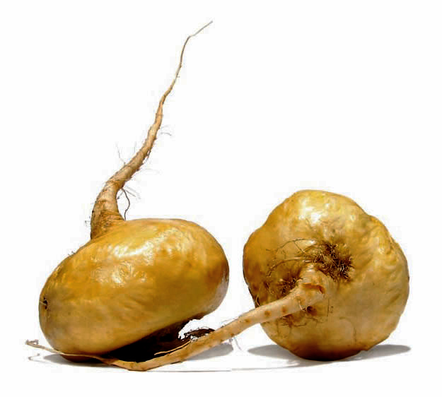
Ingredient
– Maca
Maca, which is widely used in Peru, can energize the body and helps to boost sex drive.
Maca’s capability to increase in men:
Semen volume
Sperm count
Sperm motility
South America
Peru

Slide 42
Ingredient
– Prostaep-III
It is herb extract that contain epimedii extract, flavonoids & polysaccharides.
Prostaep is our BF Suma’s patent.

Slide 43
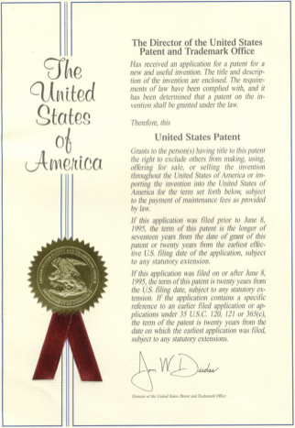
International Patents for Prostaep
India
Korea
USA
China

Slide 44
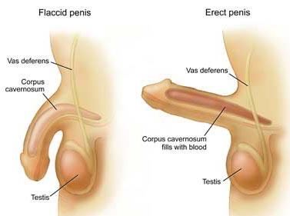
Prostaep Mechanisms
Improve penile blood vessel dilatation
Improve blood flow into the penis
Stimulate sexual arouse

Slide 45
Ingredient
– Vitamin B1
Promote blood sugar transform into energy
Maintain body vitality
Maintain healthy nervous system, heart, blood and muscle function.

Slide 46
Product Superiority
More Natural
Better Absorption
06
1
2
04
5
03
02
3
Much
Safer
4
Higher Concentration
More
Effective

Slide 47
Product Superiority
More Natural
BF Suma select top grade fresh Maca and natural herbal Epidermii.

Slide 48
Product Superiority
Easier Absorption
100% BETTER
VS
Other similar product’s absorption
BF Suma product’s absorption

Slide 49
Product Superiority
Higher Concentration
High concentration & scientific ratio of active ingredients.

Slide 50
Product Superiority
More Effective
Enhance sexual performance
Boosting sex drive
Promote semen secretion and maintain healthy reproductive system

Slide 51
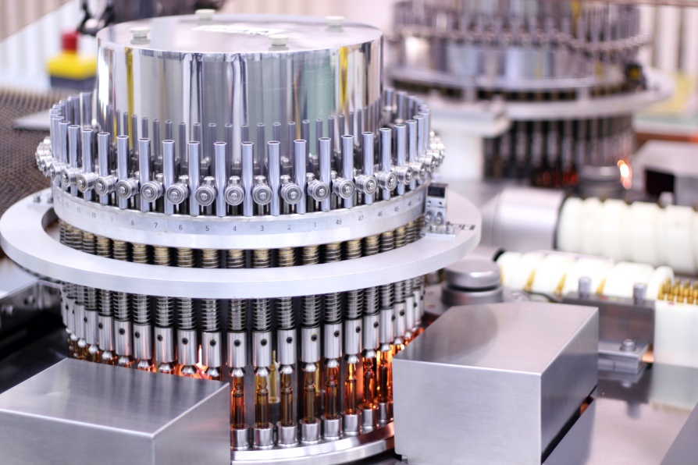
Product Superiority
Safer
Strictly manufactured in accordance to GMP regulation.
Advance technology guarantee the activity of ingredient.

Slide 52
Product Functions
Enhance sexual performance
Boosting sex drive
Promote semen secretion and maintain healthy reproductive system

Slide 53
APPLICATIONS
Recommend for men who want to improve overall sexual performance.
For men who need to improve semen quality.
For men to prevent erectile dysfunction.

Slide 54
USAGE
1-2 capsules daily after meal.
It may take 2-3 weeks to see the noticeable benefits.
Fit for adults men.
Prohibit for children.

Slide 55
Q & A
Q1: Can X Power Man Capsules increase my penis’s length?
A1: The main function of X Power Man Capsules is helping to improve sexual performance but not increasing penis’ s length.
In fact, the penis’s length is decided by genetic and acquired physical growth.
For any products which claim to increase adults’ penis length, you should confirm their real mechanisms with professionals.

Slide 56
Q & A
Q2: Can X Power Man Capsules prolong men’s sexual intercourse?
A2: X Power Man Capsules helps to prevent erectile dysfunction by promoting blood flow to penis.
Good blood circulation is beneficial to the overall body health.
If body maintains at a healthy and functional status, each system including fertility system will have a better performance.

Slide 57
Q & A
Q3: How long should I intake the X Power Man Capsules to get an obvious effect?
A3: It may take 2-3 weeks to see the noticeable benefits.
At the same time, you should also
Getting plenty of rest
Eating a healthy diet
Exercising regularly
Having relaxation

Slide 58
Make you confidence!
Make your woman obsessed with you!

Slide 59
THANK YOU !
Email: info@bfsuma.com
Website: www.bfsuma.com
Tel: 1-626-287-4700

