Slide 1
Refined Yunzhi Essence
BF Suma Ghana TOT
11-Feb-2017

Slide 2
CONTENTS
PART 1
Immunity
PART 2
Cancer
PART 3
Yunzhi
PART 4
Refined Yunzhi Essence

Slide 3
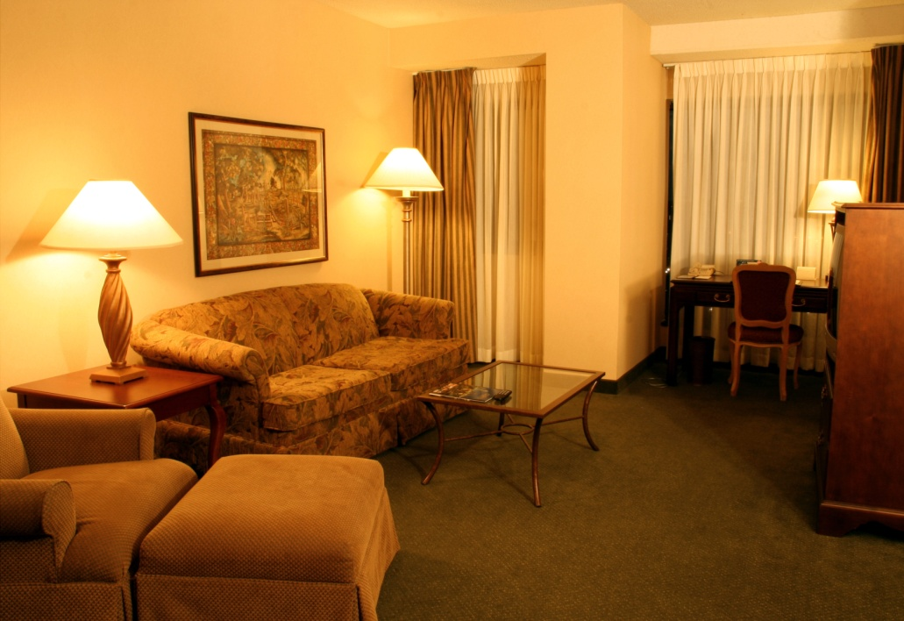
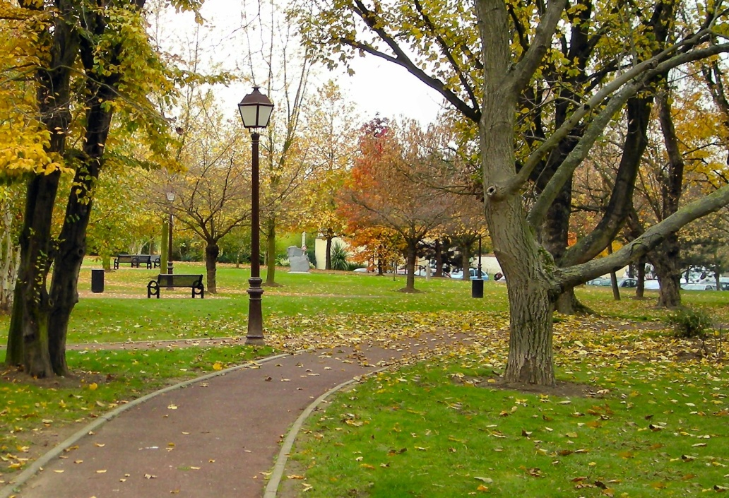
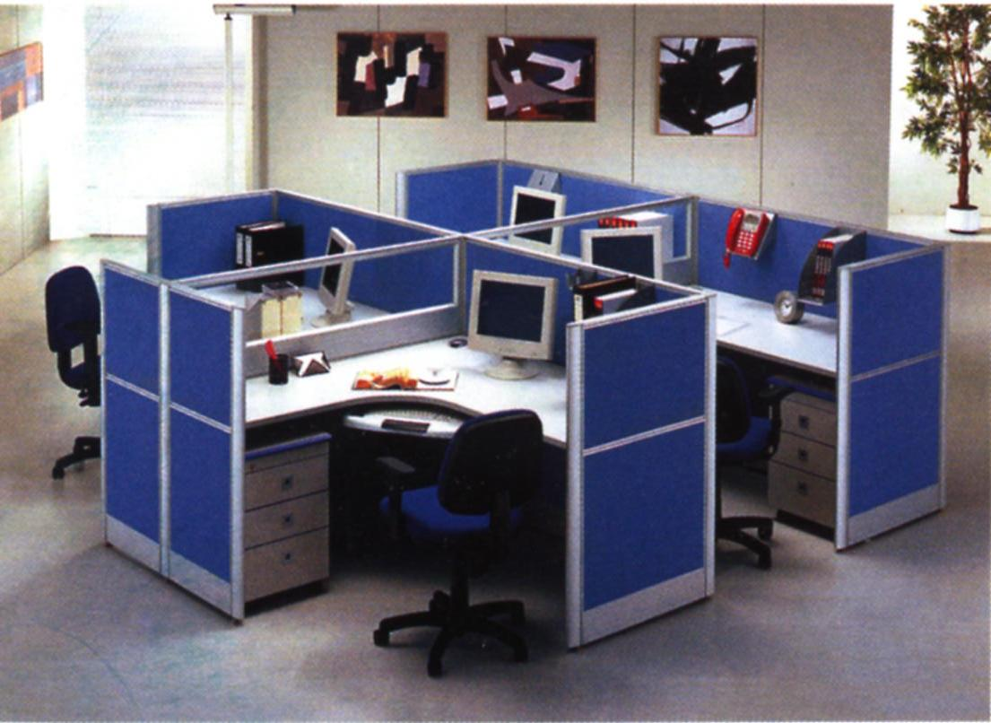
What kind of danger & threaten?
The environment we are living seems safe and calm.
However, it hides danger and threaten…

Slide 4
The air we breath contains a lot of microorganisms.
They are tiny, large amount and invisible unless using the optical microscope or electron microscope to enlarge their size to hundred or thousand times.
Some microorganisms are pathogens, which are harmful for our body health, while some are not.

Slide 5
Major Diseases Caused By Pathogens
PATHOGENS | DISEASES | ORGANS AFFECT | TRANSMISSION
Bacteria | Bubonic plague | Lung | Rats and fleas
 | Cholera | Intestine | Food and water
 | Pertussis | Immune system | Air
 | Typhoid fever | Intestine, skin | Contact Flying insects

Slide 6
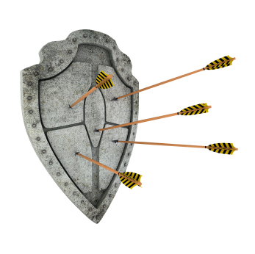
IMMUNE SYSTEM
– the defense warrior of human health
People born with immune system.
Immune system protects body from viruses, bacteria and harmful fungus’ invasion.
99% human diseases are related to immune system.

Slide 7
CONTENTS
Part 2
Cancer
PART 1
Immunity
Part 3
Yunzhi
Part 4
Refined Yunzhi Essence

Slide 8
CANCER & IMMUNITY
– direct relationship
Low Immunity
Strong Immunity
Internal
Cancer
Hepatitis…
External
Infection of virus, bacteria, fungi, parasites
Health body
Not easy to get illness
Immunity

Slide 9
All people are potential cancer patients, but most of the cancer cells in the human body under the control of the immune system and stay in a repressed state.
Everyday, about 300 cells may happen to mutant. Genetic mutation will increase to more than 3,000 times a day with age.
Any of the 60 trillion cells in body may mutant.

Slide 10
Team
No. 1
Unhealthy
lifestyle
Vicious circle
Wastes
Accumulate
in
cells
Organs’
Functions
Become
unhealthy
Health
Tumor
Cancer
Die

Slide 11
Cancer is a main reason causing death.
DATA & STATISTICS
7.6 million death for cancer, more than 10% of total.
THE DEATH TREND
13.1 million
7.6 million
56 million death in 2008
2008
2013

Slide 12
Top 10 cancer types for male in 2008
DATA & STATISTICS
RANK | TYPE | % OF ALL CANCERS
1 | Lung | 16.5
2 | Prostate | 13.6
3 | Colorectum | 10.0
4 | Stomach | 9.7
5 | Liver | 7.9
6 | Oesophagus | 4.9
7 | Bladder | 4.4
8 | Non-Hodgkin lymphoma | 3.0
9 | Leukaemia | 3.0
10 | Lip, oral cavity | 2.6

Slide 13
Top 10 cancer types for female in 2008
DATA & STATISTICS
RANK | TYPE | % OF ALL CANCERS
1 | Breast | 22.9
2 | Colorectum | 9.4
3 | Cervix uteri | 8.8
4 | Lung | 8.5
5 | Stomach | 5.8
6 | Corpus uteri (endometrium) | 4.8
7 | Liver | 3.7
8 | Ovary | 3.7
9 | Thyroid | 2.7
10 | Non-Hodgkin lymphoma | 2.6

Slide 14
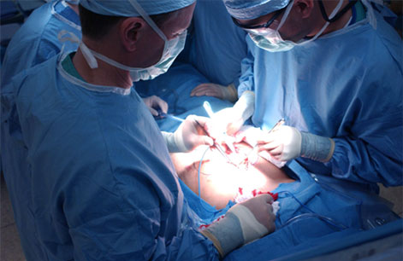
TREATMENTS FOR CANCER
Danger
Outcome highly depends on physicians skills
It is risky to remove tumor near brain & large vessels.
May induce complication and potential recurrence of tumor in future.
Surgery

Slide 15
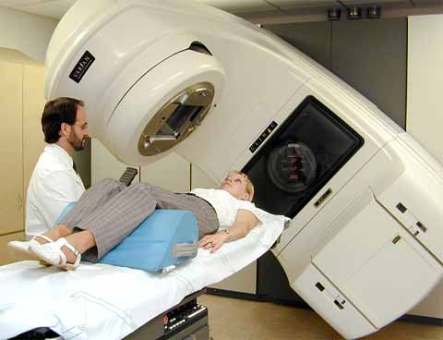
TREATMENTS FOR CANCER
Radiotherapy
Inevitable damage to normal tissue , suppress immune system and poor performance to tumor which insensitive to radiation.
Danger

Slide 16
TREATMENTS FOR CANCER
Chemotherapy
Current drugs for chemotherapy are very toxic to normal cells.
There is a long way to develop drugs of “high efficiency but low toxicity“.
Danger

Slide 17
Ways to deal with cancer:
Prevent

Slide 18
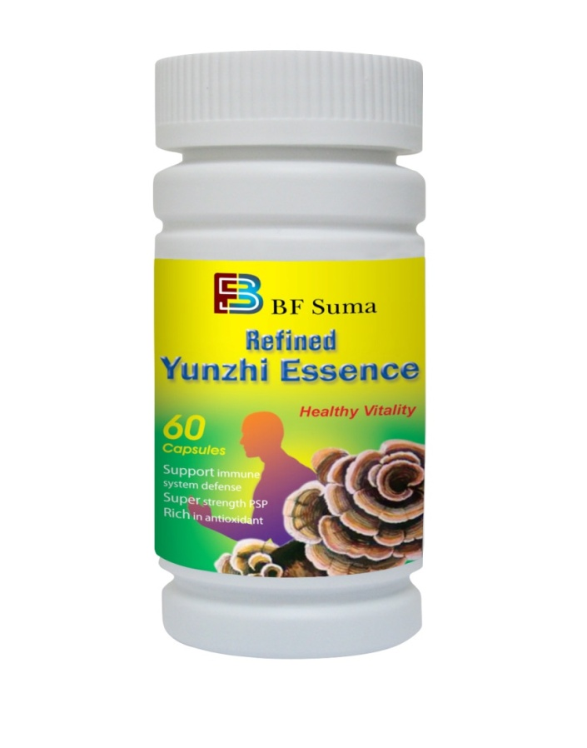
Best Solution=
+
Healthy Lifestyle
Nutritional Supplements

Slide 19
Healthy lifestyle
Good
sleep
Physical
exercise regularly
Eat
vegetables everyday
Keep
good
mood
Say “ NO”
To
fried food
Drink
Water
on time

Slide 20
Nutritional
Supplement =
Choose good quality
& functional nutritional supplement to strengthen immunity.

Slide 21
CONTENTS
Part 3
Yunzhi
PART 1
Immunity
Part 2
Cancer
Part 4
Refined Yunzhi Essence

Slide 22
Yunzhi
Latin name: Trametes versicolor

Slide 23
In western world, Yunzhi is a mushroom known as “ turkey tail” because its fun shape resembles the tail of a standing turkey.
Yunzhi is striped with dark-to -light brown bands that alternate with bands of orange, blue, white and tan.
Yunzhi prefers to grow on dead logs.

Slide 24
MAIN FUNCTIONS OF Yunzhi
Strengthen immune system
Reduce chemotherapy side effects
Enhance appetite

Slide 25
Yunzhi Function 1:
Strengthen Immune System
Enhance vitality
&
More energetic
Strengthen Immune System
Reduce illness

Slide 26
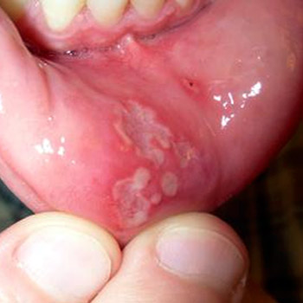
Yunzhi Function 2:
Reduce chemotherapy side effect
Chemotherapy is able to kill cancer cells, but it also effect body health.
Susceptible to infection
White blood cell decrease
Side effects
Mouth ulcers
Hair loss
Nausea

Slide 27
Yunzhi Function 3:
Enhance appetite
Mentally and physically diseases may reduce the appetite.
Yunzhi helps body maintain health and enhance appetite.

Slide 28
CONTENTS
Part 4
Refined Yunzhi Essence
PART 1
Immunity
Part 2
Cancer
Part 3
Yunzhi

Slide 29
Refined
Yunzhi Essence
A
PRECIOUS GIFT
INFUSED WITH NATURE

Slide 30
INGREDIENT
Contain high concentration of Yunzhi essence.
The active component containing in Yunzhi essence is PSP(polysaccharide-peptide)

Slide 31
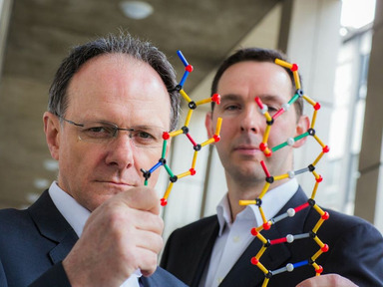
The National Cancer Research Center in the United States has declared PSP a fungous anti-cancerous substance.
MECHANISM
PSP helps to improve immune system for
Cancer patients before surgical treatment
Cancer patients after chemotherapy, radiotherapy.
PSP stimulates the immune cell proliferation;
PSP reduces the toxic side effects of chemotherapy.
Reduce the toxic effect on bone marrow
Such as anemia, susceptibility to infection.

Slide 32
PRODUCT SUPERIORITY
More Natural
Higher concentration
Safer
Easier absorption
More effective

Slide 33
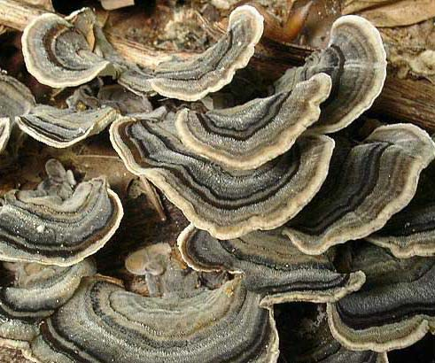
Product Superiority
More Natural
BF Suma select top grade natural yunzhi.
The area cultivating Yunzhi is under Good Agricultural Practice(GAP) regulation.

Slide 34
Product Superiority
Easier Absorption
100% BETTER
VS
BF Suma product’s absorption
Other similar product’s absorption

Slide 35
Product Superiority
Higher Concentration
High concentration of active ingredient PSP(polysaccharide-peptide)

Slide 36
Product Superiority
More Effective
Anti cancer
Reduce side effects of chemotherapy
Revitalize immunity.

Slide 37
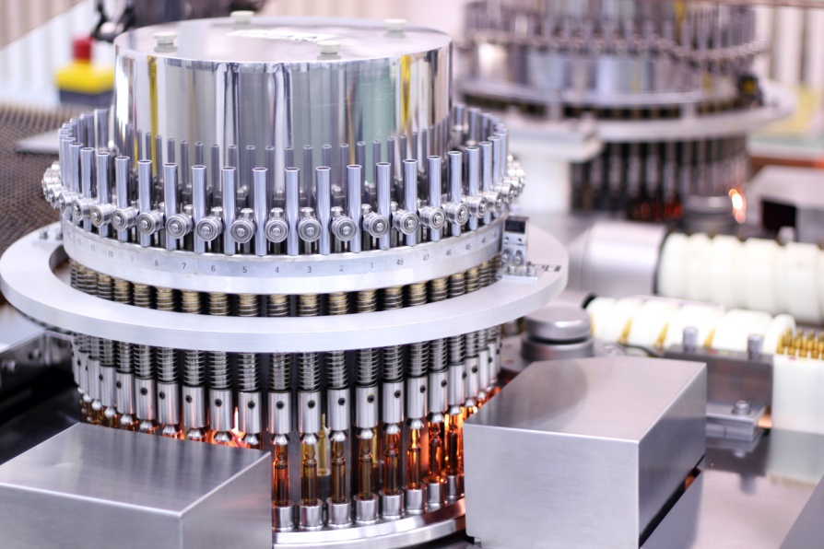
Product Superiority
Safer
Strictly manufactured in accordance to GMP regulation.
Advance technology guarantee the activity of ingredient.

Slide 38
PRODUCT FUNCTIONS
Strengthen Immune System
Reduce Chemotherapy Side Effects
Functions
Enhance Appetite

Slide 39
APPLICATIONS
Refined Yunzhi Essence apply to
FOLLOWING PEOPLE
Cancer Patients receiving chemotherapy and radiation therapy
People recovery from a major surgery, such as remove an organ and so on.
Healthy people to enhance immune system and reduce illness

Slide 40
USAGE
For normal people who strengthen immunity, take 2 capsules twice daily;
For cancer patients who during chemotherapy treatment, double dose;
It is better to continually take this product for 6-8 months after chemotherapy treatment.
Fit for adults and the elderly people.
Not recommend to infants and children.

Slide 41
Revitalize cancer patients!

Slide 42
THANKS FOR WATCHING
Africa Marketing Department 2016 Q3

