Slide 1
Pure & Broken Ganoderma Spores
BF Suma Ghana TOT
11-Feb-2017

Slide 2
CONTENTS
CONTENTS
01
02
03
Immune system
Pure & Broken
Ganoderma Spores
Ganoderma

Slide 3
ARE
WE
WELL PROTECTED
?

Slide 4
WHO
PROTECT
US
?

Slide 5
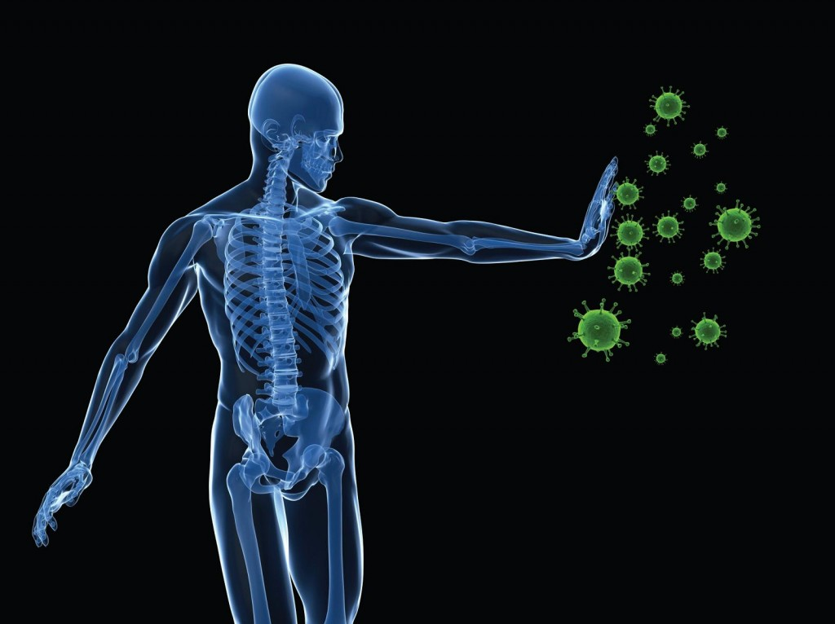
WHAT HELP OUR
BODIES
DEFEND
VIRUSES?

Slide 6
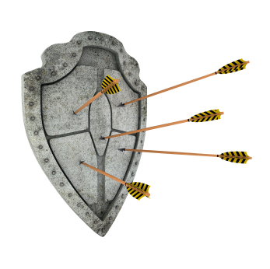
IMMUNE SYSTEM
– the defense warrior of human health
People born with immune system.
Immune system protects body from viruses, bacteria and harmful fungus’ invasion.
99% human diseases are related to immune system.

Slide 7
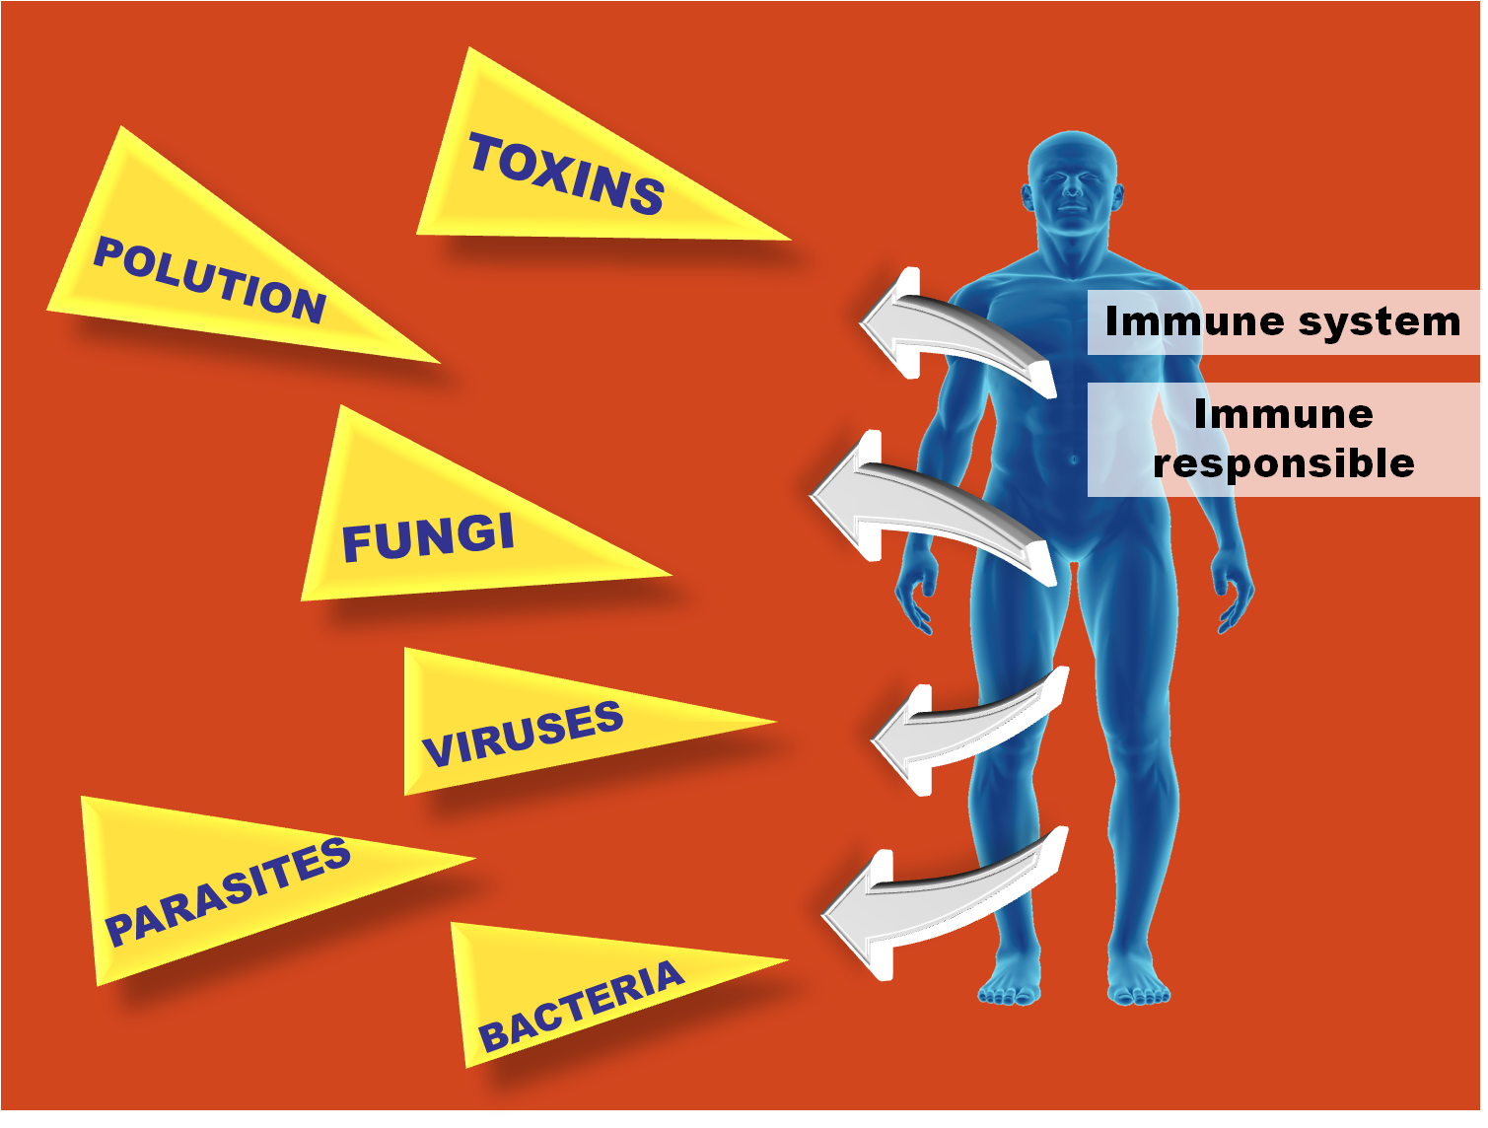

Slide 8
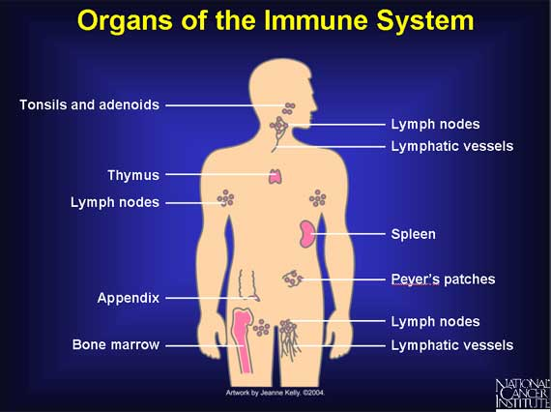
COMPONENTS OF IMMUNE SYSTEM
Immune Organs
Immune Cells
Lymphocytes
Immune
Molecular
Immunoglobulin
and
Cell factors

Slide 9
THREE DEFENSE LINES OF
IMMUNE SYSTEM
Physical defense
White blood cell
Lymphocytes
( a kind of white cell)

Slide 10
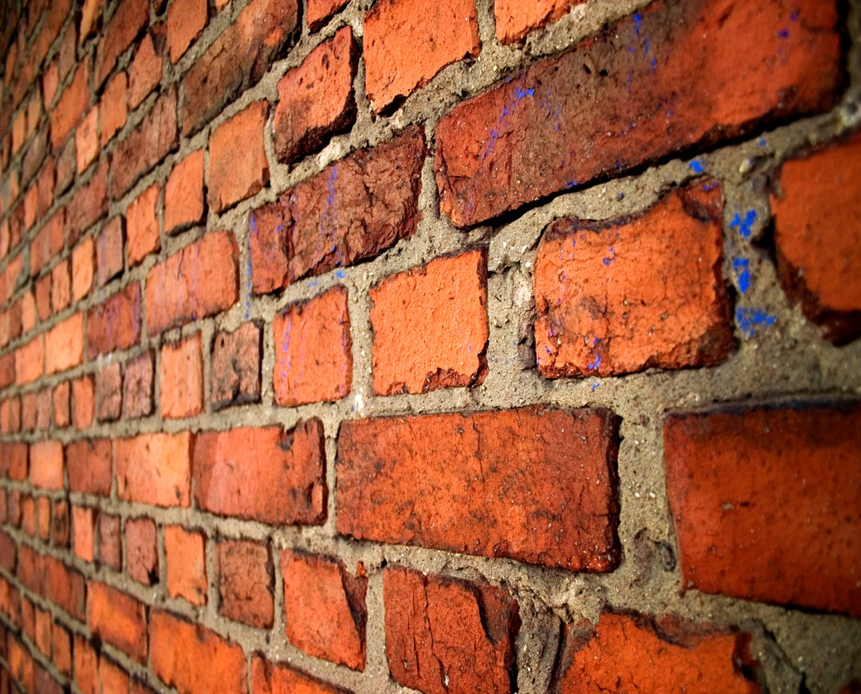
THE FIRST LINE
Physical defense
Consists with skin, secretions, mucous membranes.
The first line is like a wall that block the pathogens outside of body.

Slide 11
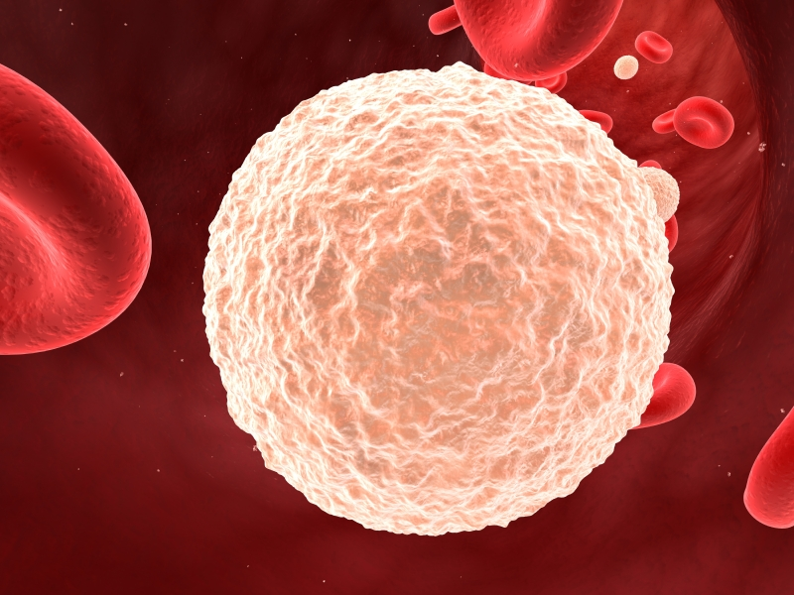
THE SECOND LINE
White blood cells
(white cell in blood)
When pathogens pass through first line and enter into body, white blood cells begin to work.
White blood cells “eat” and decompose the pathogens.
In blood test
High white blood cell → inflammation
Low white blood cell → poor immunity

Slide 12
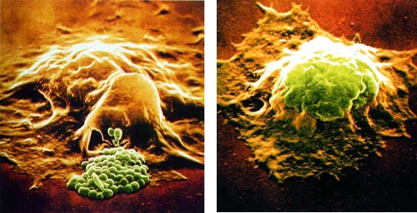
THE SECOND LINE
Phagocytes
(white cell in tissues)
Phagocytes swallow the pathogens, digest and finally kill them.

Slide 13
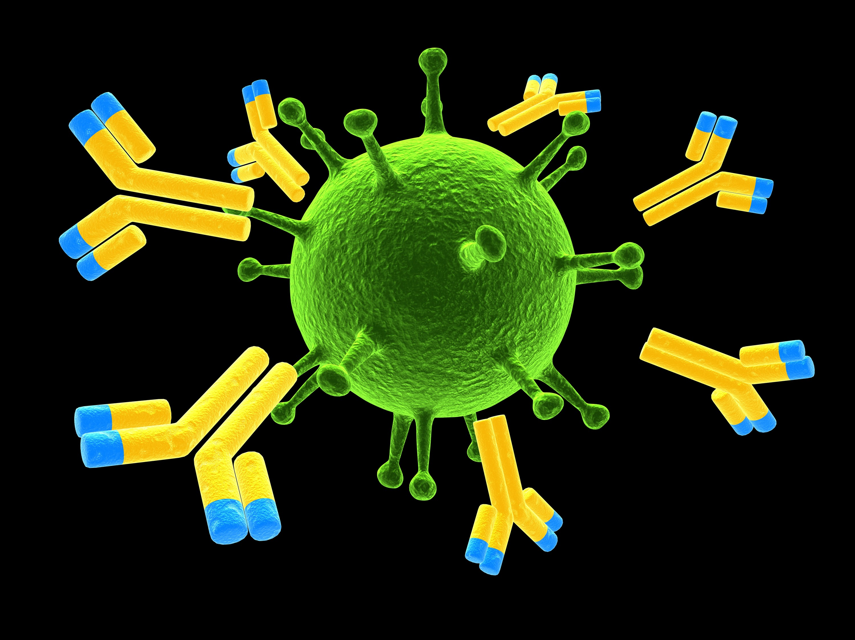
THE THIRD LINE
Activating lymphocytes
Producing Antibody
When the second line find it is difficult to kill the pathogens, the third defense line activates.
Antibodies bind pathogens and induce other killing cells to kill the pathogens.

Slide 14
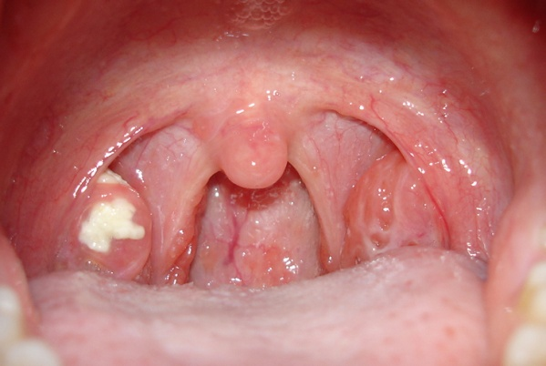
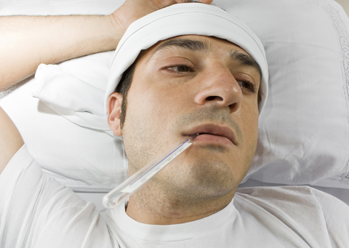
The first two lines of defense happen in local area of body, and its symptoms are redness, swelling, swelling, pain and inflammation.
Inflammation in Tonsil
The third line of defense happen with systematic reactions. The clinical symptom is fever.

Slide 15
FUNCTIONS OF IMMNUE SYSTEM
Immune system
Against
infection
Anti-aging
Maintain
health
Prevent
cancer

Slide 16
HARM OF LOW IMMUNITY
More easy to catch a cold.
More easy to get flu.

Slide 17
HARM OF LOW IMMUNITY
Aging faster than their peers with good immunity.

Slide 18
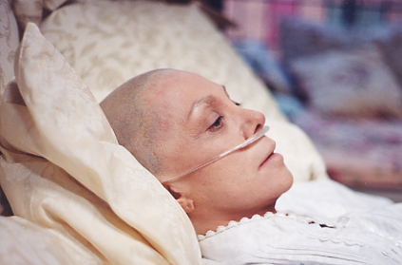
HARM OF LOW IMMUNITY
Increase the risk of cancer

Slide 19
How about your immune system?
Do a self-assessment right now!
Do you have the below symptoms?
Easy to catch a cold and illness long lasting.
The cut is difficult to heal.
Ineffective after eating drugs.
Usually feel tired and lack of energy.
Backache.
Lot of hair loss without reasons.
WARNING
These symptoms may indicate the low immunity.

Slide 20
BF SUMA
MAKE SUGGESTIONS
TO
STRENGTHEN IMMUNE SYSTEM

Slide 21
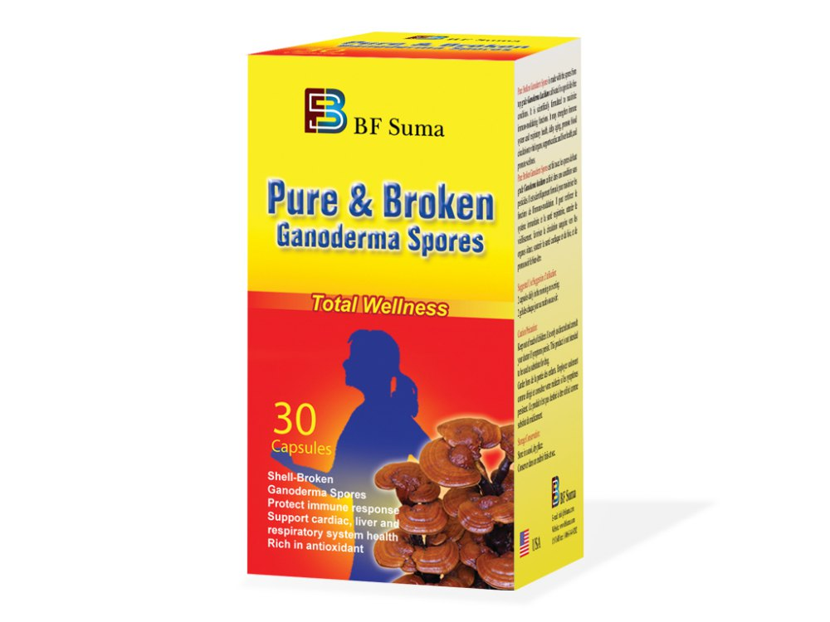
Best Solution=
+
Healthy Lifestyle
Nutritional Supplements

Slide 22
Healthy lifestyle
Good
sleep
Physical
exercise regularly
Eat
vegetables everyday
Keep
good
mood
Say “ NO”
To
fried food
Drink
Water
on time

Slide 23
Nutritional
Supplement =
Choose good quality
& functional nutritional supplement to strengthen immunity.

Slide 24
CONTENTS
CONTENTS
01
02
03
Immune system
Pure & Broken
Ganoderma Spores
Ganoderma

Slide 25
Ganoderma lucidum

Slide 26
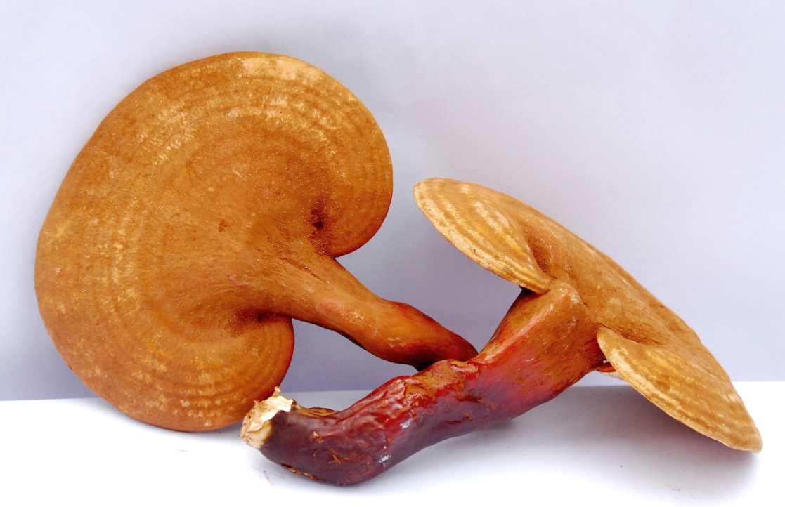
THE KING OF HERB
– GANODERMA LUCIDUM
The plant in the picture is called Reishi in China and Japan.
It is known as “Ten-Thousand-Year Mushroom” and “Mushroom of Immortality” because it is said to promote longevity.
Ganoderma lucidum is the Latin name of Reishi.
“One of the most important elixirs in the Orient”
– said by Hiroshi Hikino, a professor of University of Tahoka, in Japan.

Slide 27
MAIN FUNCTIONS OF GANODERMA LUCIDUM
1. Strengthen immune system
2. Maintain liver health function
3. Anti-aging

Slide 28
Ganoderma Function 1: Strengthen Immune System
Reduce the risk of catching cold & flu
1.1
Strengthen immune system
Decrease the risk of cancer
Ganoderma Lucidum
1.2
Help to reduce the side effects of radiation therapy
1.3

Slide 29
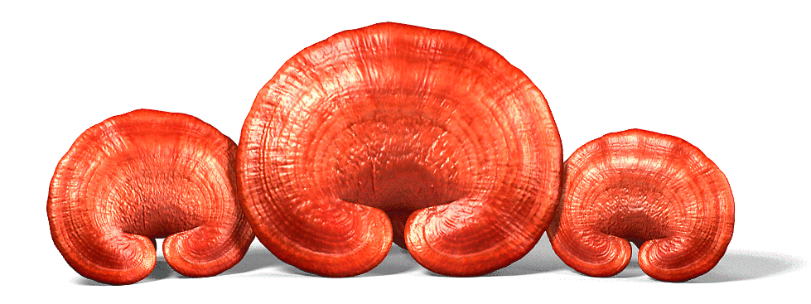
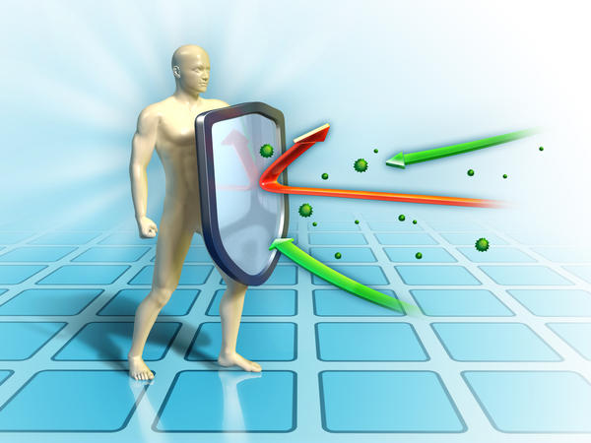
1.1
Reduce the risk of catching cold & flu
Ganoderma strengthen immune system and vitalize the immune cells.
Strong immunity is able to effectively resist pathogens’ invasion.
Cold & flu are caused by the virus.

Slide 30
Reduce the risk of other diseases caused by cold
1.1
If one’s immunity is weak, and if he catches a cold, his risk of get other diseases is very high.
The pathogens may invade into other organs and cause problems.
Strong immunity help body heal within 1 week after catching a cold.
Strong immune system kills the pathogens on time and reduces the risk of other diseases.

Slide 31
1.2
Decrease the risk of cancer
All people are potential cancer patients, but most of the cancer cells in the human body under the control of the immune system and stay in a repressed state.
Everyday, about 300 cells may happen to mutant. Genetic mutation will increase to more than 3,000 times a day with age.
Any of the 60 trillion cells in body may mutant.

Slide 32
Unhealthy
lifestyle
Team
No. 1
Organs’
Functions
Become
unhealthy
Vicious circle
Wastes
Accumulate
in
cells
Health
Tumor
Cancer
Die

Slide 33
1.2
Decrease the risk of cancer
Ganoderma would not kill cancer cells.
Ganoderma help to boost immune system.
Strong immunity monitor the unhealthy cell and clean them that reduce the risk of cancer.

Slide 34
1.3
Help to reduce the side effects of radiation therapy
Cancer cells
kill
Radiation therapy to cancer patients
White blood cells
(radiation’s side effect)
kill
Ganoderma improves immune function by keeping the production of white blood cell from dropping in spite of radiation.

Slide 35
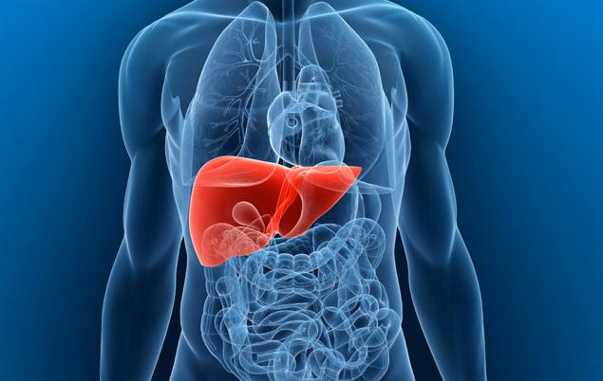
Ganoderma Function 2:
Maintain liver health function
Liver is one the most important organs in human body. It is responsible for synthesis, metabolism, detoxification, immunity and so on.
Ganoderma nourish and revitalize the liver cell. It maintain the liver’s healthy function.

Slide 36
Ganoderma Function 3:
Anti-aging
Anti-aging
Antioxidant → aging slow
Improve the DNA synthesis and cell deviation → aging slow

Slide 37
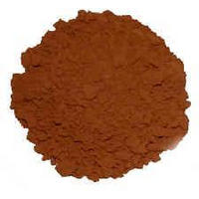
Ganoderma Spore Is Precious
100 kg Ganoderma
1 kg
Ganoderma
Spore powder
Can only extract out

Slide 38
Ganoderma Spore Is Highly Effective
Polysaccharide
(the active component)
amount in Ganoderma spore
Polysaccharide amount in Ganoderma
is 70 times than

Slide 39
IN SHORT
Ganoderma spore ≠ Ganoderma
Ganoderma spore ≠ Ganoderma Essence
Ganoderma spore = Essence of Ganoderma
Essence

Slide 40
MECHANISM
Ganoderma contains polysaccharide
Polysaccharide helps to
Vitalize the immune cells
Nourish the liver cells

Slide 41
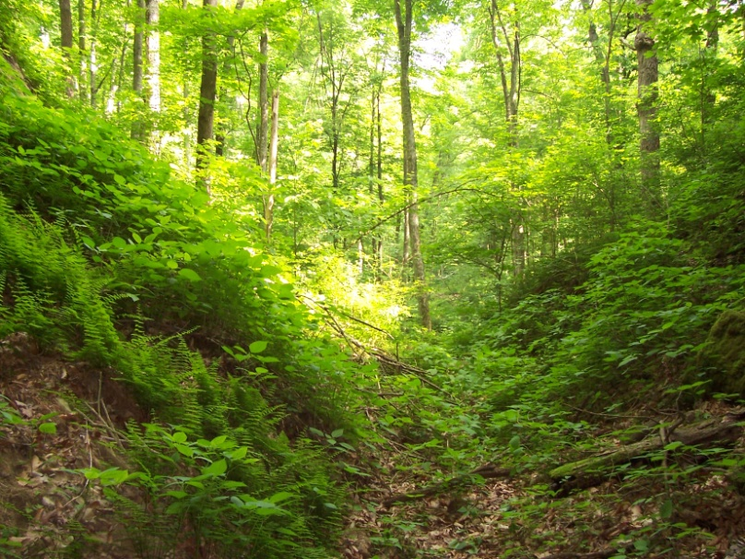
MANUFACTURING STRENGH
Featured Ganoderma plants source from pure & unpolluted nature
Pure nature

Slide 42
MANUFACTURING STRENGH
Revolutionary technique in achieving 99.9% breakage of walls
Scientifically process
Break spore wall
Nano-technology in refinery
Micronization
Anti-aggregation

Slide 43
PRODUCT FUNCTIONS
Pure & Broken
Ganoderma Spores
Boost immune system
Reduce side effects of radiation for cancer patients
Maintain liver health
Prevent cancer
Anti-aging

Slide 44
APPLICATIONS
Poor immunity people
People who is recovering from surgery
People who want to prevent cancer
People who have cancer and taking the radiotherapy or chemotherapy
Cardiovascular disease, diabetes, liver disease, bronchitis patients
Neurasthenia, insomnia, anxiety, memory loss, fatigue syndrome persons
Pigmentation, age spots increases, the need to slow down aging, longevity people

Slide 45
USAGE
2 capsules daily in the morning or evening.
Fit for adults and the elderly people.
Not recommend to infants and children.
People who surgery within a week and bleeding patients should not take.

Slide 46
Ganoderma Function 3:
Anti-aging
strong immunity → energetic → aging slow
Anti-aging
Antioxidant → aging slow
Improve the DNA synthesis and cell deviation → aging slow

Slide 47
CONTENTS
CONTENTS
01
02
03
Immune system
Pure & Broken
Ganoderma Spores
Ganoderma

Slide 48
PURE & BROKEN GANODERMA SPORES
A SELECT GIFT
INFUSED WITH NATURE

Slide 49
INGREDIENT
Pure & broken ganoderma spore powder
Contain high concentration of polysaccharide

Slide 50
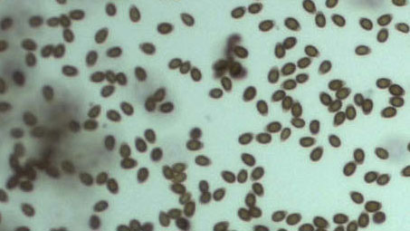
Ganoderma Spore
When the Ganoderma grow maturely, it would eject the spores.
Ganoderma spores is very small, each only 4-6 micrometer.

Slide 51
Ganoderma Spore Is Precious
100 kg Ganoderma
1 kg
Ganoderma
Spore powder
Can only extract out

Slide 52
Ganoderma Spore Is Highly Effective
Polysaccharide
(the active component)
amount in Ganoderma spore
Polysaccharide amount in Ganoderma
is 70 times than

Slide 53
IN SHORT
Ganoderma spore ≠ Ganoderma
Ganoderma spore ≠ Ganoderma Essence
Ganoderma spore = Essence of Ganoderma
Essence

Slide 54
MECHANISM
Ganoderma contains polysaccharide
Polysaccharide helps to
Vitalize the immune cells
Nourish the liver cells

Slide 55
MANUFACTURING STRENGH
Featured Ganoderma plants source from pure & unpolluted nature
Pure nature

Slide 56
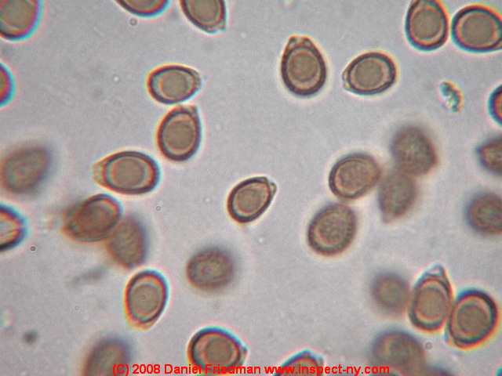
MANUFACTURING STRENGH
Advanced technology to extract highly concentration of spores from Ganoderma.
Highly concentration of Ganoderma spores

Slide 57
MANUFACTURING STRENGH
Revolutionary technique in achieving 99.9% breakage of walls
Scientifically process
Break spore wall
Nano-technology in refinery
Micronization
Anti-aggregation

Slide 58
PRODUCT FUNCTIONS
Pure & Broken
Ganoderma Spores
Boost immune system
Reduce side effects of radiation for cancer patients
Maintain liver health
Prevent cancer
Anti-aging

Slide 59
APPLICATIONS
Poor immunity people
People who is recovering from surgery
People who want to prevent cancer
People who have cancer and taking the radiotherapy or chemotherapy
Cardiovascular disease, diabetes, liver disease, bronchitis patients
Neurasthenia, insomnia, anxiety, memory loss, fatigue syndrome persons
Pigmentation, age spots increases, the need to slow down aging, longevity people

Slide 60
USAGE
2 capsules daily in the morning or evening.
Fit for adults and the elderly people.
Not recommend to infants and children.
People who surgery within a week and bleeding patients should not take.

Slide 61
Life is more fun with healthy immune system!

