Slide 1
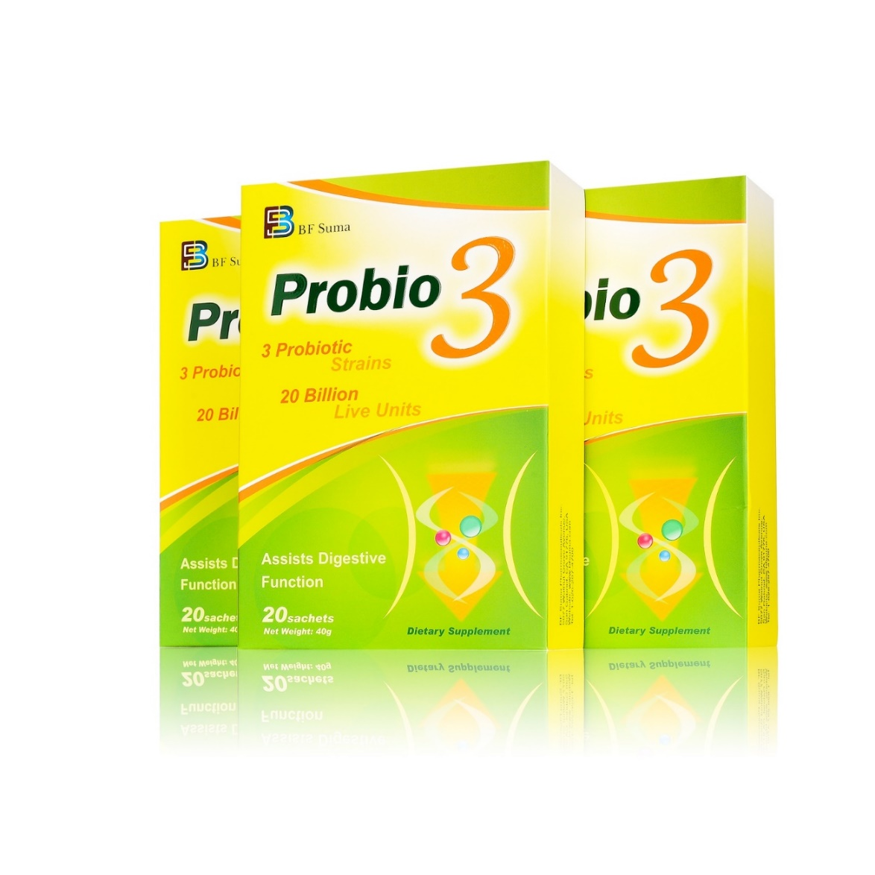
Probio 3
3

Slide 2
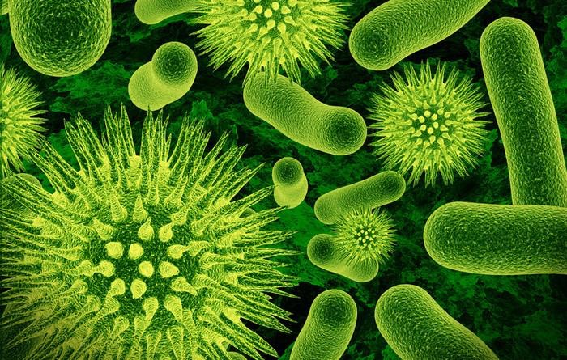
Digestive System Health And Gut Flora
Our Gut Flora
Teeming with microbes-up to 70% of the body’s total number
It is a very complex ecosystem harbouring tens of trillions of microorganism
A healthy adult has about 2kg of these bacteria in the gut
They play a vital role in the body –without them we probably would not survive
Notes:
Gut flora is the name given today to the microbe population living in our intestine

Slide 3
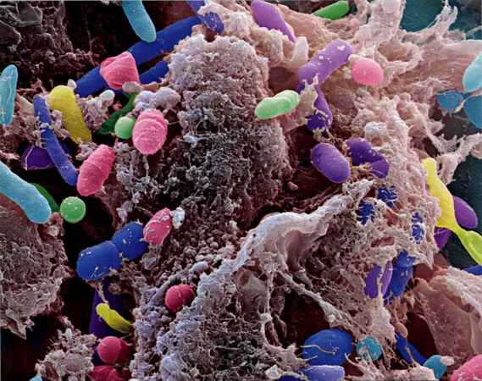
_{Why is Gut Flora Important ？}
It helps the body to digest certain food that our stomach and small intestine have not be able to digest
A healthy and balanced gut microbiota is key to ensuring proper digestive function
It plays an important role in the immune system , performing a barrier effect
It helps combat aggressions from other microoganisms, maintaining the wholeness of the intestinal mucosaIt.

Slide 4
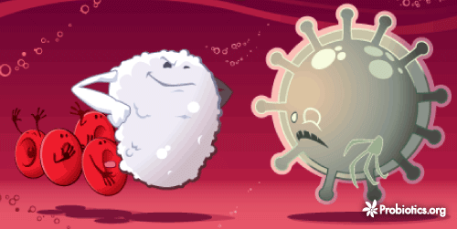
Probiotic
The World Health Organization's (WHO) 2001 definition of probiotics is :
“live micro-organisms which, when administered in adequate amounts, confer a health beneﬁt on the host”

Slide 5
^{Benefits of} Probiotic
Boost the immune system
Increase vitamin B6&B12
Prevent /treat many disease associated with the GI tract
Childhood diarrhea
ABx associated diarrhea
Infectious diarrhea
Irritable bowel syndrome
Constipation
Ulcerative colitis
Pouchitis
Crohn’s disease
Eczema
C-diff infection

Slide 6
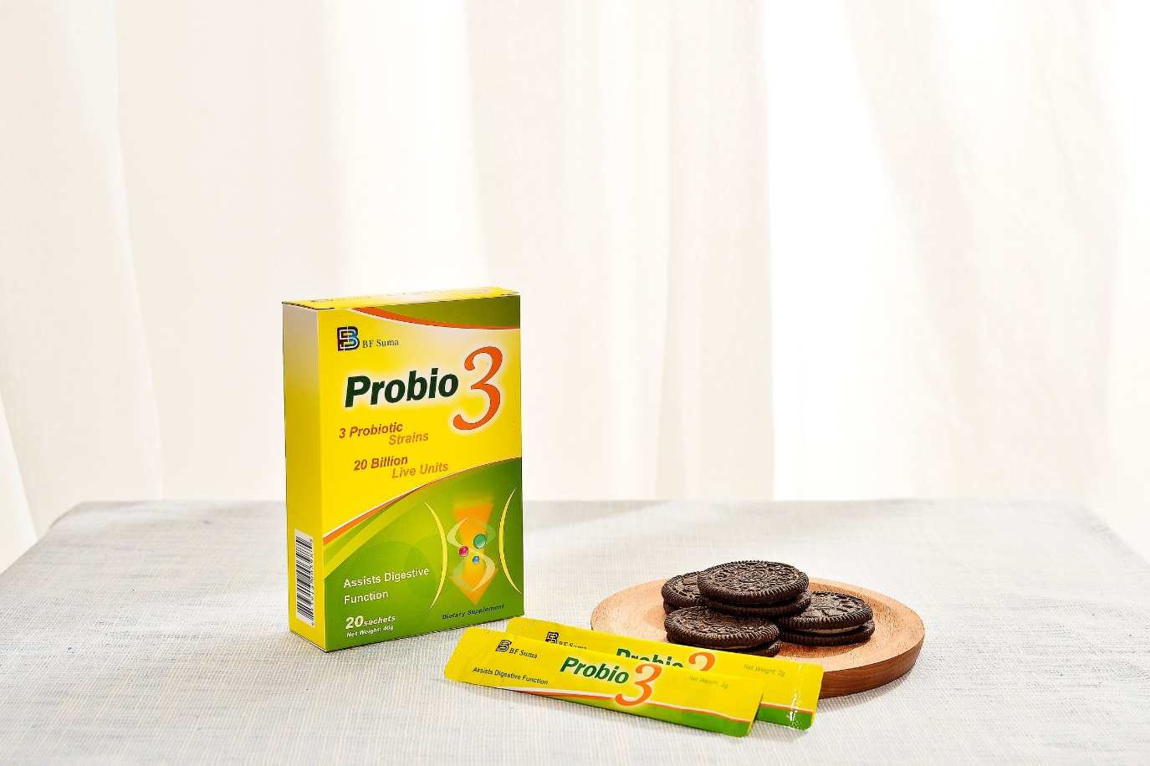
Probio 3
3
The viable count of the probiotics in 1 probio3 is 20 billion , equivalent to 80 cups 250ml yogurt.
Good taste
Easy storage and portability

Slide 7
Probio 3
3
Triple effect from three useful bacterial floras
Bifidobacterium longum –help to Inhibit bad bacteria in the gut
Streptococcus thermophilus No.1-help to clean the waste in the gut
Streptococcus thermophilus No.2-help to promote intestinal peristalsis, remove toxins

Slide 8
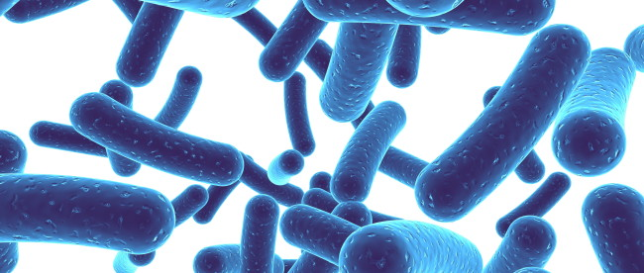
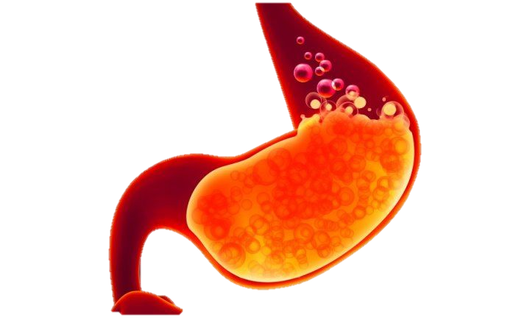
Each strain of Probio3 is clinically studied
To Survive
Harsh Acidic Environment

Slide 9
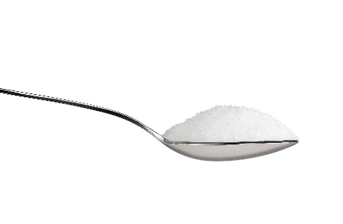
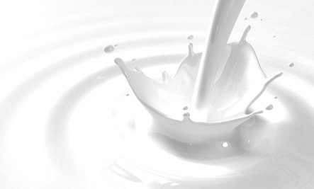
Probio3 Source
04
02
Pure Vegetarian and Natural Source
03
Room Temperature
Longer Shelf-life

Slide 10
Adults with probio3
Normal bowel movement
Toxin removal
Physical and mental comfort
Acne disappeared
Probio 3
3
Children with probio3
No constipation
No diarrhea
Good appetite

Slide 11
Other Benefits of Probio3
Allergies
Immunity
02
04
01
03
Urinary Health
Women’s Health

Slide 12
THANKS FOR WATCHING

