Slide 1
Pressure Free Tea

Slide 2
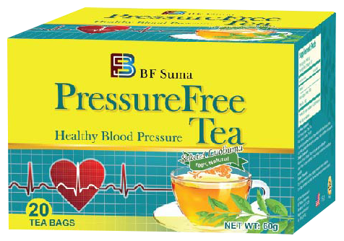
PressureFree Tea

Slide 3
COPYRIGHT STATEMENT
This training material is owned by BF Suma Pharmaceuticals Inc.
BF Suma Pharmaceuticals Inc. reserves all rights of final interpretation and revision.
Any reproduction or usage for commercial purpose in whole or in part without permission is prohibited.

Slide 4
Awaited
& Upgraded
Direct Product Name
Attractive Packaging
New Formulation
Better Effect

Slide 5
New Formulation
Add Green Tea
Anti-aging
Healthy blood pressure

Slide 6
PressureFree Tea
A drink that helps you to control your blood pressure with a simple change in diet.

Slide 7
Background Introduction

Slide 8
What is Hypertension?
Hypertension is a condition
That is also known as high / raised blood pressure
In which the blood vessels have persistently raised pressure
≤119/79 mmHg is normal blood pressure (systolic/diastolic pressure)
Hypertension is dangerous because
without control can lead to
heart attack
enlargement of the heart
heart failure
kidney failure
stroke

Slide 9
Facts from the WHO
> 1 in 3 adults worldwide have high blood pressure (HBP)
HBP causes around 50% of all deaths from stroke and heart disease
HBP is directly responsible for 7.5 million deaths in 2004 – almost 13% of all global deaths

Slide 10
Difference in control between countries
Widespread diagnosis and treatment
People remain undiagnosed
Low-cost medication
(e.g. almost 40% of adults in the WHO European Region and 31% of adults in the WHO Region of the Americas had high blood pressure in 1980. By 2008, this had dropped to below 30% and 23% respectively.)
Often miss out on treatment that can help reduce the risks
(e.g. in the WHO African region, more than 40% (and up to 50%) of adults in many countries are estimated to have high blood pressure and this proportion is increasing)
Developed countries
Developing countries

Slide 11
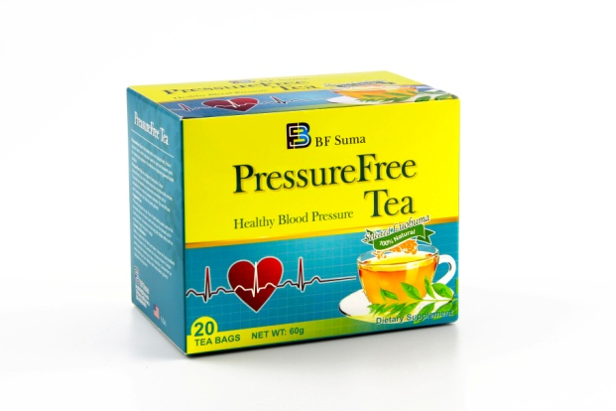
Pressure Free Tea helps you In 4 aspects
Lowers blood pressure and cholesterol
New
Relief from anxiety
Anti-oxidant
Better Urinary

Slide 12
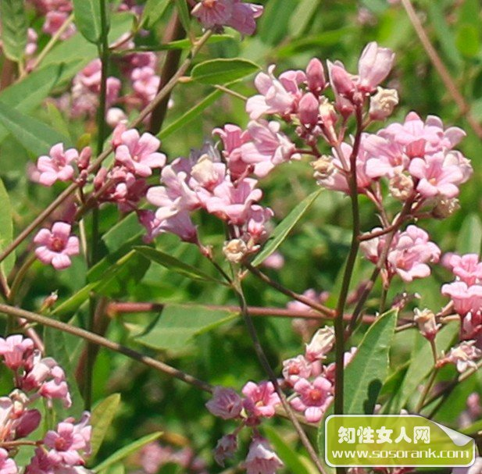
Active Ingredients
Green Tea
Luobuma Tea
Major Functions
Stimulate blood vessels to dilate
prevents blood vessels from constriction (keeps blood vessels dilated)
Gets rid of excess fluid
Larger area with smaller volume flowing, less resistance and lower pressure
Luobuma

Slide 13
3 stage of improvements
Constant lowering of blood pressure: generally sees effect in 1-2 months
Stage 1
Long-term use to see the effects
Getting better: Symptoms reduces in 2-3 months
Stage 2
Stable: *may reduce medication dose upon long term use
Stage 3

Slide 14
PressureFree, Healthy Blood Pressure so Easy!

Slide 15
THANKS FOR WATCHING
Africa Marketing Department 2017

