Slide 1
GluzojointF Capsules

Slide 2
GluzoJoint-FTM Capsules
Maintain Healthy Cartilage

Slide 3
1
2
3
4
Body Joint
Body Joint Location
Joint Structure
Joint Function
Easily Injured & Impaired

Slide 4
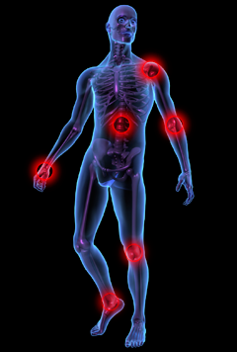
Body Joint Location
Shoulder Joint
Vertebral Articulation
Elbow Joint
Wrist Joint
Hip Joint
Finger Articulation
Knee Joint
Ankle Joint

Slide 5
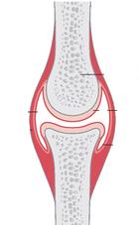
Joint Structure & Components
Bone
Fluid Inside Joint
(Synovial Fluid)
Articulate Cartilage
Knee Joint Structure

Slide 6
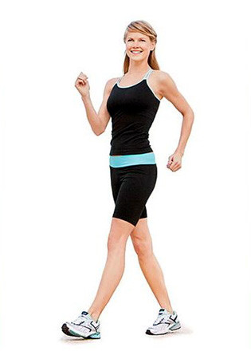
Joint Function
Connect bones
Allow bone movements (except for skull bones)
Prevent bone surface from movement rubbing
Provide bone supporting

Slide 7
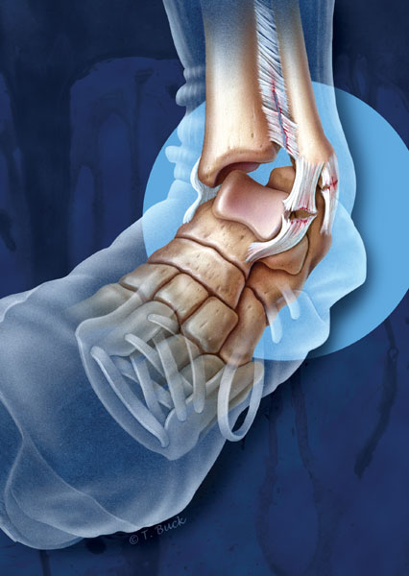
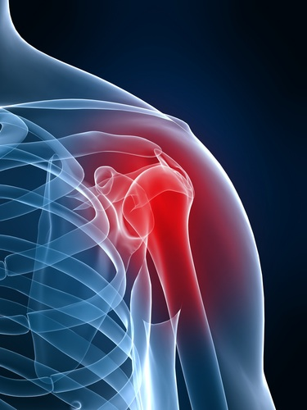
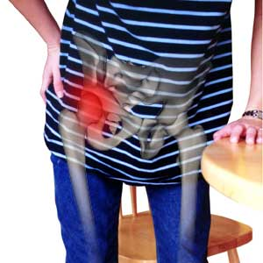
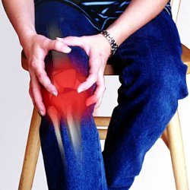
Most Easily Injured & Impaired
In Daily Activities
Ankle Joint
Shoulder Joint
Hip Joint
Knee Joint
Sprain
Dislocation
Aged women fall down - Damage
Aged people Arthritis

Slide 9
2
1
3
4
Joint Diseases
Osteoarthritis(OA)
Evolution of OA
Predilection Sites
Data and Facts
Prevalence of OA
Impact of OA

Slide 10
Osteoarthritis (OA)
Genes
Weight
Injury
or Overuse
When bone surfaces become less well protected by cartilage, bone may be exposed and rubbed
OA
Causes of OA
Symptoms of OA
Damage to Bone
Result
Osteoarthritis (OA) is degeneration of cartilage inside the joint.
Include joint pain, tenderness, stiffness, locking, and sometimes an effusion
Pain for movement, atrophy for regional muscles and may lax ligaments

Slide 11
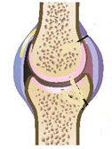
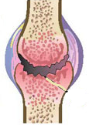
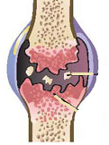
Evolution of (OA)
Cartilage turn thin
Cartilage continue turn thin
Cartilage Fragments
Bone Spurs
Overgrowth of bone and appear cartilage fragment
Normal Joint
Thinning of Cartilage

Slide 12
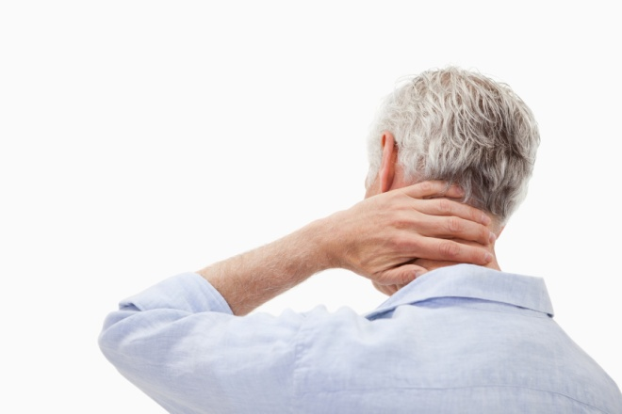
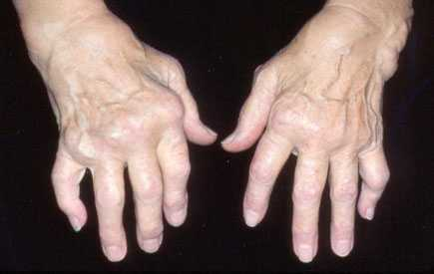
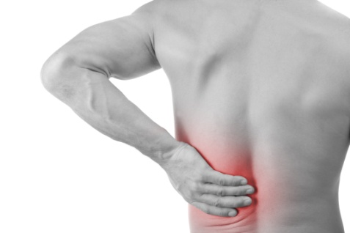
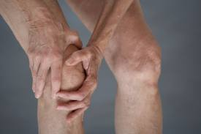
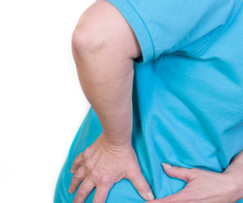
Typical Sites of Joint Pain
Neck
Articulation of hands
Spine
Hip
Knee Joint

Slide 13
Data & Facts
9.6 %
18 %
80 %
25 %
400,000,000
9.6% of men and 18.0% of women aged 60+ have OA.
4 billion people have OA
80% of OA patients have limitations in movement. 25% cannot perform their major daily activities of life

Slide 14
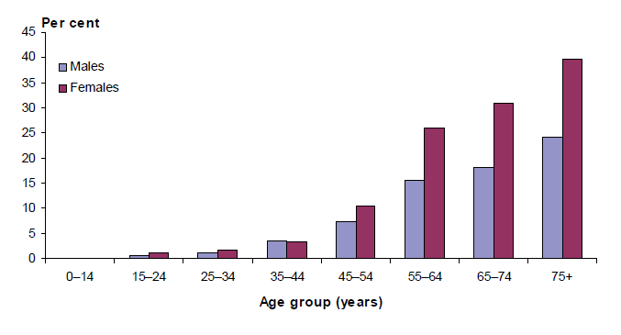
Prevalence of OA
The morbidity of osteoarthritis at age 44+ increases rapidly.
——Source: AIHW analysis of ABS 2007-08 National Health Survey.

Slide 15
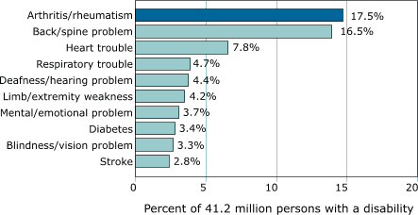
Leading cause of Disability

Slide 16
3
1
2
4
Traditional Treatment Drawbacks
Lose Weight & Aerobic Exercises
Medicines
Surgeries

Slide 17
Traditional Treatments
Lose Weight & Aerobic Exercise
Surgery
Jogging
Cycling
Swimming
Debridement
Joint Replacement
Medicines
Oral Analgesic to Resist Pain
…

Slide 18
Lose Weight
Less the Burden of Joint
Drawbacks: Could not achieve the quick result for relieving OA pain.

Slide 19
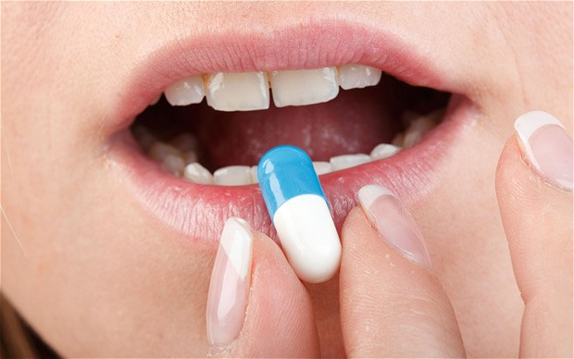
Oral Painkiller Drugs
Relief the Joint Pain
Drawbacks: Inducing side effects that may harmful to gastrointestinal health, such as ulcer.

Slide 20
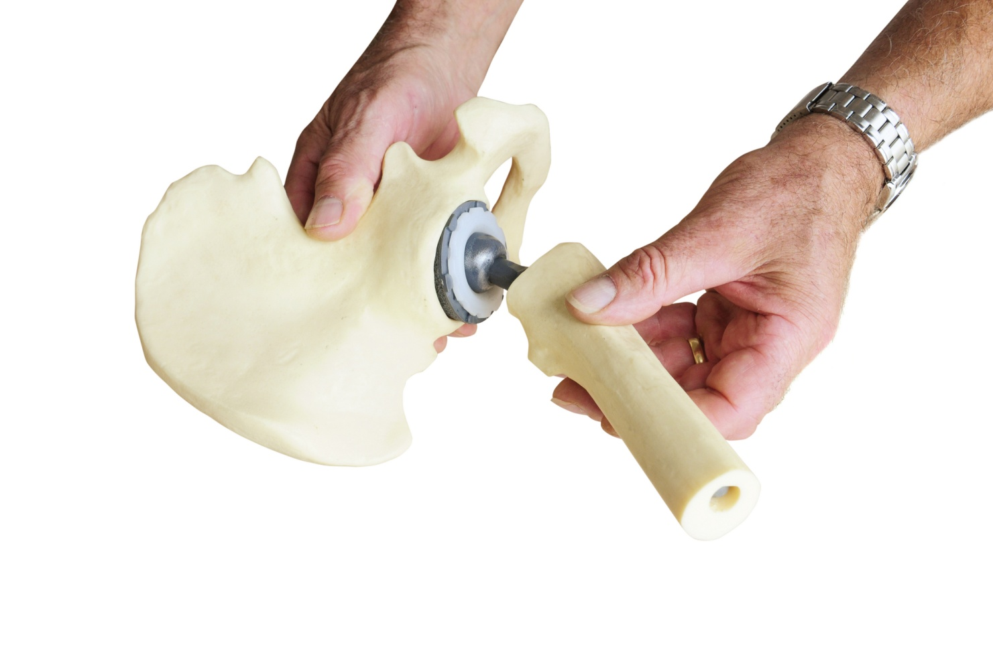
Surgeries
Replace an Artificial Joint
Drawbacks: High cost to treatment.

Slide 21
4
1
2
3
GlozoJoint-FTM Capsules
GlozoJoint-FTM Capsules
Ingredients
Mechanisms
Product Functions
Unique Advantages
Use Directions & Applications

Slide 22
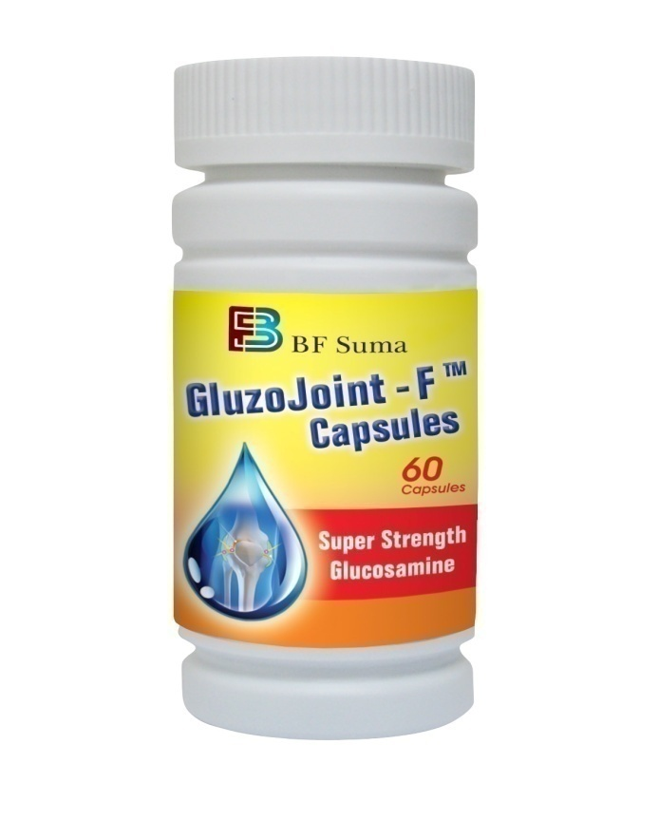
GluzoJoint-FTM Capsules
Maintain
Healthy
Cartilage

Slide 23
Ingredients
Exist in Body
Is an amino acid mainly exist in joints and connective tissues
Physical Functions
Important component of fluid inside joint
Important raw material for synthesis physical substances in body
Reduce with Age
Decrease producing glucosamine with age
Glucosamine
Daily Food Intake
Can intake only a few in daily food

Slide 24
Mechanisms
Supply the physical substance to synthesis proteoglycans, which is the component of cartilage
Natural Care for Cartilage
Glucosamine
Long lasting to Relief Pain
Inhibit: Enzyme that may damage
cartilage cells
Stimulate: Produce normal amount of
proteoglycans to protect
cartilage cell membrane.

Slide 25
Product Functions
1
Care For Cartilage
2
Relief Joint Pain
Improve Joint
Movement
3

Slide 26
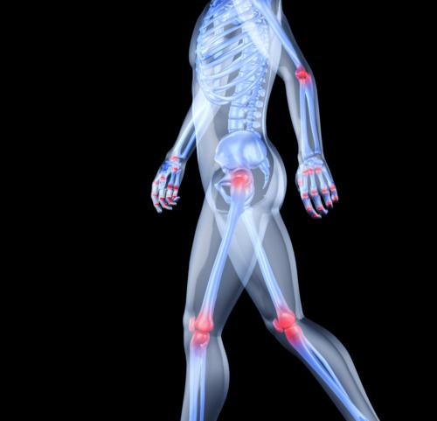
Clinical Studies
Great Absorption & Effect Targeting
Oral Intake
GluzoJoint-F TM
Gastric Acid
Metabolism
90 %
Absorbed into Blood
Glucosamine
8 Hours
Reach to Body Joint
Peak Value

Slide 27
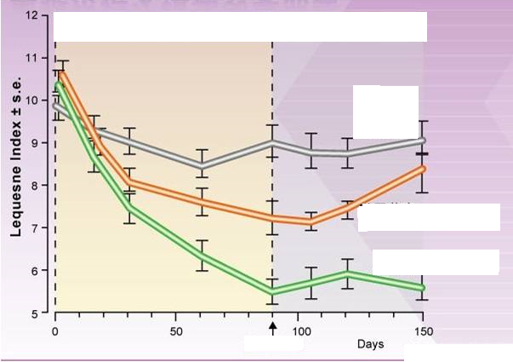
Clinical Studies
Long Lasting to Relief Pain
Treating Period
Withdrawal Period
General Placebo
General painkiller
GlozoJoint-F TM
End Treatment

Slide 28
Unique Advantages
Know-How Technology
High Purity
More Profession
More Safety

Slide 29
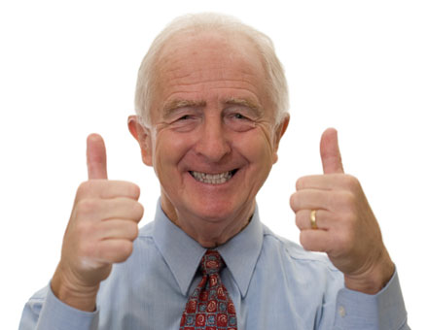
Unique Advantages
High Purity
99% Active Ingredient
Featured Quality Raw Materials From Spain
Know-How Technology
US certified cGMP product line
International Certified Quality Control

Slide 30
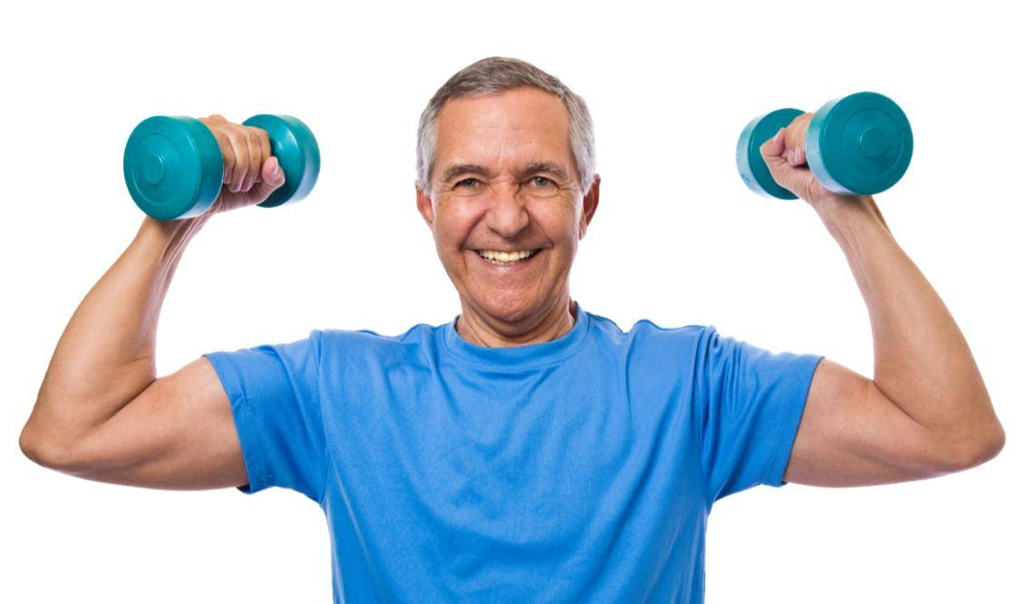
Unique Advantages
Well Safety
More Professional
Glucosamine is the necessary substance of the body, no toxic to heart, kidney and lung
Less side effects
Designed for osteoarthritis
Commit to maintain your healthy cartilage

Slide 31
Use Directions
Principle:
Enough supplement of GluzoJoint-FTM
Complete course of treatment to care for cartilage
Dosage:
1 capsule with meal, twice daily
For 6 weeks or longer
2 – 3 courses of treatment/year

Slide 32
Applications
Care for Joint
Nutrition for Fitness People
Prevent Joint Discomfort
Overcome Discomfort after sporting

Slide 33
Thank You!
Email: info@bfsuma.com
Website: www.bfsuma.com
Tel: 1-626-287-4700

Slide 34
THANKS FOR WATCHING
Africa Marketing Department 2017

