Slide 1
Femicare

Slide 2
FemiCare
THE RE-BORN OF WOMEN
WITH REFRESH FEELING

Slide 3
CONTENT
PART 1
PART 2
PART 3
PART 4
PART 5
Five life stages of women
Vaginal
Health
Vaginal Infection diseases
Risks that causing vaginal infection diseases
BF Suma
FemiCare

Slide 4
In each woman’s life, she would experiences five different stages.

Slide 5
The First Stage: First Menstruation.
Girl’s body would undergo adolescence changes and the passageway from uterus to vagina opens.

Slide 6
The Second Stage: Marriage.
She undergoes change from a young girl to a young lady.

Slide 7
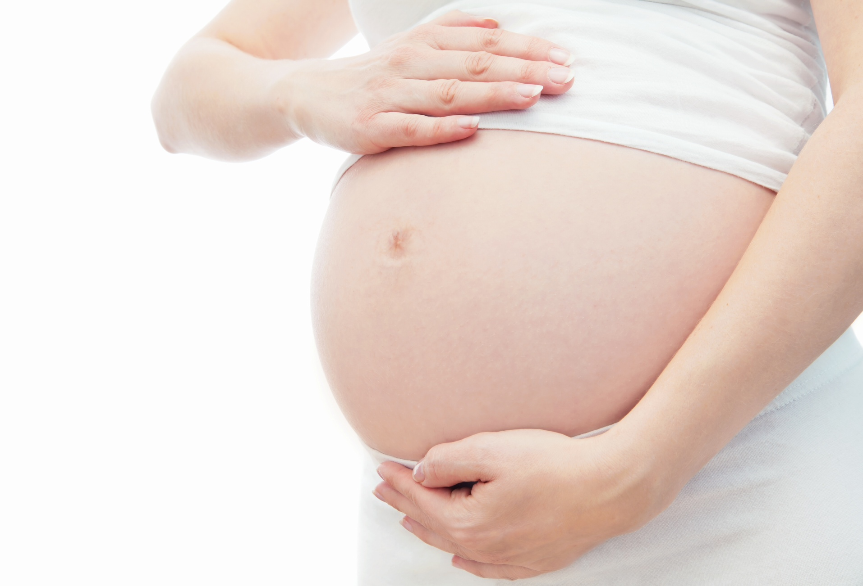
The Third Stage: Pregnancy.
The stage that prepares to be a mother.

Slide 8
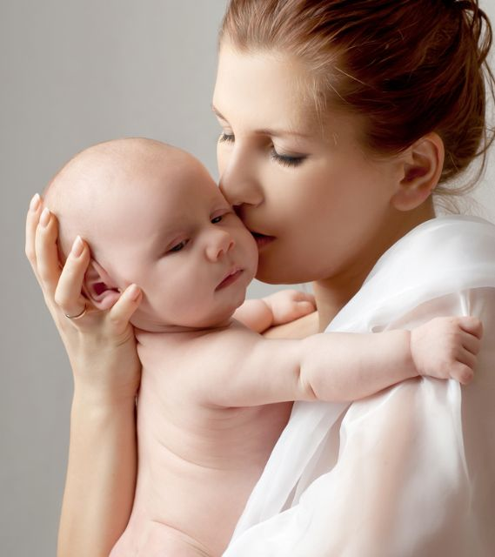
The Fourth Stage:
Perinatal
The stage that body recover after giving birth.

Slide 9
The Fifth Stage: Menopause.
Many physiological changes happens during this stage.

Slide 10
During each stage, the health of private area – vagina, is one of the most important issues that women need to concern.
Each stage would have possibility that get Vaginitis and Vaginal Infections.

Slide 11
CONTENT
PART 1
PART 2
PART 3
PART 4
PART 5
Five life stage of women
Vaginal
Health
Vaginal Infection diseases
Risks that causing vaginal infection diseases
BF Suma
FemiCare

Slide 12
First, let us know the women’s private area
– VAGINA –

Slide 13
1. Know “her” – vagina
2. “She” is acid
3. “She” provides dwelling for many bacteria
4. “She” needs fresh air
5. “Her” health needs to be check regularly

Slide 14
1. Know “her” – vagina
See the female reproductive system side perspective on the next slide
The vagina is an elastic, muscular canal with a soft, flexible lining that provides lubrication and sensation.
It connects the uterus to the outside world.
It receives the penis during sexual intercourse and also serves as a conduit for menstrual flow from the uterus. During childbirth, the baby passes through the vagina (birth canal).

Slide 15
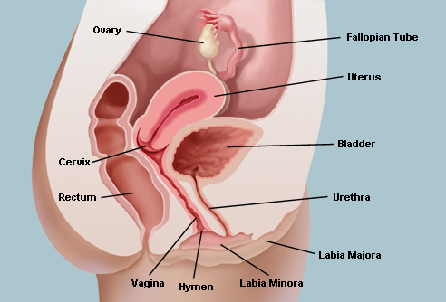
Side Perspective View of Female Reproductive System

Slide 16
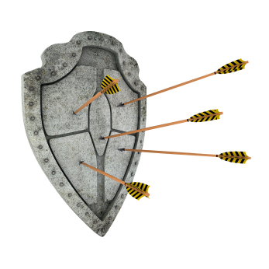
2. “She” is acidic
Lactic acid bacteria dwell in the vaginal cells and interact with vaginal epithelial cells to produce lactic acid.
Acidic environment build a natural barrier. Acidic environment can inhibit the breeding of harmful bacteria and resist the invasion of pathogenic microorganisms.
Therefore, a health vagina is weak acidic.

Slide 17
3. “She” provides dwelling for many bacteria
Don’t worry!
This is normal!
There are “good bacteria” such as lactic acid bacteria which protect vagina.
There are also “ harmful bacteria” such as mold, E. coli, and pathogenic microorganisms that cause various gynecological diseases.
In normal condition, “good bacteria” and “bad bacteria” live together and mutual resistant to maintain balance. This condition does not cause discomfort in vagina.

Slide 18
4. “She” needs fresh air
Like other parts of body, vagina also need fresh air.
Skinny jeans or rayon underwear make “her” difficult to breathe, then the bacteria will multiply, easy to cause infection.

Slide 19
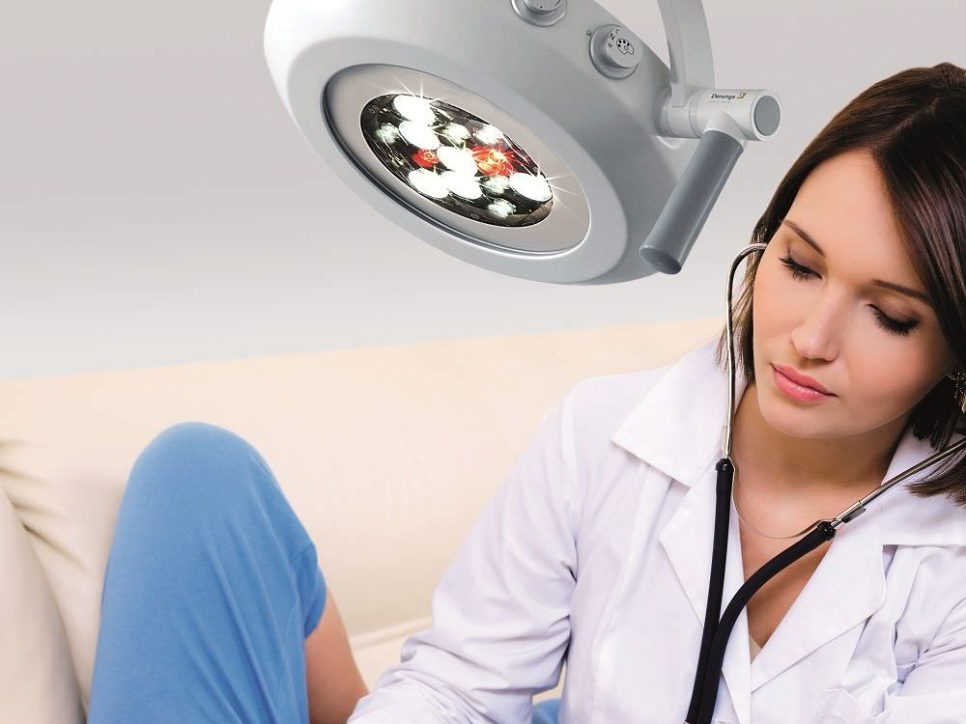
5. “Her” health needs to be check regularly
5. “Her” health needs to be check regularly
Women should do self-examination for vagina regularly.
Sweep aside the labia and use a mirror to observe whether the vaginal skin color is normal, whether have pimples. And also need to pay attention to the color of secretions.
If have any abnormal conditions, be sure to find a doctor for a professional inspection as soon as possible.

Slide 20
CONTENT
PART 1
PART 2
PART 3
PART 4
PART 5
Five life stage of women
Vaginal
Health
Vaginal Infection diseases
Risks that causing vaginal infection diseases
BF Suma
FemiCare

Slide 21
Shocking Data!
95% married women would have get vaginitis and vaginal infections.
All life stage of women would have this possibility.
95 %

Slide 22
What is Vaginitis?
Vaginitis is an irritation and/or inflammation of the vagina characterized by discharge, irritation and/or itching.
It is caused commonly from a yeast infection or bacterial overgrowth.

Slide 23
What Are Common Vaginal Infections?
Bacterial Vaginosis (BV)
1
Trichomoniasis
2
Vaginal Yeast Infection
3

Slide 24
Vaginal Infection 1: Bacterial Vaginosis (BV)
Harmful Bacteria
KNOW BV:
BV is the most common vaginal infection in women of childbearing age.
It is mentioned before that the vagina normally has a balance of mostly “good bacteria” and fewer “harmful bacteria”.
BV, develops when the balance changes.
With BV, there is an increase in harmful bacteria and a decrease in good bacteria.
Good Bacteria

Slide 25
Vaginal Infection 1: Bacterial Vaginosis (BV)
SYMPTOMS OF BV:
A physician may observe these signs during a physical examination and may confirm the diagnosis by doing tests of vaginal fluid.
The primary symptom is an abnormal, odorous vaginal discharge.
Have burning during urination or itching around the outside of the vagina.
1
2
3
4
5
1
The fish-like odor is noticeable especially after sexual intercourse.
However, nearly half of the women with clinical signs of BV report no symptoms.

Slide 26
Vaginal Infection 1: Bacterial Vaginosis (BV)
COMPLICATIONS OF BV:
Researchers have shown an association between BV and pelvic inflammatory disease (PID), which can cause infertility and tubal (ectopic) pregnancy.
BV also can cause adverse outcomes of pregnancy, including premature delivery and low-birth weight infants.
In addition, BV can increase a woman’s susceptibility to other sexual transmitted diseases, such as chlamydia and gonorrhea.
Complications of BV

Slide 27
Vaginal Infection 2: Trichomoniasis
1
2
3
Trichomoniasis is a common sexually transmitted disease (STD) that affects about 7 million Americans yearly.
It is caused by a single-celled protozoan parasite called Trichomonas vaginalis.
The urethra is the most common site of infection in man, and the vagina is the most common site of infection in women.

Slide 28
Vaginal Infection 2: Trichomoniasis
SYMPTOMS OF TRICHOMONIASIS
Men almost never have symptoms.
When women have symptoms, they usually appear within 5 to 28 days of exposure.
The symptoms in women include a heavy, yellow-green or gray vaginal discharge with a strong odor, discomfort during intercourse and painful urination. Irritation and itching of the female genital area and, on rare occasions, lower abdominal pain also can be present.

Slide 29
Vaginal Infection 2: Trichomoniasis
COMPLICATIONS OF TRICHOMONIASIS:
Researchers suggest that trichomoniasis is associated with increased risk of transmission of HIV and may cause a woman to deliver a low-birth weight or premature infant.

Slide 30
Vaginal Infection 3:
Vaginal Yeast Infection
KNOW
IT
Vaginal yeast infection or is a common cause of vaginal irritation. Yeast are always present in the vagina in small numbers, and symptoms only appear with overgrowth.

Slide 31
Vaginal Infection 3:
Vaginal Yeast Infection
SYMPTOMS OF VAGINAL YEAST INFECTION:
The most frequent symptoms of yeast infection are itching, burning and irritation of the vagina.
Painful urination and/or pain during intercourse are common.
Vaginal discharge is not always present and may be minimal.
The thick, whitish-gray discharge is typically described as cottage-cheese-like in nature, although it can vary from watery to thick in consistency.

Slide 32
CONTENT
PART 1
PART 2
PART 3
PART 4
PART 5
Five life stage of women
Vaginal
Health
Vaginal Infection diseases
Risks that causing vaginal infection diseases
BF Suma
FemiCare

Slide 33
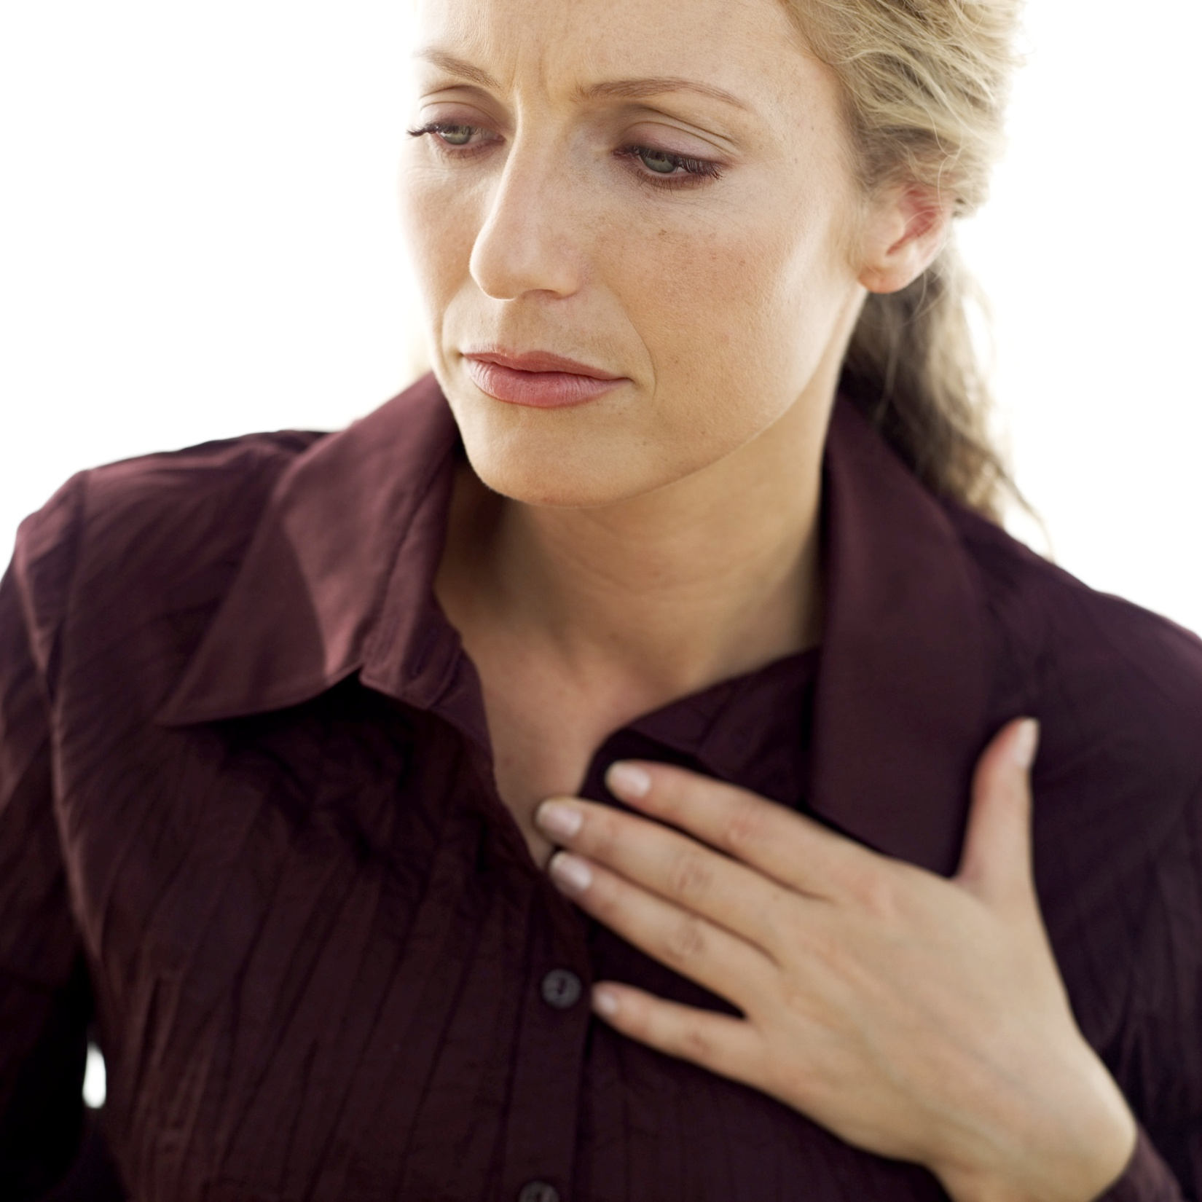
Why women are easily to get vaginal infection diseases?
Suitable environment:
Vagina provide a warm and humid place which is suitable for bacteria living.
Convenience for bacteria invasion:
The vagina length is 6-8cm and link to the outside that convenience to invade pathogens.
Risk brought by men:
Men’s urethral hide many bacteria that bring hidden dangers during sexual intercourses.

Slide 34
8 Risk Factors Threaten Women Vaginal Health
Underwear
Longtime
sitting
Menstruation
Antibiotics
Public
places
Skinny
jeans
Sex
Menopause

Slide 35
Risk 1:Public places
Large flow of people, and easily cross-infection.
Public toilets
Swimming pool
Public seats

Slide 36
Risk 2: Underwear
A dirty underwear is one of the sources of vaginal infectious diseases.
Averagely, a dirty underwear has 0.1g faeces and per 1g faeces contain 10million viruses.
Some people usually wash pieces of dirty underwear with other cloths at the same time, this would pollute other cloths and affect body health.
Some people do not dry underwear under the sun. humid environment is easier for bacteria and viruses overgrowth.
ADVISES
Change new underwear per 6 months.
Wash underwear separately.
Choose cotton rather than nylon or fiber underwear.

Slide 37
Risk 3 & 4: Skinny jeans & Longtime sitting
Airtight
Skinny jeans is too tight that limit the private area breathe fresh air.
Easy to harmful bacteria overgrowth

Slide 38
Risk 5 & 6: Sex & Menstruation
Destroy the vaginal acidic environment
Most of the condoms will destroy the vaginal acid-base balance.
Semen is alkaline which will affect the vaginal acidic environment as well.
Menstruation flow would also affect the vaginal acid-base balance.

Slide 39
Risk 7:Menopause
Menopause women’s hormone would turn to unbalanced.
This would lead to “good bacteria” decreasing.

Slide 40
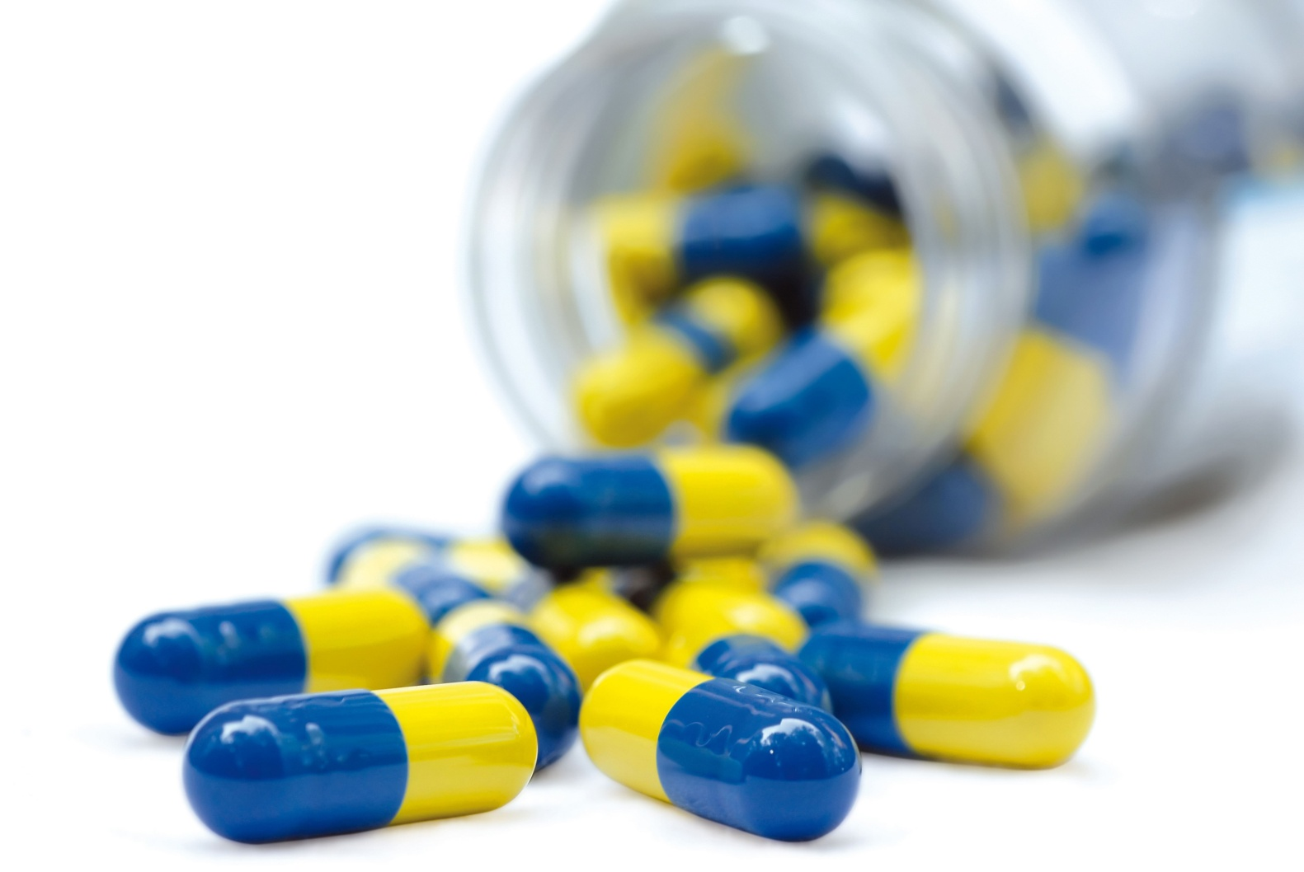
Risk 8: Antibiotics
Antibiotics not only kill “harmful bacteria, but also kill “good bacteria”.

Slide 41
How to keep vaginal infectious diseases away?
BF Suma Gives You
A Best Solution!

Slide 42
Do exercise regularly
No abuse of antibiotics
Physical exercises are able to strengthen immune system. It is also help to maintain the balance of “good bacteria” and “harmful bacteria” in vagina.
No abuse of antibiotics means that not damage to the ecological environment in body.
Avoid unclean sex
Wear clean underwear
Avoid to sex with many people.
Avoid to be infected with sexual transmitted diseases.
It is better to replace underwear everyday, especially during menstruation period.

Slide 43
Clean & Care Vagina
Not recommend to use soap to wash vaginal area.
Use herbal lotion specially design for vagina health.

Slide 44
CONTENT
PART 1
PART 2
PART 3
PART 4
PART 5
Five life stage of women
Vaginal
Health
Vaginal Infection diseases
Risks that causing vaginal infection diseases
BF Suma
FemiCare

Slide 45
THE
RE-BORN OF WOMEN

Slide 46
FemiCare Features
High-effective
Natural
Safe
Health

Slide 47
FemiCare Ingrediences
Rejuvenating Mineral Elements
From the natural resources with ÖKO-HITECH Marine Ecological Extraction Technique.
Compound Trace Elements extracted
From USA Great Salt Lake
Natural Essential Oil from plant
Other Ingredients
Multiple vitamines, amino acid vegetable antioxidative element

Slide 48
FemiCare Functions
1
2
Reinforce the vagina’s resistance against infection.
Eliminate abnormal vaginal discharge, unpleasant odor and itchiness feelings.
Functions
3
4
Effectively prevent harmful bacteria.
Keep the vagina area clean and comfortable

Slide 49
Summary
Anti-bacteria
Cleanses
Extra care
Refreshing

Slide 50
Use Directions
Wash with Feminine Cleaner once a day.
7 to 10 days as a treatment.

Slide 51
Cautions
For external use only.
Not for virgin, female in menstruation, pregnancy, and lactation.
FemiCare does not prevent pregnancy, or treat sexually transmitted diseases (STDs), or pelvic inflammatory diseases (PID).
Do not use if allergic to this product.
Suitable for vagina infection.
Keep the appliance clean.
Keep out of reach of children.

Slide 52
Recommend Femicare to Your Friends, Refresh And Happy Together!

Slide 53
THANKS FOR WATCHING
Africa Marketing Department 2017

