Slide 1
Detoxilive capsules
Internal Training
2017.06.20

Slide 2
Detoxilive capsules main points
Main effect： Protecting the Liver；
Suited for : Drinkers ; sub-health population; memory decline individuals;
Age range :25-50 years
Selling points ：
① High PC content (phosphatidylcholine, more than 38% ) ;
②Originated from USA;
③ High absorption efficiency (soft capsules)

Slide 3
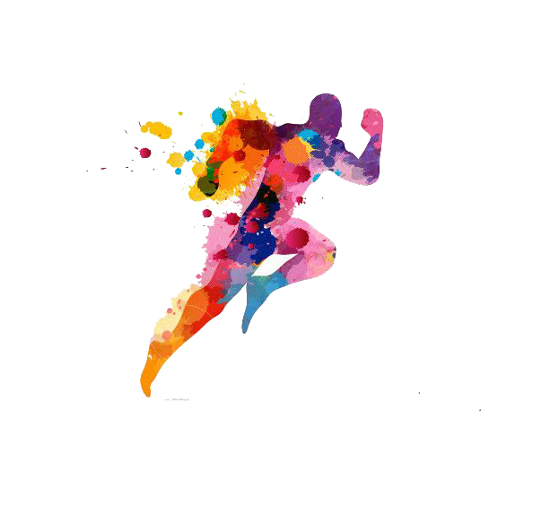
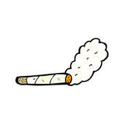
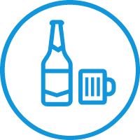
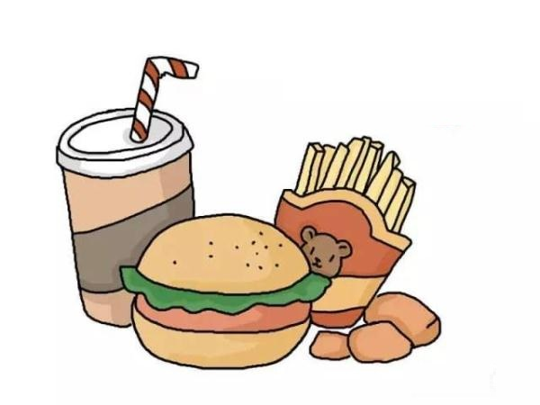
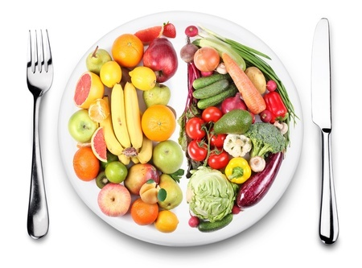
Facing health challenge?
Lack of exercise
Excessive drinking
Liver Damage
Fried foods
Skipping breakfast
Notes:
肝脏缺少疼痛神经，导致肝病具有相当的隐蔽性，症状一般很难被察觉，不少患者能吃能喝，有的还又白又胖，甚至没有明显症状，等到出现疼痛等情况时，病情往往已经进展到中重度。

Slide 4
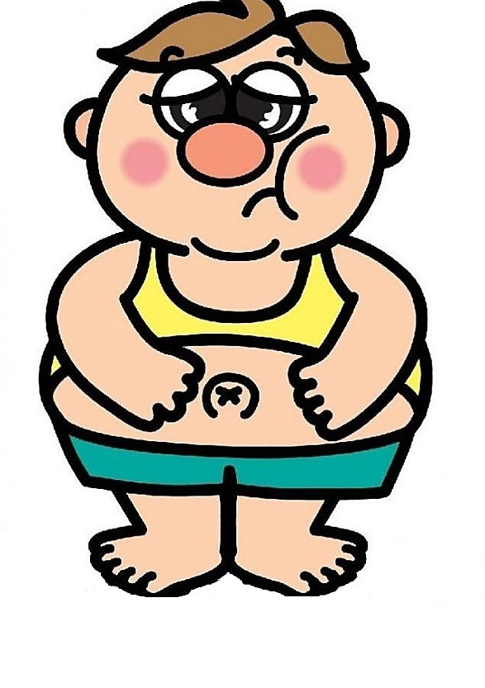
liver , root of life
Red nose
Fatigued or exhausted
Sweating
Loss appetite
Body odor
Dull skin
Drunk suddenly
Angry and anxious
Urine color yellow
Nosebleeds
Eye dry
Poor digestion
Irregular periods
Easy to infections

Slide 5
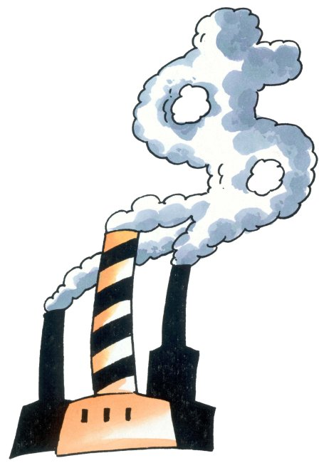
Liver-An organ without nerves
Liver is one of the most important detox and metabolic organs.
The time for the liver detoxification and self repairing is between 11 p.m. to 1 a.m.
The liver itself does not have too much sensory nerve distribution, so the liver is called “the silent organ”.
liver injury
hepatitis
fatty liver
alcohol liver
cirrhosis
liver cancer
Four steps to liver cancer ：
Notes:
肝脏就是个傻大个，性情憨厚，天天干活都不知道累。它累成怎么样，它也从不呻吟叫苦，也不会喊痛，它作为我们人体的一个垃圾分解站，掌管着糖、脂肪、解毒、代谢，人体大部分的新陈代谢和有毒物质的转化，所以它也是最易污染的部门。
深夜11点到1点是肝脏的排毒与自我修复的时间，所以长期熬夜特别容易伤肝(晚11-凌晨1点，肝排毒；凌晨1-3点，胆排毒；凌晨3-5点，肺排毒；需在熟睡中进行。凌晨5-7点，大肠排毒应排便；需在熟睡中进行。)

Slide 6
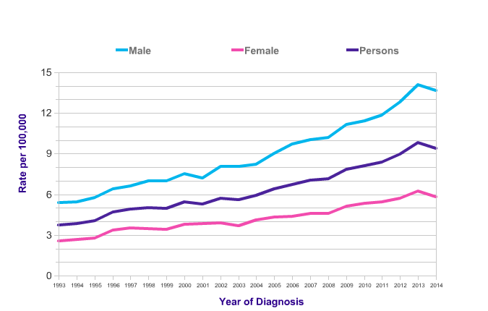
Liver cancer is not far from you
From 1993 to 2014, the incidence of liver cancer increased rapidly. It has increased by 142% in no more than 20 years, among which men hepatocellular carcinomas covers 155%.
Liver cancer is the second leading cancer among all types of cancer.
Liver Cancer (C22), European Age-Standardised Incidence Rates, 1993-2014​
Notes:
另外，临床证实：肝损伤持续发展，甚至会引发其他疾病。因肝脏的排毒解毒能力、分解代谢血脂及血糖能力下降，使得72%的人并发高血脂，60%的人出现糖尿病，53%的人会因肝脏无法很好地过滤血液导致心脑血管疾病。

Slide 7
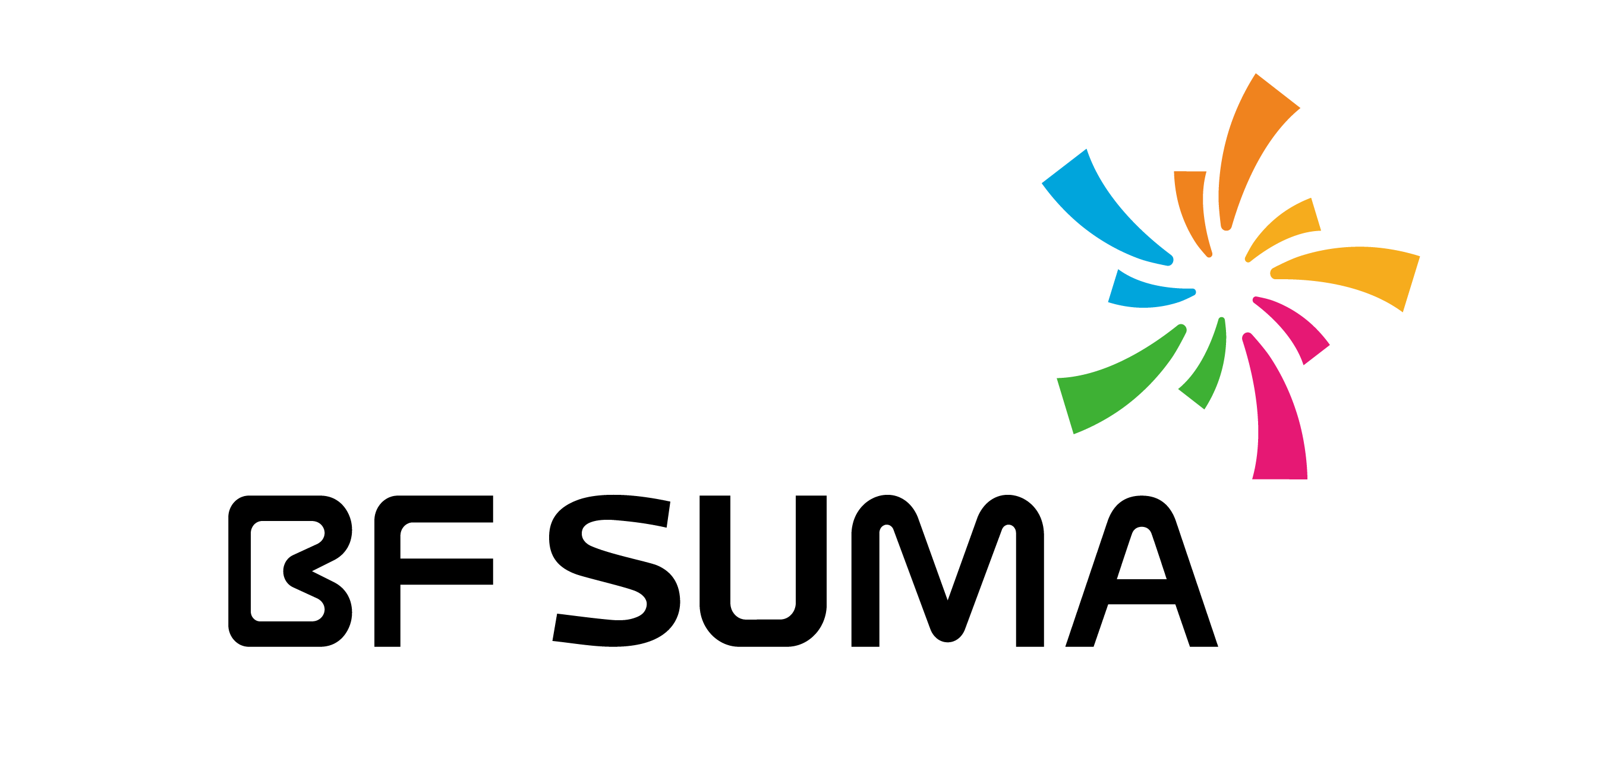
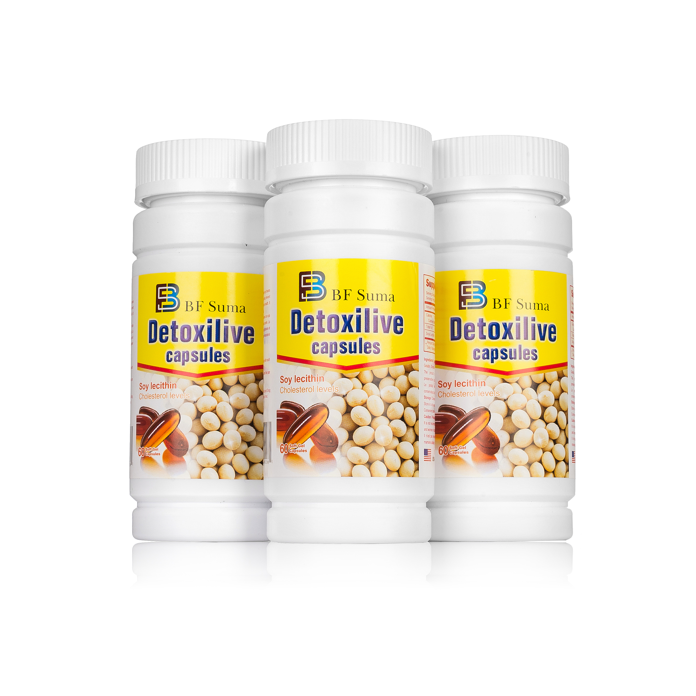
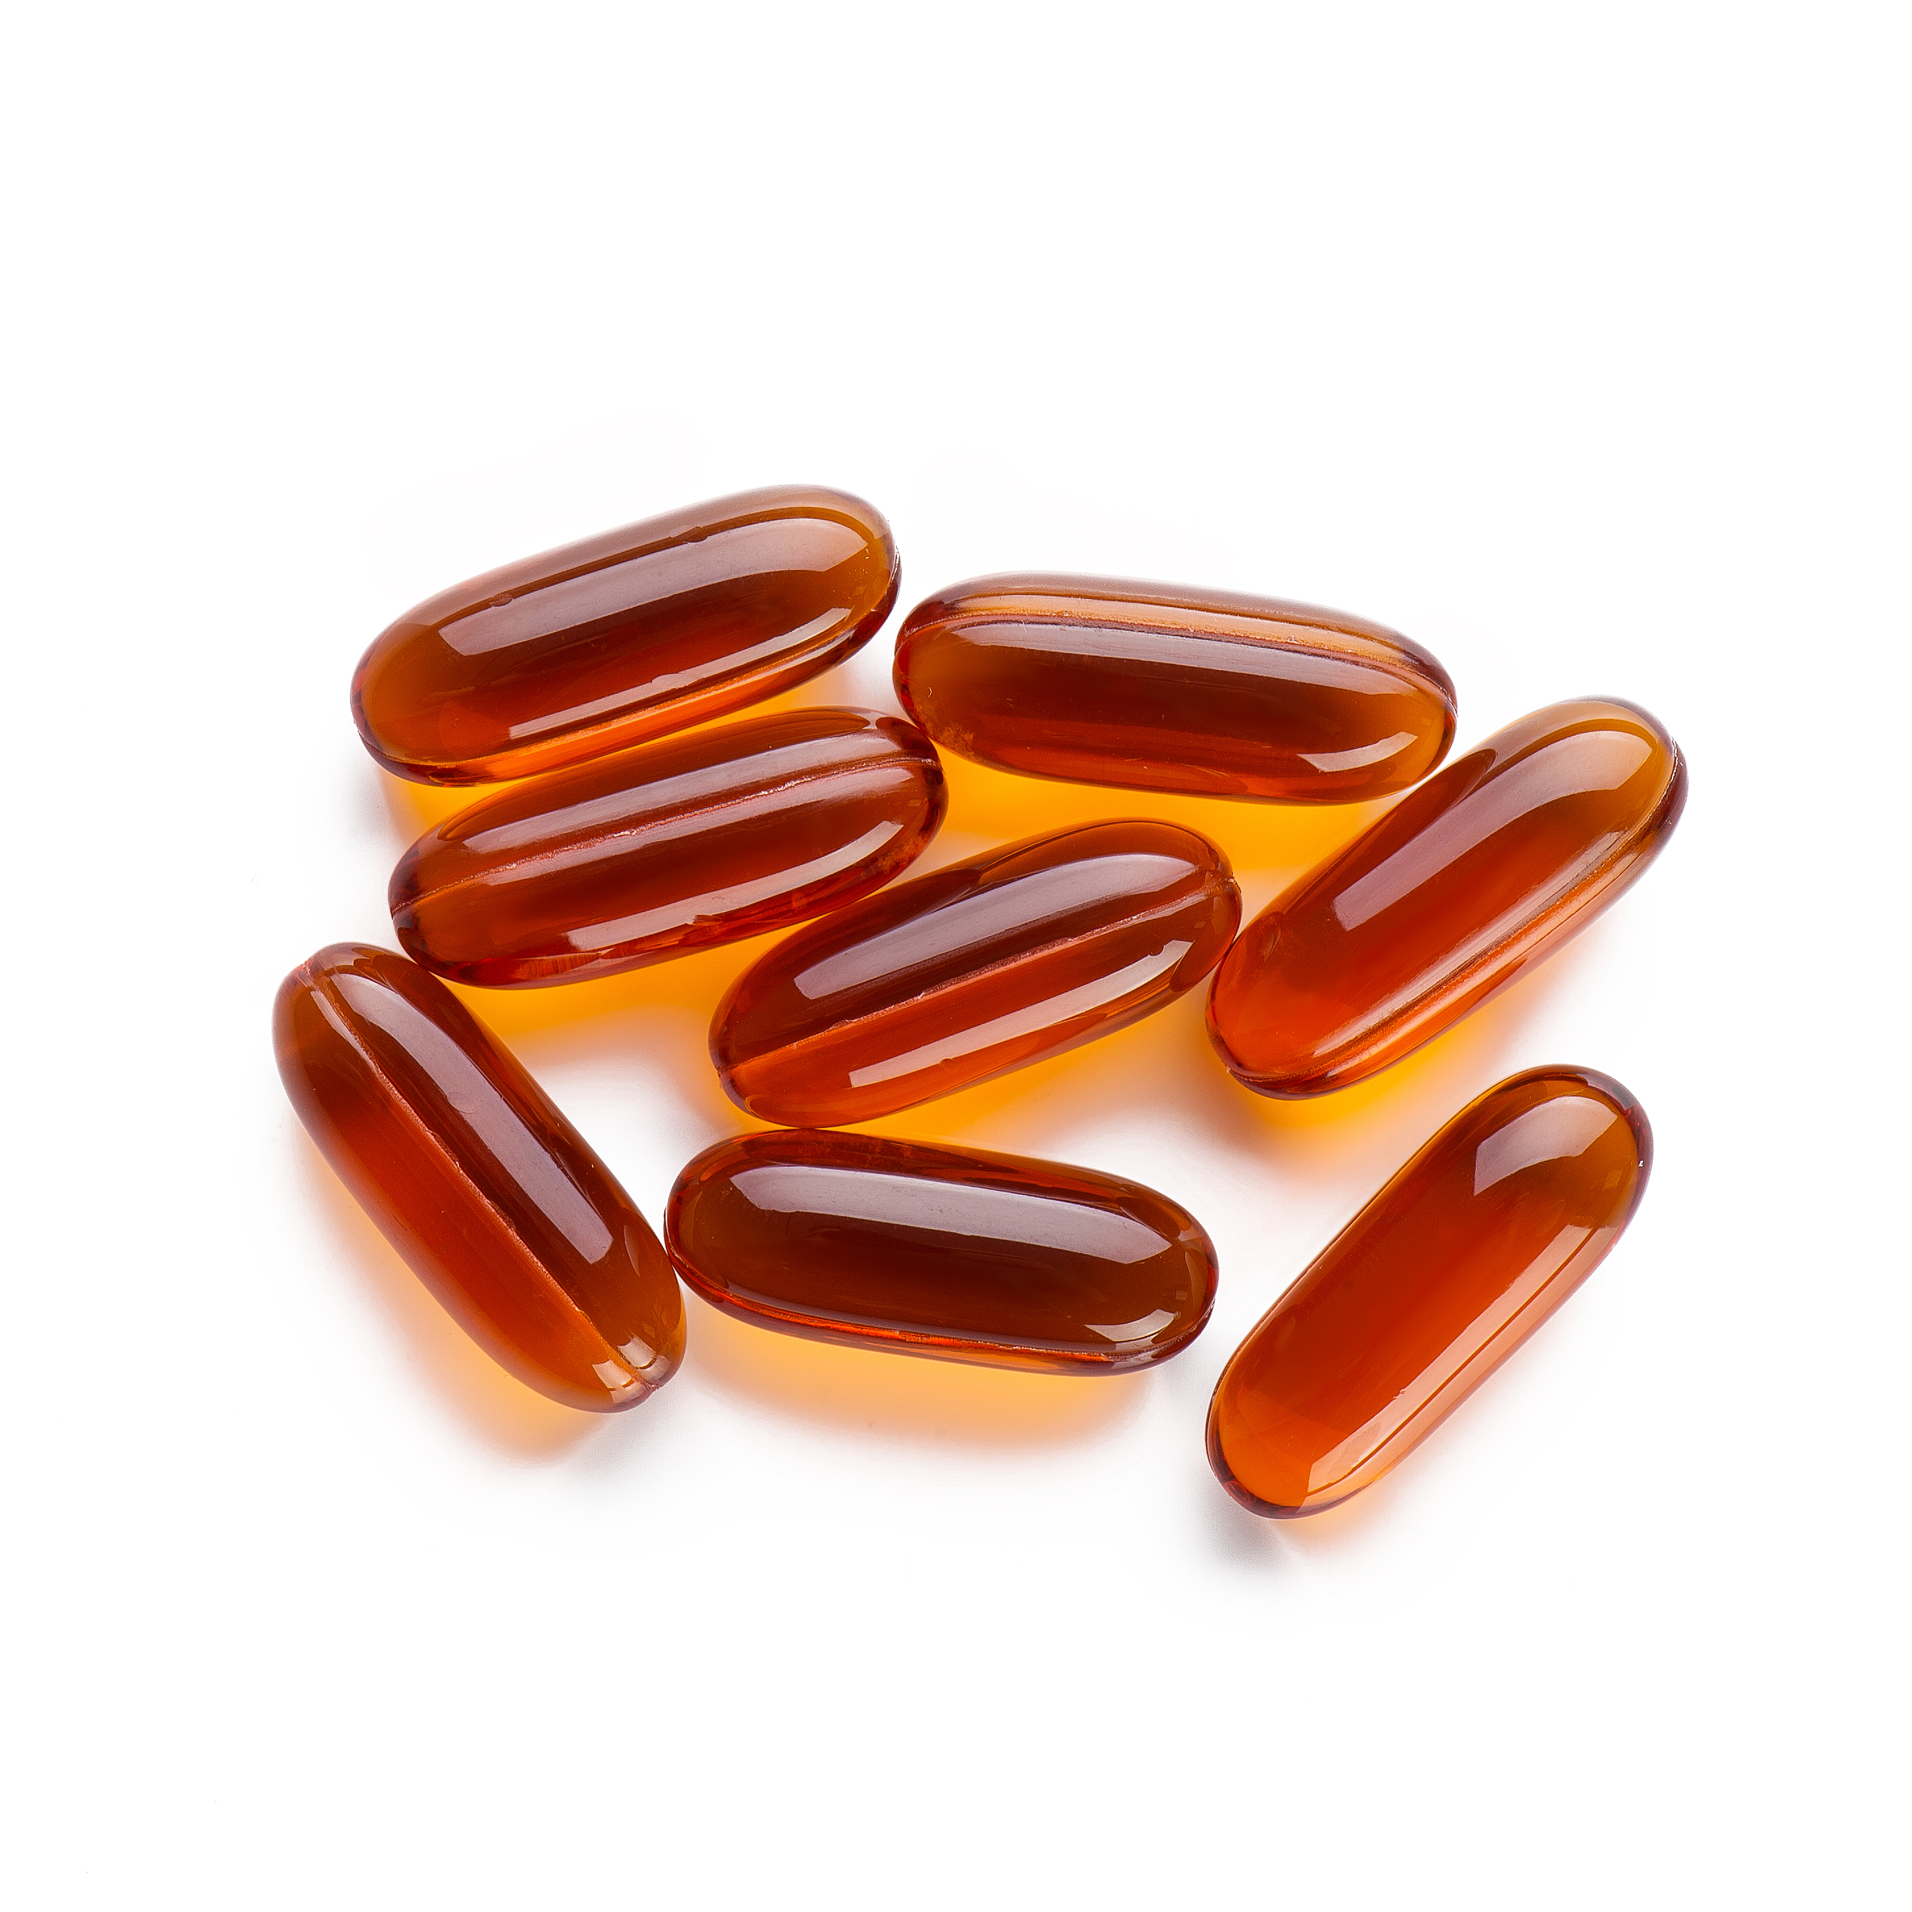
BF SUMA
detoxilive capsules
Your health , your liver
let me to safeguard...
Soybeans are sourced from North America ,
pure and natural.
Notes:
大豆卵磷脂是唯一一个经过大量临床验证，具有肝脏解毒与保护功能的营养物质

Slide 8
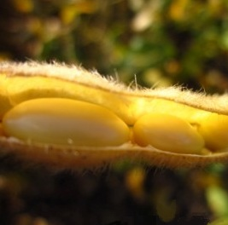
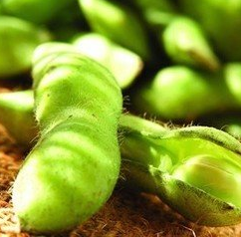
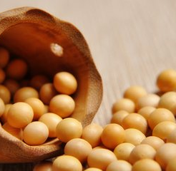
The yellow gem under the north America sunshine
excellent soybeans
We select beans from North America’s farm . Unique climatic conditions, geographical advantages and sunshine throughout the year make the soybeans in its highest quality.
We improve the clarification and transparency of soybean extract with mature extraction technology from German. It can ensure the quality and efficiency of soybeans.

Slide 9
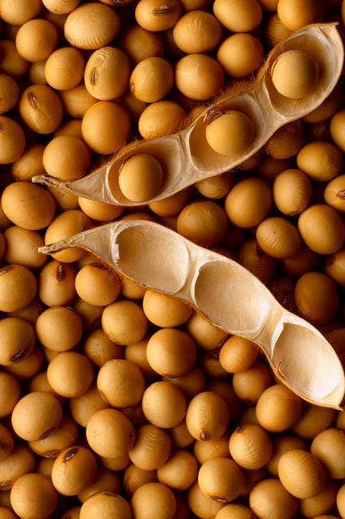
Soy lecithin-the third nutrient
Continued to be the best selling nutrient for 30 years in US
Lecithin is parallel with protein, vitamin and called “the third primary nutrient”
Soybean is most active in all kinds of lecithin.
Lecithin can improve the liver function parameters effectively.
Mainly contains phosphatidylcholine, has the following effect：
Protection of the liver
Prevention of Alzheimer 's disease
Prevention of cardiovascular diseases
Reducing diabetes symptoms
Notes:
可以快速恢复肝组织功能，修复肝脏结构

Slide 10
High PC content , good effect
The lecithin extract contains a variety of active ingredients, such as PC, PE, PI, PA , etc
Among them, the most effective ingredients of lecithin is PC（ Phosphatidylcholine ）
Food grade phospholipids. It does not identify PC content.
health food grade phospholipids, PC contain 23-35%.
Medicinal grade phospholipids, PC contain 45%-92%
87%
May
34%
Fed
Effective control the cholesterol
Clinical trial :
people participated in experiments:240
usage amount:1.89g/day
38%
Notes:
食品级磷脂，粗加工液体磷脂，不标识PC含量，38%，我们的PC含量比保健品最高的还要高出10%

Slide 11
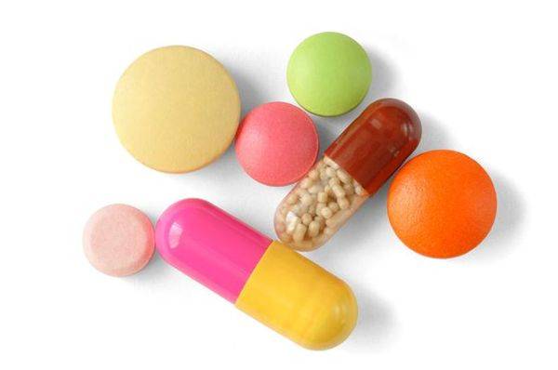
Advanced technology around the world
soft capsule
It is developed with soft capsule technology, making it soft and pure. It can also improve the effectiveness of lecithin.
soft capsules
Traditional tablets
High absorption efficiency (70-90%)
Low absorption efficiency(20%-40%)
PK
Sophisticated instruments to insure accurate
Scatter other parts of the body create loss.
Reduce ingredient to expose to the air
Easy to get oxidized and reduce efficacy
Easy to swallow and no bitter
Hard to swallow and bitter taste
Absorption
Accuracy
Stability
Taste
Notes:
崩解速度快

Slide 12
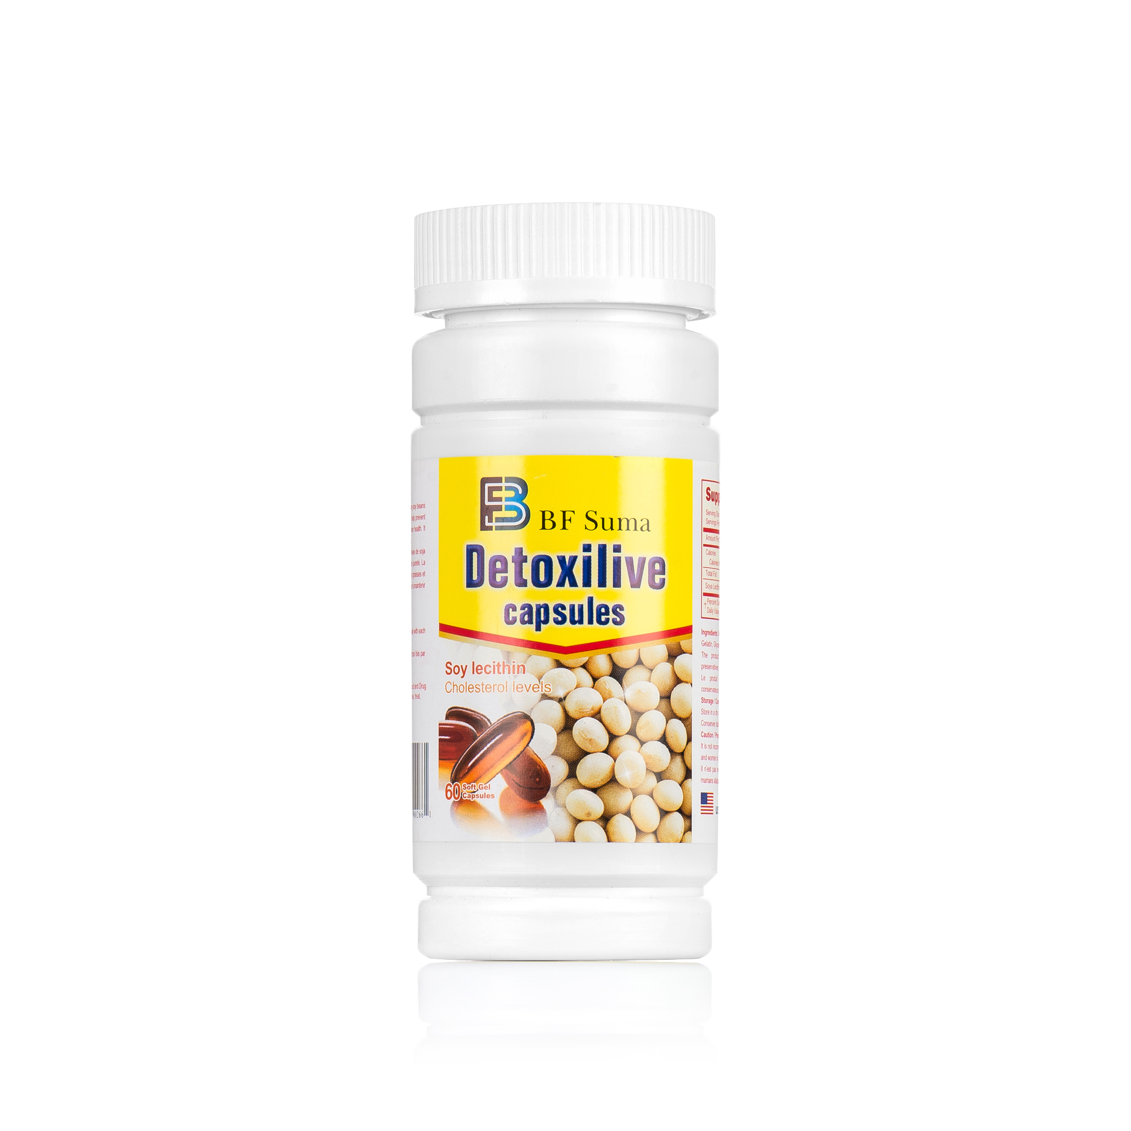
BF SUMA detoxilive capsules
North America Bean Source
High absorption efficiency
Pure natural beans from north America’s farm, mild without stimulation.
Combined with soft capsule packing technology, it can improve the absorption efficiency.
Contain 38% of PC
German technology, made in America
Beyond maximum content of the general health products，it can improve the liver, cardiovascular effectively.
Raw materials come from all over the world , the quality of production is monitored by the US FDA.

Slide 13
THANKS FOR WATCHING
Africa Marketing Department 2017

