Slide 1
TOPIC
Bf Suma Lagos Nigeria
October 25, 2016

Slide 2
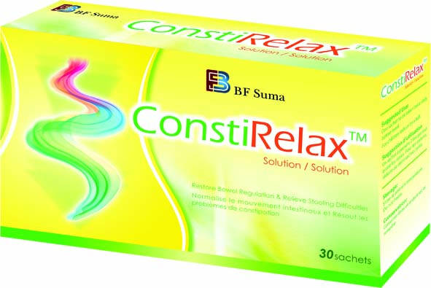
ConstiRelaxTM
Good Digestion Makes You Enjoy The Day

Slide 3
Busy Modern Life
Our busy, modern lifestyles may be responsible for most cases of constipation: not eating enough fibre or drinking enough water, not getting enough exercise , and not taking the time to respond to an unmistakable urge to go to the toilet.

Slide 4
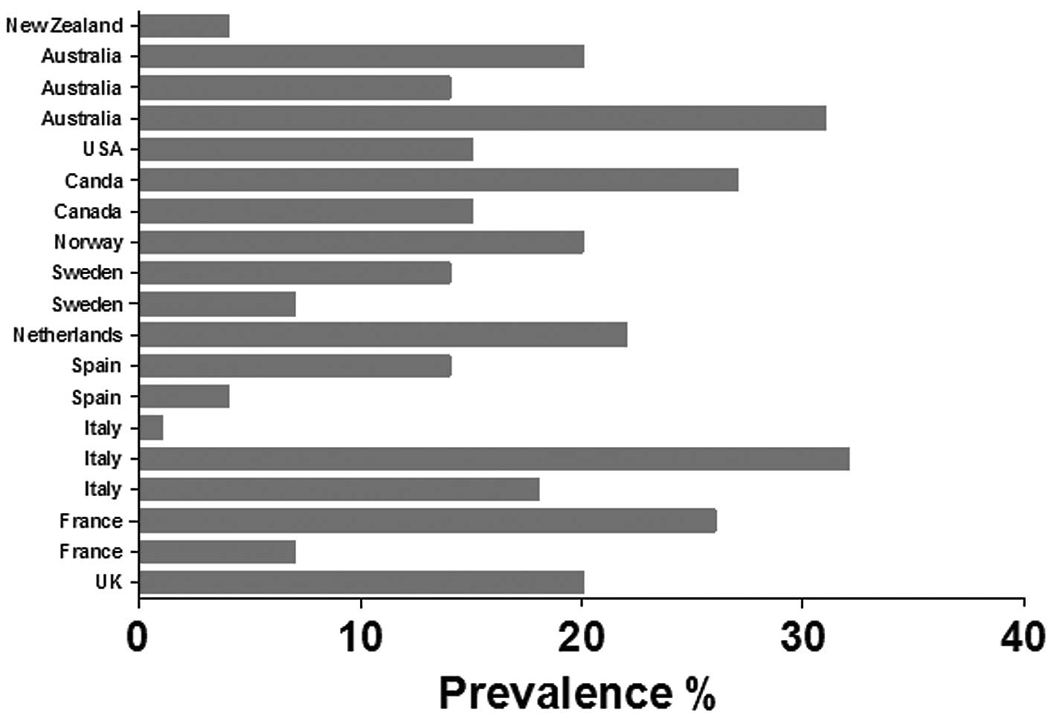
Prevalence of constipation in varies countries in 2013
Chronic Constipation is A Serious Issue

Slide 6
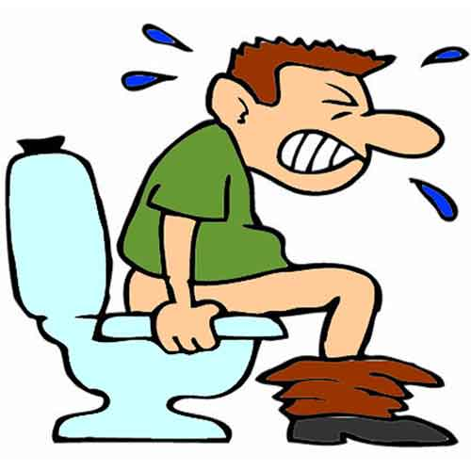
Is Constipation Dagerous For Your Health ?
Yes! It is
A person will always have the problem of constipation (temporary or chronic )

Slide 7
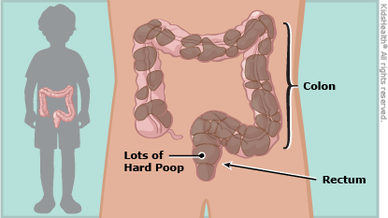
Problem Caused By Constipation
PHYSICAL HEALTH
Colorectal disorder : Causes flat lesions and polyps that eventually transform into colon cancer
Profoundly affect the endocrine and immune systems
SOCIAL FUNCTIONING
Basic activities such as grocery shopping or sitting at a desk are painful and challenging
The more severe the constipation, the more fatigued you become , barely able to get through the work day
MENTAL WELL-BEING
Cause stress
Diminish your overall sense of well-being
Constipation predisposes you to all major colorectal disorders starting with enlarged hemorrhoids and ending up with colorectal cancer. The reasons aren‘t difficult to understand — your colon was designed by nature to hold a few pounds of feces in transit. When a person gets constipated, the colon may be holding 10, 20 or more lbs. The weight by itself isn‘t the problem, but the volume is – large, heavy stools enlarge and stretch out the colon, irritate the colon mucosa, harm the anal canal, and may produce toxins related to fermentation and rotting.

Slide 8
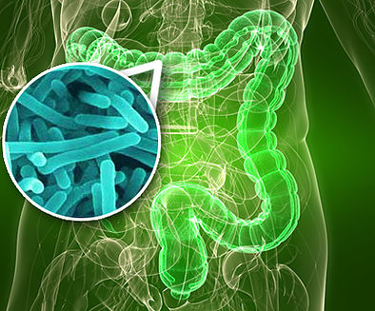
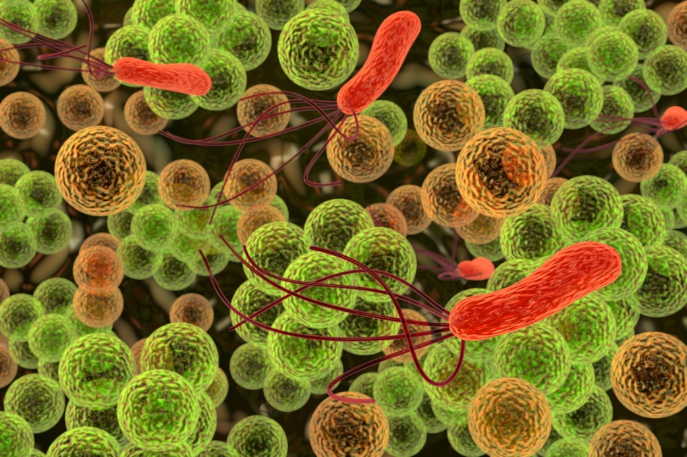
Constipation is one of the symptoms of dysbacteriosis

Slide 9
So much depends upon the human gut. It is after all the organ that determines if—and how—what we eat fuels the other organs
That’s why we need it to be in optimal health and fix any digestion problems now rather than later.

Slide 10
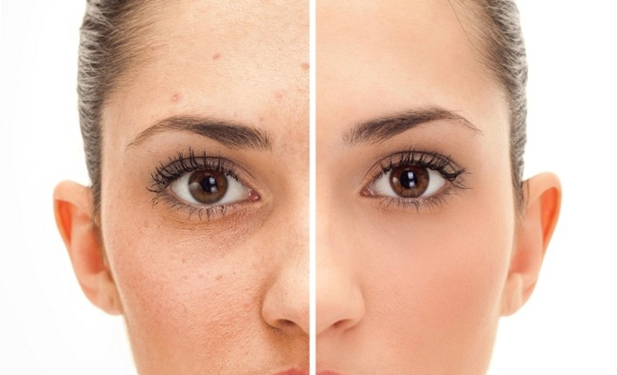
GUT HEALTH
The Gut Health Can Make You Feel Easy From Inside To Outside, Boost Luster And Whiten Skin And Get Rid Of Toxin
Gut Health, In Other Words, When Beauty Comes As Much From Within As Without, It In Turn Magnifies Their Outer Beauty.

Slide 11
ConstiRelaxTM
100% natural and safe
Regulate and improve the intestinal flora
Safeguard gut health while improve immunity

Slide 12
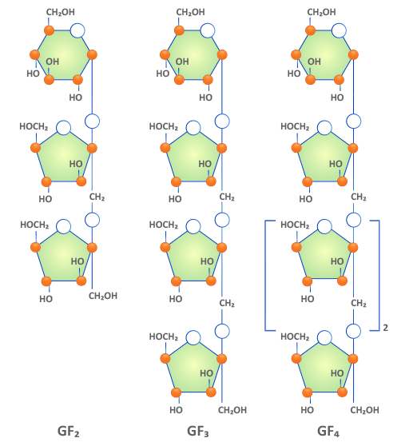
ConstiRelaxTM
Fructo-oligosacharide(FOS)
Good Nutrition For Your Gut Bacteria
Digest And Absorb More Thoroughly
Maintain A Healthier Intestinal Environment
According to nutrition experts, and many medical studies, soluble dietary fiber and oligosaccharides have similar function. FOS can promote bowel movement, relieve constipation, diarrhea etc . The reason is that the small intestine can not fully absorb FOS, intestinal flora can make use of the unable to digest part .thereby FOS can alter the gut ecology to normalize the intestinal flora in human digestive system. the number of beneficial bacteria is improved. Digestion and normal bowel movement get better .

Slide 13
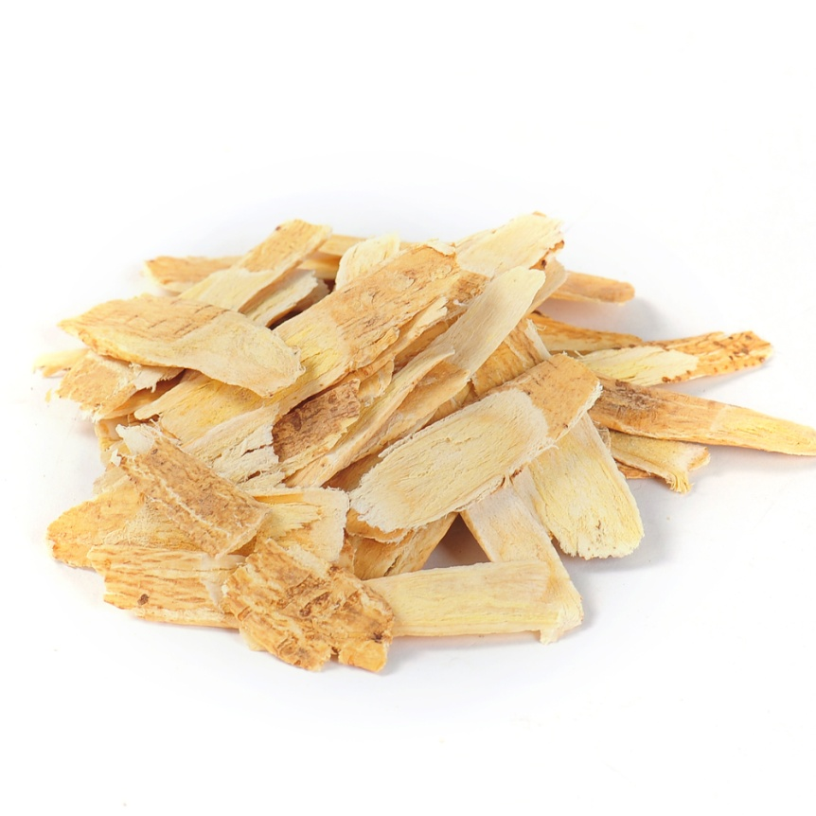
ConstiRelaxTM
Radix Astragali Extract
Radix Astragali is one of the most powerful immune-building plants on the planet
1. Acts as an Anti-Inflammatory
2. Boosts the Immune System
3. Slows or Prevents the Growth of Tumors etc.

Slide 14
Laxatives
ConstiRelaxTM
By accelerating excretion
Do help bowel movements.
Laxatives can be habit-forming. When stop ,there is a significant risk of constipation
May cause progressive dysfunction
Relieving constipation
Do good for your gut bacteria
Maintain a healthier intestinal environment
Improve your immunity

Slide 15
BF SUMA –REALLY GOOD FOR YOUR HEALTH
Thank you !
Email: info@bfsuma.com
Website: www.bfsuma.com
US Toll Free: 1-626-287-4700

Slide 16
THANKS FOR WATCHING
Africa Marketing Department 2016 Q3

