Slide 1
Anatic Herbal Essence Soap

Slide 2
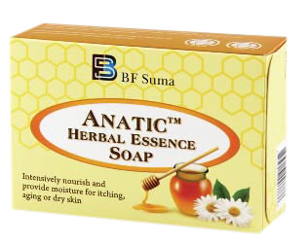
Enjoy pure nature, enjoy pleasing spa
AnaticTM Herbal Essence Soap

Slide 3
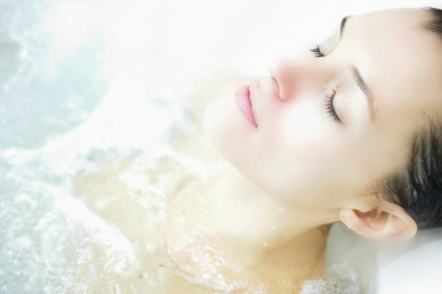
Contents
Soap Knowledge
Soap Importance
Differences Between Traditional Soap and Pure Natural Soap
Herbal Essence Soap

Slide 4
Soap Knowledge

Slide 5
History
Components
Development
In 18th century, soap is said to had been used in Italy.
In 20th century, soap was manufactured in chemical industry.
Chemical Reaction:
Oil / Fat + NaOH
↓
Soap Base
Artificial Addictives
In recent years, the pure natural soap without any artificial addictives has became customer’s favorite.

Slide 6
Soap Importance

Slide 7
Hygiene
Hygiene is a global concerned issue.
Hands & body washing would clean the pathogens (bacteria and virus) on the skin.
To prevent the disease or the spreading of disease, eg. influenza or common cold.
Washing with Soap
Water is an inefficient skin cleaner.
Soap is able to enhance solubility of fat and protein, which are the components of pathogens.
Soap Importance

Slide 8
Traditional soap
vs
Pure natural soap

Slide 9
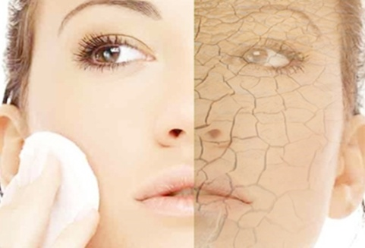
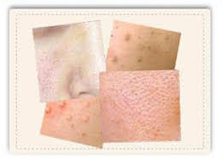
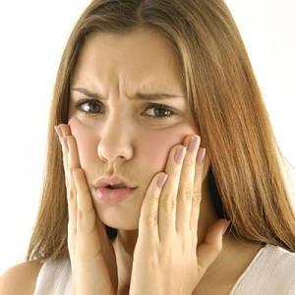
Why not traditional soap?
Skin Trouble
Alkaline
Dry
tension
allergy
Addictives
Unpleasant smell
Artificial colors
Other skin disorders…

Slide 10
Why pure natural soap?
Herbal Extracts
Long lasting moisture
Good smelling
Skin friend
Extra hydrating and
smoothing
Olive oil &
honey
Clean weapon
Green tea to remove the toxins on skin

Slide 11
Herbal Essence Soap

Slide 12
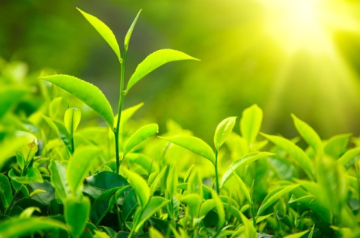
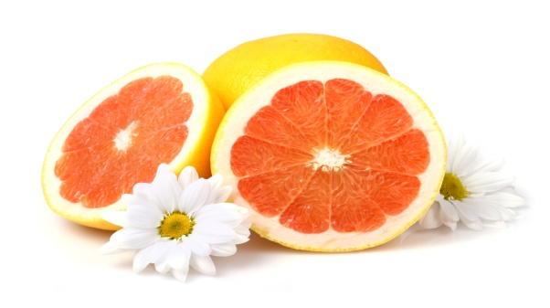
Healthy----Herbal Extracts
Sandalwood
Green tea
Grapefruit
Form a protective layer to prevent bacterial invasion and the formation of melanin and uneven color traits of skin.
Activation of skin cells, promote metabolism and repair damaged skin. Help skin returns to the natural color, flexibility and smoothness.
Anti-oxidation, regulate the balance of skin oils, maintain skin moisture, prevent skin from aging.

Slide 13
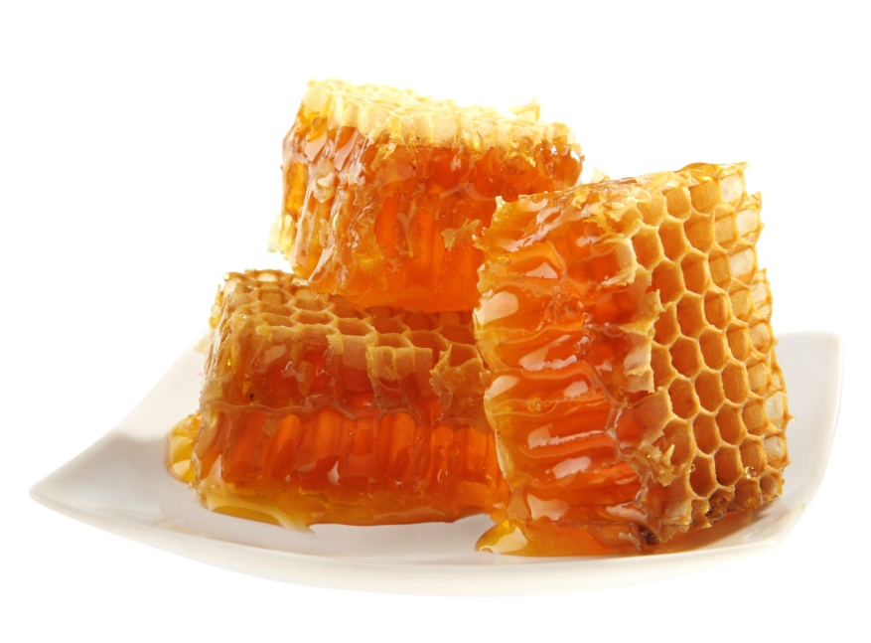
Long Lasting Moisture----Wild Honey
Honey help maintain the necessary sebum and moisture.
Skin moisture will remain even after washed.
Help skin be more smoothness.
Enjoy pure nature

Slide 14
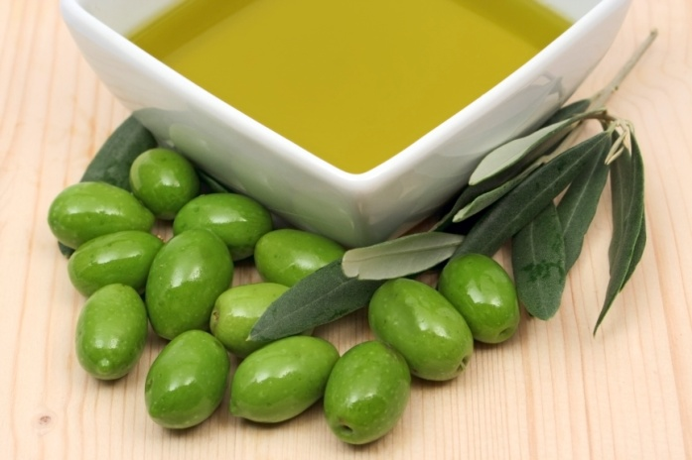
Extra Hydrating ----Natural Olive Oil
Contain rich amount of squalene and essential fatty acid.
Absorbed easily, effectively maintain the bounciness and moisture of skin.
Contain rich single-unsaturated fatty acids, vitamin E, K, A, D and other phenolic antioxidants. It can eliminate facial wrinkles, prevent skin from aging, provide skin and hair care and prevent the effects of hand-foot chap:
Protect the skin against ultra-violet rays and prevent the growth of cancer.

Slide 15
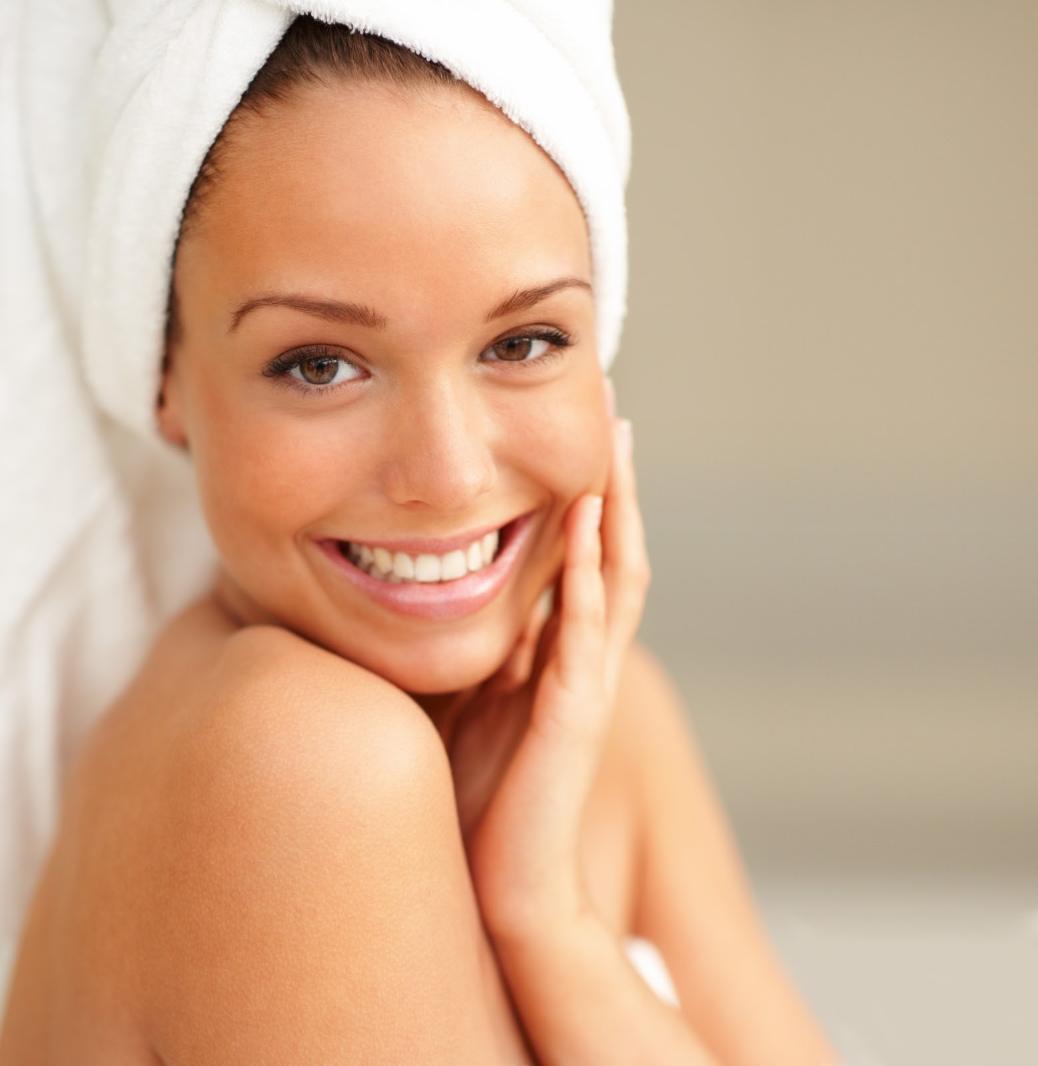
Other Features
Revitalizes
Skin
Reduces
Itchiness
Pleasing
Aroma
Enjoy pleasing spa

Slide 16
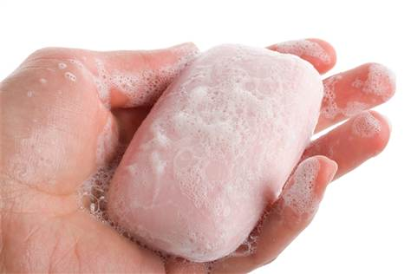
Use Direction
Either can be used for hand washing or body washing.
Available for both men and women.
It is suitable for all kind of skin. The moisture effect is especially suit for oily skin.

Slide 17
Healthy skin,
you Deserve it!

Slide 18
THANKS FOR WATCHING
Africa Marketing Department 2017

